Slide 1
JESUS!
Lesson 8
Temptation of Jesus

Slide 2
Prayer Requests
1
Class Prayer
Praise
Thanksgiving
Concern
Grow up to be like Jesus

Slide 3
The Temptations of Jesus
2
Temptations

Slide 4
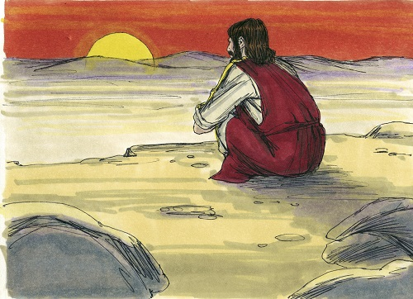
3
Matthew 4:1
Jesus goes into the desert

Slide 5
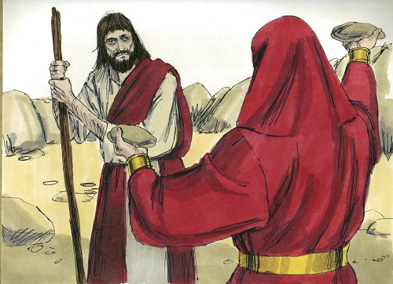
4
Matthew 4:2-3
First temptation: Stones into bread

Slide 6
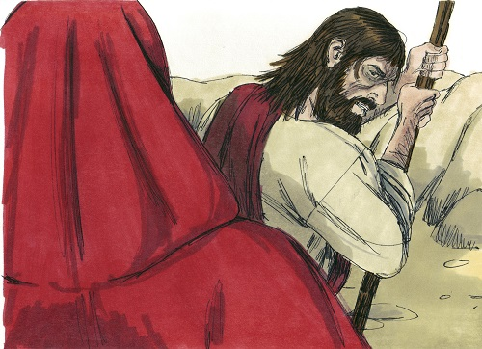
5
Matthew 4:4
Jesus resist the temptation.

Slide 7
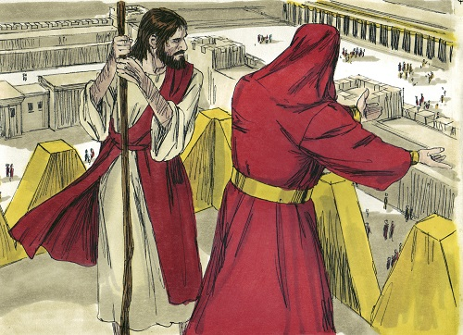
6
Matthew 4:5-6
Second temptation: Jesus is taken to the highest point of the Temple

Slide 8
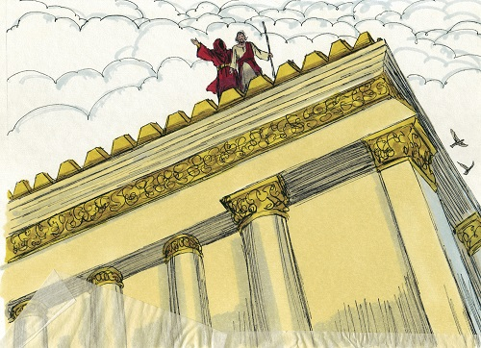
7
Matthew 4:7
Jesus quotes Scripture

Slide 9
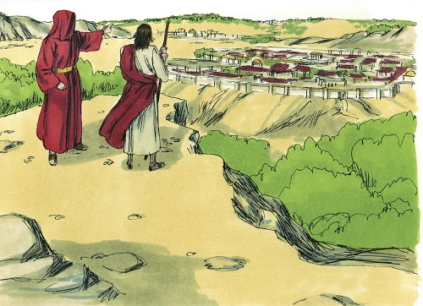
8
Matthew 4:8-9
Third temptation: Kingdoms of the world

Slide 10
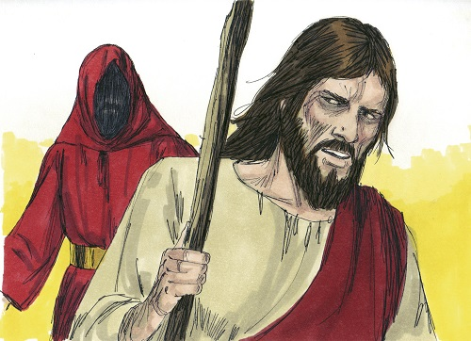
9
Matthew 4:10
Jesus turns his back on temptation.

Slide 11
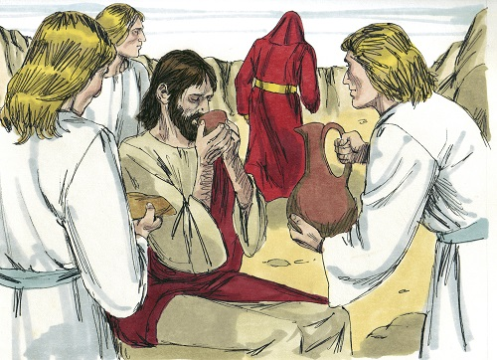
10
Matthew 4:11
The devil leaves Jesus

