Slide 1
JESUS!
Lesson 6
Jesus’ Youth

Slide 2
Prayer Requests
1
Class Prayer
Praise
Thanksgiving
Concern
Grow up to be like Jesus

Slide 3
Escape to Egypt
2
Escape to Egypt

Slide 4
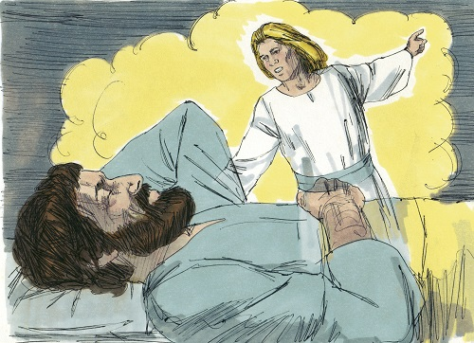
3
Matthew 2:13
When they had gone, an angel of the Lord appeared to Joseph in a dream. “Get up,” he said, “take the child and his mother and escape to Egypt.”

Slide 5
4
Fulfillment of Prophecy from Jeremiah 31:15
Matthew 2:16
A voice is heard in Ramah,
Weeping and great mourning,
Rachel weeping for her children,
and refusing to be comforted, because they are no more.
When Herod realized that he had been outwitted by the Magi, he was furious, and gave orders to kill all the boys in Bethlehem and it vicinity who were 2 years old and under.

Slide 6
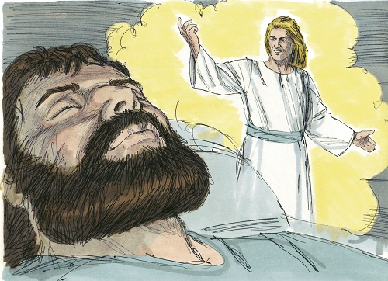
5
Matt 2:19-20
After Herod died, an angel of the Lord appeared in a dream to Joseph in Egypt and said, “Get up, take the child and his mother and go to the land of Israel,”

Slide 7
Boy Jesus at the Temple
6
Jesus Goes to Jerusalem

Slide 8
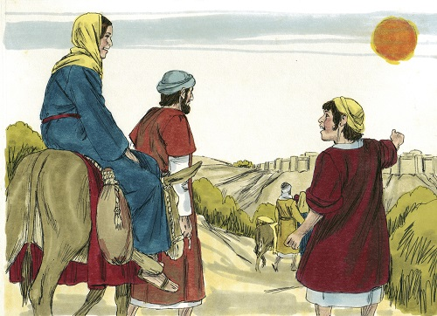
7
Luke 2:41-42
Every year his parents went to Jerusalem for the Feast of the Passover. When he was twelve years old, they went up to the Feast, according to the custom.

Slide 9
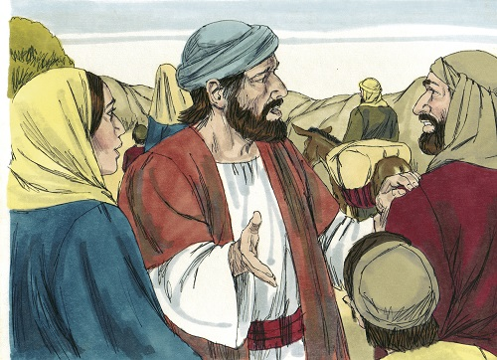
8
Luke 2:43
After the Feast was over, while his parents were returning home, the boy Jesus stayed behind in Jerusalem, but they were unaware of it.

Slide 10
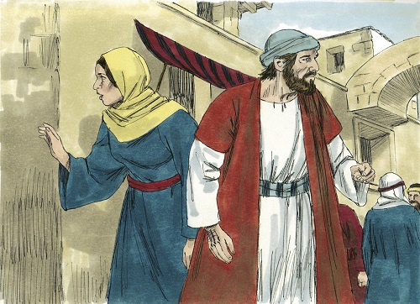
9
Luke 2:45
When they did find him, they went back to Jerusalem to look for him.

Slide 11
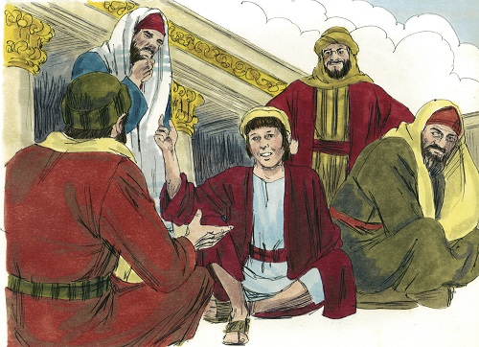
10
Luke 2:46
After three days they found him in the temple courts, sitting among the teachers, listening to them and asking them questions.

Slide 12
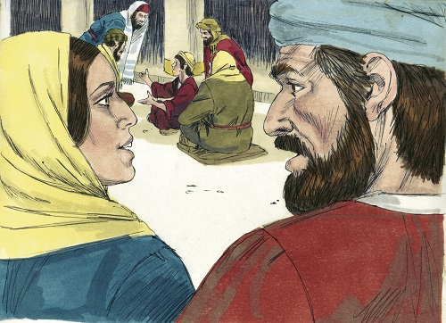
11
Luke 2:47
Everyone who heard him was amazed at his understanding and his answers.

Slide 13
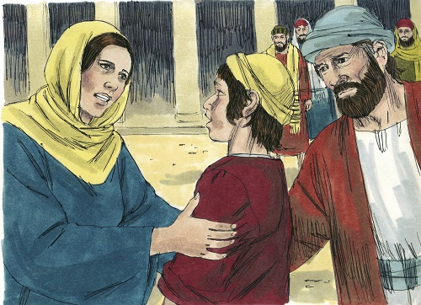
12
Luke 2:48
When his parents saw him, they were astonished. His mother said to him, “Son, why have you treated us like this? Your father and I have been anxiously searching for you.

Slide 14
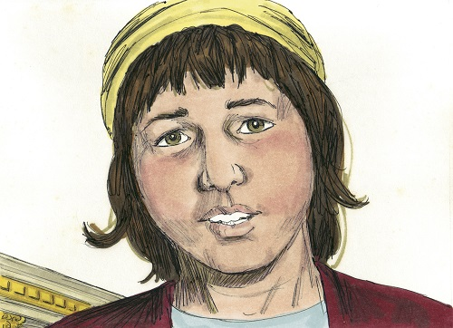
13
Luke 2:49-50
“Why have you been searching for me?” he asked. “Didn’t you know I had to be in my Father’s house?” But they did not understand what he was saying to them.

Slide 15
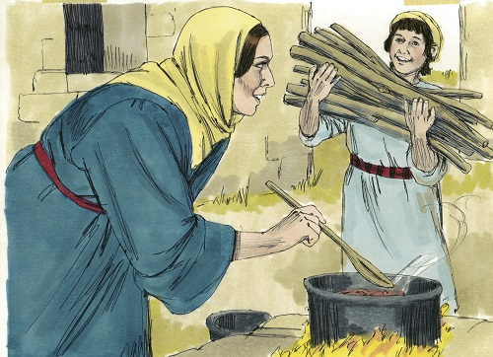
14
Luke 2:51
Then he went down to Nazareth with them and was obedient to them. But his mother treasured all these things in her heart.

