Slide 1
JESUS!
Lesson 4
Jesus is Born!

Slide 2
Prayer Requests
1
Class Prayer
Praise
Thanksgiving
Concern
Grow up to be like Jesus

Slide 3
Joseph has a Dream
2
Joseph

Slide 4
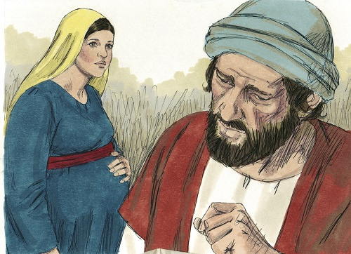
3
Matthew 1:19
Because Joseph was a righteous man and did not want to expose Mary to public disgrace, he had in mind to divorce her quietly.
Notes:
18 This is how the birth of Jesus the Messiah came about : His mother Mary was pledged to be married to Joseph, but before they came together, she was found to be pregnant through the Holy Spirit. 19 Because Joseph her husband was faithful to the law, and yet did not want to expose her to public disgrace, he had in mind to divorce her quietly.

Slide 5
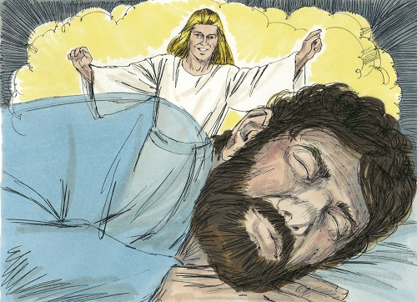
4
Matthew 1:20
But an angel of the Lord appeared to Joseph in a dream and said, “Do not be afraid to take Mary home as your wife, because what is conceived in her is from the Holy Spirit.
Notes:
20 But after he had considered this, an angel of the Lord appeared to him in a dream and said, “Joseph son of David, do not be afraid to take Mary home as your wife, because what is conceived in her is from the Holy Spirit. 21 She will give birth to a son, and you are to give him the name Jesus, because he will save his people from their sins.” 22 All this took place to fulfill what the Lord had said through the prophet: 23 “The virgin will conceive and give birth to a son, and they will call him Immanuel” (which means “God with us”).

Slide 6
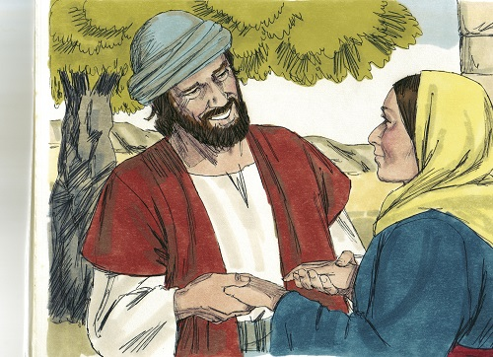
5
Matthew 1:24
When Joseph woke up, he did what the angel of the Lord had commanded him and took Mary home as his wife.

Slide 7
A Census is Taken
6
A Census is Taken
Notes:
24 When Joseph woke up, he did what the angel of the Lord had commanded him and took Mary home as his wife. 25 But he did not consummate their marriage until she gave birth to a son. And he gave him the name Jesus.

Slide 8
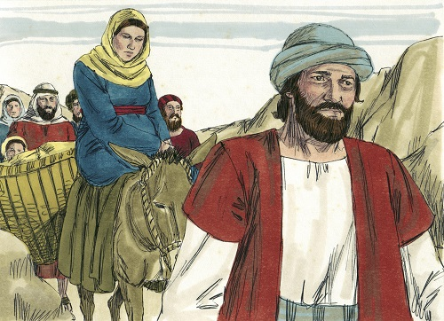
7
Luke 2:1&4
Caesar Augustus issued a decree that a census should be taken. So Joseph went with Mary from Nazareth to Bethlehem because he belonged to the house of David.
Notes:
1 In those days Caesar Augustus issued a decree that a census should be taken of the entire Roman world. 2 (This was the first census that took place while Quirinius was governor of Syria.) 3 And everyone went to their own town to register. 4 So Joseph also went up from the town of Nazareth in Galilee to Judea, to Bethlehem the town of David, because he belonged to the house and line of David.

Slide 9
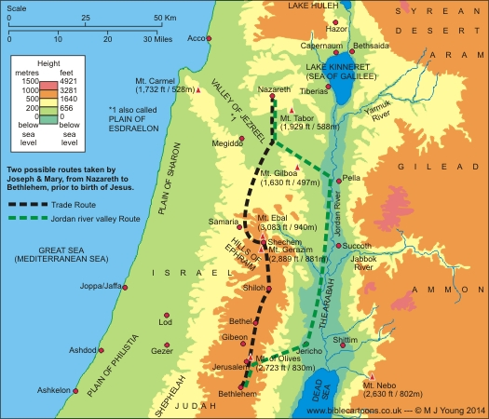
3
8
Luke 2:1&4
Caesar Augustus issued a decree that a census should be taken. So Joseph went with Mary from Nazareth to Bethlehem because he belonged to the house of David.

Slide 10
9
How Long did the Trip Take?
Distance = 90 miles
Walking Speed = 3 miles per hour
Number of hours each day= 6 hours
The Journey

Slide 11
10
How Long did the Trip Take?
Distance = 90 miles
Walking Speed = 3 miles per hour
Number of hours each day= 6 hours
Distance traveled each day = 3 mph X 6 hours
The Journey

Slide 12
11
How Long did the Trip Take?
Distance = 90 miles
Walking Speed = 3 miles per hour
Number of hours each day= 6 hours
Distance traveled each day = 3 X 6 = 18 Miles
The Journey

Slide 13
12
How Long did the Trip Take?
Distance = 90 miles
Walking Speed = 3 miles per hour
Number of hours each day= 6 hours
Total number of days traveled
Total Distance / Miles Traveled Each Day
90 / 18 = ?
The Journey

Slide 14
13
How Long did the Trip Take?
Approximately
5 Days
The Journey

Slide 15
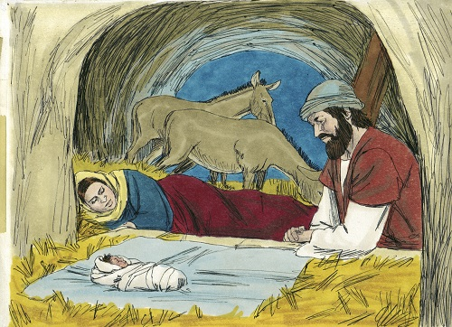
14
Luke 2:6
While they were there, the time came for the baby to be born. She wrapped him in clothes and placed him in a manger, because there was no room at the inn.
Notes:
6 While they were there, the time came for the baby to be born, 7 and she gave birth to her firstborn, a son. She wrapped him in cloths and placed him in a manger, because there was no guest room available for them.

Slide 16
The Shepherds and the Angels
15
Shepherds

Slide 17
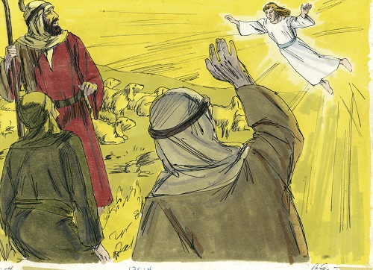
16
Luke 2:8
And there were shepherds living out in the fields nearby, keeping watch over their flocks at night. An angel of the Lord appeared to them and they were terrified.
Notes:
8 And there were shepherds living out in the fields nearby, keeping watch over their flocks at night. 9 An angel of the Lord appeared to them, and the glory of the Lord shone around them, and they were terrified.

Slide 18
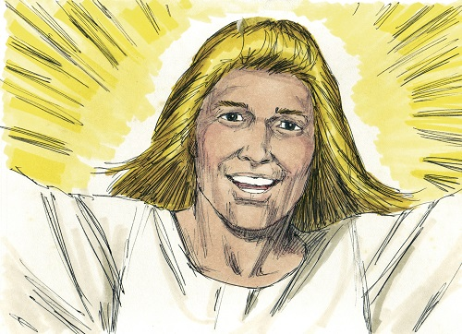
17
Luke 2:10
The angel said, “Do not be afraid. Today in the town of David a Savior has been born to you, he is Christ the Lord.
Notes:
10 But the angel said to them, “Do not be afraid. I bring you good news that will cause great joy for all the people. 11 Today in the town of David a Savior has been born to you; he is the Messiah, the Lord.

Slide 19
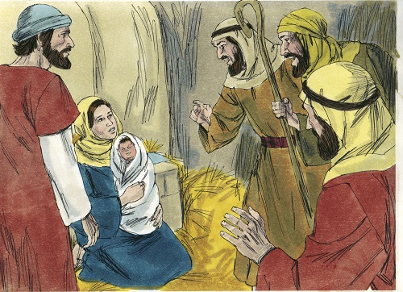
18
Luke 2:16
So they hurried off and found Mary and Joseph, and the baby, who was lying in the manger.
Notes:
10 But the angel said to them, “Do not be afraid. I bring you good news that will cause great joy for all the people. 11 Today in the town of David a Savior has been born to you; he is the Messiah, the Lord. 12 This will be a sign to you: You will find a baby wrapped in cloths and lying in a manger.” 13 Suddenly a great company of the heavenly host appeared with the angel, praising God and saying, 14 “Glory to God in the highest heaven, and on earth peace to those on whom his favor rests.” 15 When the angels had left them and gone into heaven, the shepherds said to one another, “Let’s go to Bethlehem and see this thing that has happened, which the Lord has told us about.” 16 So they hurried off and found Mary and Joseph, and the baby, who was lying in the manger.

Slide 20
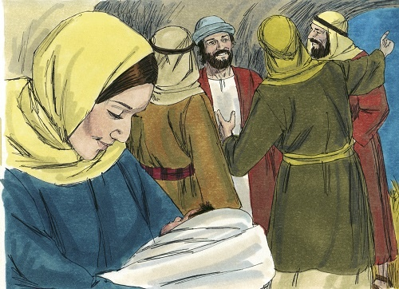
19
Luke 2:19
But Mary treasured up all these things and pondered them in her heart. The shepherds returned glorifying and praising God for all the things they had seen and heard.
Notes:
17 When they had seen him, they spread the word concerning what had been told them about this child, 18 and all who heard it were amazed at what the shepherds said to them. 19 But Mary treasured up all these things and pondered them in her heart. 20 The shepherds returned, glorifying and praising God for all the things they had heard and seen, which were just as they had been told.

