Slide 1
JESUS!
Lesson 3
Birth Announcements

Slide 2
Prayer Requests
1
Class Prayer
Praise
Thanksgiving
Concern
Grow up to be like Jesus

Slide 3
The story of Elizabeth and Zechariah
2
Elizabeth and Zechariah

Slide 4
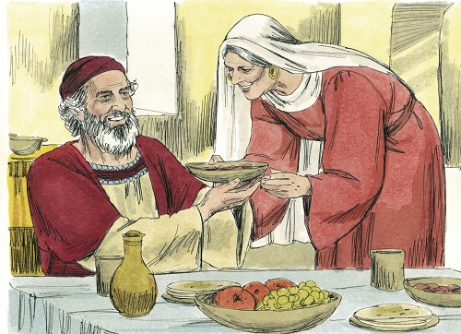
3
Luke 1:5-7
Elizabeth and Zechariah were upright in the sight of God, observing all the Lord’s commandments….But they had no children and both were well along in years.
Notes:
5 In the time of Herod king of Judea there was a priest named Zechariah, who belonged to the priestly division of Abijah; his wife Elizabeth was also a descendant of Aaron. 6 Both of them were righteous in the sight of God, observing all the Lord’s commands and decrees blamelessly. 7 But they were childless because Elizabeth was not able to conceive, and they were both very old.

Slide 5
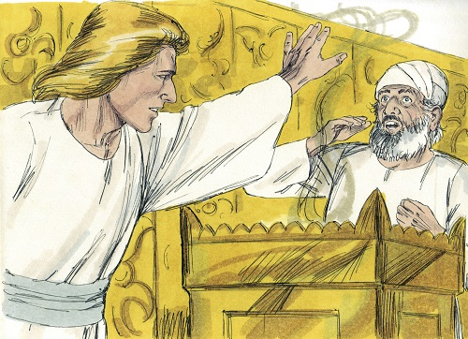
4
Luke 1:8-11
Once when Zechariah was serving in the temple of the Lord an angel appeared to him. When Zechariah saw him he was startled and gripped with fear.
Notes:
8 Once when Zechariah’s division was on duty and he was serving as priest before God, 9 he was chosen by lot, according to the custom of the priesthood, to go into the temple of the Lord and burn incense. 10 And when the time for the burning of incense came, all the assembled worshipers were praying outside. 11 Then an angel of the Lord appeared to him, standing at the right side of the altar of incense. 12 When Zechariah saw him, he was startled and was gripped with fear.

Slide 6
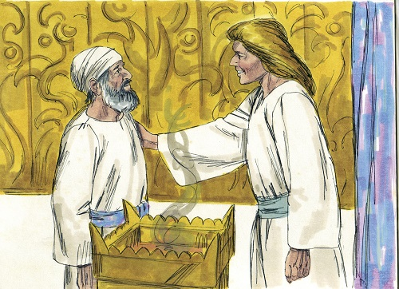
5
Luke 1:13
The angel said, Zechariah your prayer has been heard. Your wife will bear you a son and you will give him the name John.
Notes:
13 But the angel said to him: “Do not be afraid, Zechariah; your prayer has been heard. Your wife Elizabeth will bear you a son, and you are to call him John. 14 He will be a joy and delight to you, and many will rejoice because of his birth, 15 for he will be great in the sight of the Lord. He is never to take wine or other fermented drink, and he will be filled with the Holy Spirit even before he is born. 16 He will bring back many of the people of Israel to the Lord their God. 17 And he will go on before the Lord, in the spirit and power of Elijah, to turn the hearts of the parents to their children and the disobedient to the wisdom of the righteous—to make ready a people prepared for the Lord.”

Slide 7
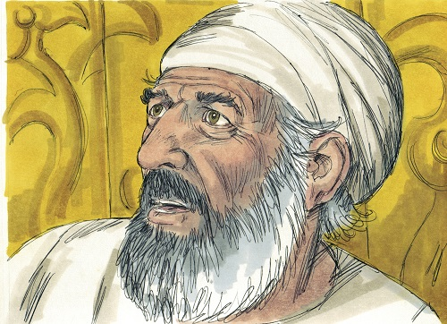
6
Luke 1:18
Zechariah asked the angel, “How can I be sure of this? I am an old man and my wife is well along in years.
Notes:
18 Zechariah asked the angel, “How can I be sure of this? I am an old man and my wife is well along in years.”

Slide 8
7
Luke 1:20
The angel said, you will not be able to speak until the day this happens, because you did not believe my words.
Notes:
19 The angel said to him, “I am Gabriel. I stand in the presence of God, and I have been sent to speak to you and to tell you this good news. 20 And now you will be silent and not able to speak until the day this happens, because you did not believe my words, which will come true at their appointed time.”

Slide 9
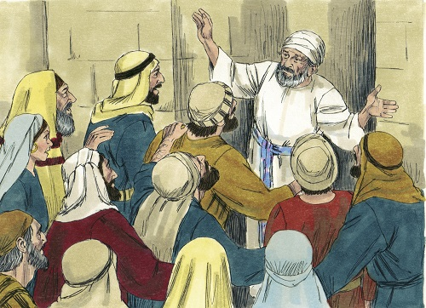
8
Luke 1:22
When Zechariah came out, he could not speak to those waiting outside. They realized he had seen a vision.
Notes:
21 Meanwhile, the people were waiting for Zechariah and wondering why he stayed so long in the temple. 22 When he came out, he could not speak to them. They realized he had seen a vision in the temple, for he kept making signs to them but remained unable to speak. 23 When his time of service was completed, he returned home. 24 After this his wife Elizabeth became pregnant and for five months remained in seclusion. 25 “The Lord has done this for me,” she said. “In these days he has shown his favor and taken away my disgrace among the people.”

Slide 10
The story of Mary
9
Mary

Slide 11
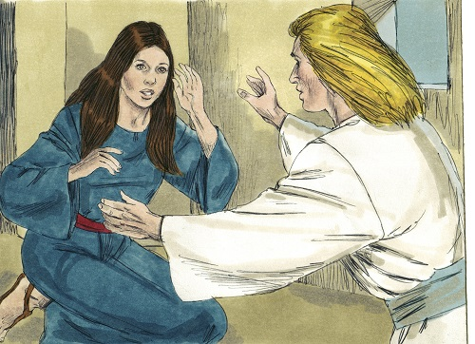
10
Luke 1:26
God sent the angel Gabriel to Nazareth, a town in Galilee, to a virgin pledged to be married to a man named Joseph.
Notes:
26 In the sixth month of Elizabeth’s pregnancy, God sent the angel Gabriel to Nazareth, a town in Galilee, 27 to a virgin pledged to be married to a man named Joseph, a descendant of David. The virgin’s name was Mary.

Slide 12
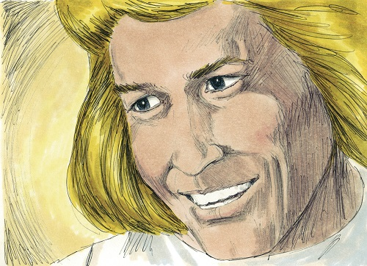
11
Luke 1:31
The angel said, “Do not be afraid. You will be with child and give birth to a son, and you are to give him the name Jesus.”
Notes:
28 The angel went to her and said, “Greetings, you who are highly favored! The Lord is with you.” 29 Mary was greatly troubled at his words and wondered what kind of greeting this might be. 30 But the angel said to her, “Do not be afraid, Mary; you have found favor with God. 31 You will conceive and give birth to a son, and you are to call him Jesus. 32 He will be great and will be called the Son of the Most High. The Lord God will give him the throne of his father David, 33 and he will reign over Jacob’s descendants forever; his kingdom will never end.”

Slide 13
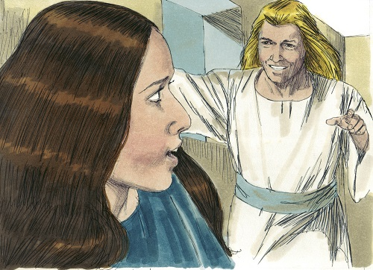
12
Luke 1:35
“How will this be,” Mary asked the angel, “since I am a virgin?” The angel answered, “The Holy Spirit will come upon you and the power of the Most High will overshadow you.”
Notes:
34 “How will this be,” Mary asked the angel, “since I am a virgin?” 35 The angel answered, “The Holy Spirit will come on you, and the power of the Most High will overshadow you. So the holy one to be born will be called the Son of God.

Slide 14
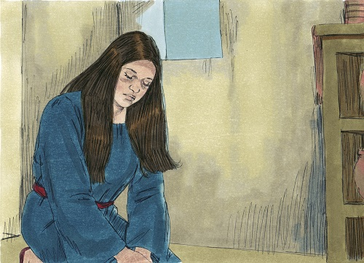
13
Luke 1:38
“I am the Lord’s servant,” Mary answered, “May it be to me as you have said.”
Notes:
38 “I am the Lord’s servant,” Mary answered. “May your word to me be fulfilled.” Then the angel left her.

Slide 15
Mary Visits Elizabeth
14
Mary Visits Elizabeth

Slide 16
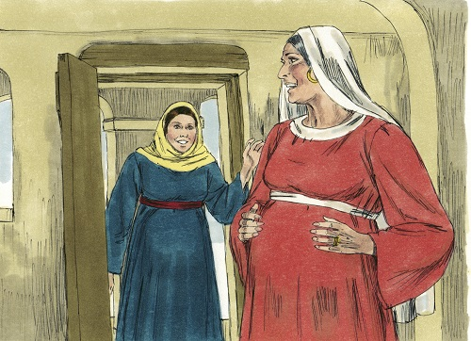
15
Luke 1:41
When Elizabeth heard Mary’s greeting, the baby leaped in her womb, and Elizabeth was filled with the Holy Spirit.
Notes:
39 At that time Mary got ready and hurried to a town in the hill country of Judea, 40 where she entered Zechariah’s home and greeted Elizabeth. 41 When Elizabeth heard Mary’s greeting, the baby leaped in her womb, and Elizabeth was filled with the Holy Spirit.

Slide 17
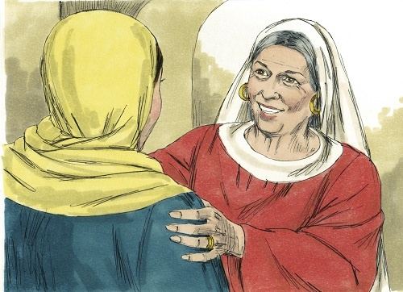
16
Luke 1:40
In a loud voice Elizabeth exclaimed, “Blessed are you among women, and blessed is the child you will bear!”
Notes:
42 In a loud voice she exclaimed: “Blessed are you among women, and blessed is the child you will bear! 43 But why am I so favored, that the mother of my Lord should come to me? 44 As soon as the sound of your greeting reached my ears, the baby in my womb leaped for joy. 45 Blessed is she who has believed that the Lord would fulfill his promises to her!”

Slide 18
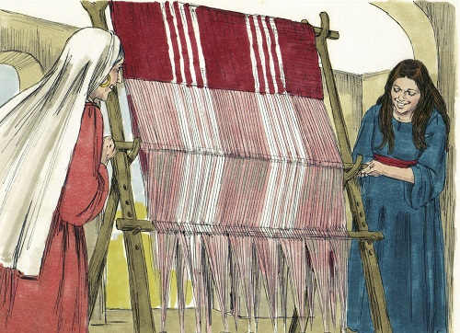
17
Luke 1:56
Mary stayed with Elizabeth for about three months and then returned home.
Notes:
56 Mary stayed with Elizabeth for about three months and then returned home.

Slide 19
Birth of John the Baptist
18
Mary Visits Elizabeth

Slide 20
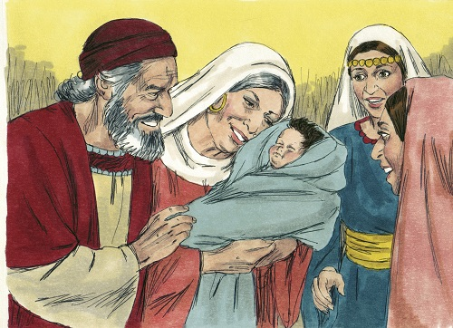
19
Luke 1:57
When it was time for Elizabeth to have her baby, she gave birth to a son. Her neighbors and relatives heard that the Lord had shown her great mercy, and they shared her joy.
Notes:
57 When it was time for Elizabeth to have her baby, she gave birth to a son. 58 Her neighbors and relatives heard that the Lord had shown her great mercy, and they shared her joy.

Slide 21
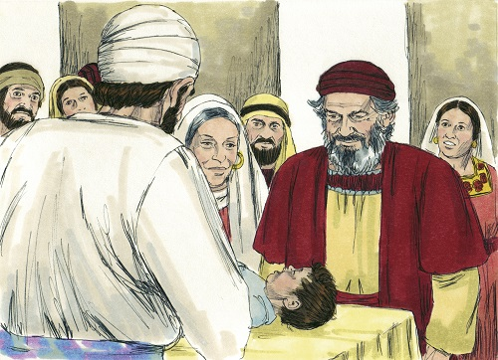
20
Luke 1:59
On the eighth day they came to circumcise the child, and they were going to name him after his father Zechariah.
Notes:
59 On the eighth day they came to circumcise the child, and they were going to name him after his father Zechariah, 60 but his mother spoke up and said, “No! He is to be called John.” 61 They said to her, “There is no one among your relatives who has that name.”

Slide 22
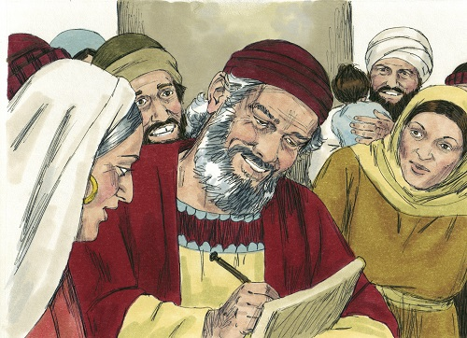
21
Luke 1:64
Zechariah asked for a writing tablet, and to everyone’s astonishment he wrote, “His name is John.” Immediately his mouth was opened and he could speak again.
Notes:
62 Then they made signs to his father, to find out what he would like to name the child. 63 He asked for a writing tablet, and to everyone’s astonishment he wrote, “His name is John.” 64 Immediately his mouth was opened and his tongue set free, and he began to speak, praising God. 65 All the neighbors were filled with awe, and throughout the hill country of Judea people were talking about all these things.

