Slide 1
JESUS!
Lesson 24
Blind-Mute Demonic Healed
Six Woes

Slide 2
Prayer Requests
1
Class Prayer
Praise
Thanksgiving
Concern
Grow up to be like Jesus

Slide 3
Blind-Mute Demonic Man Healed
2
Jesus and Beelzebub

Slide 4
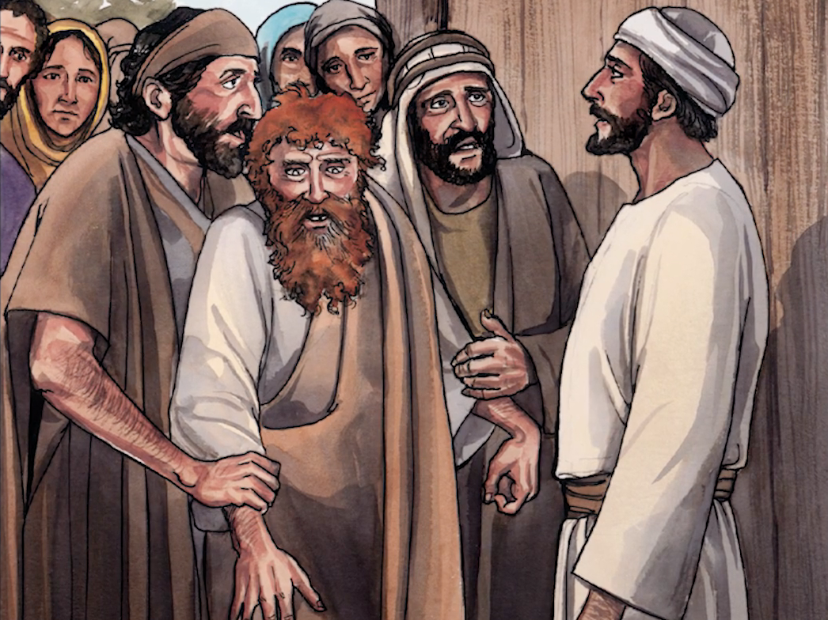
3
Blind-Mute Demonic Man
Matthew 12:22
Then they brought him a demon-possessed man who was blind and mute

Slide 5
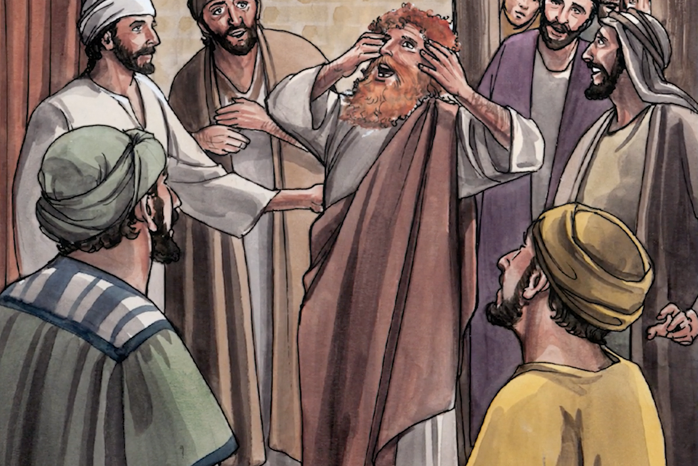
4
Jesus Heals the Man
Matthew 12:22
Jesus healed him, so that he could both talk and see.

Slide 6
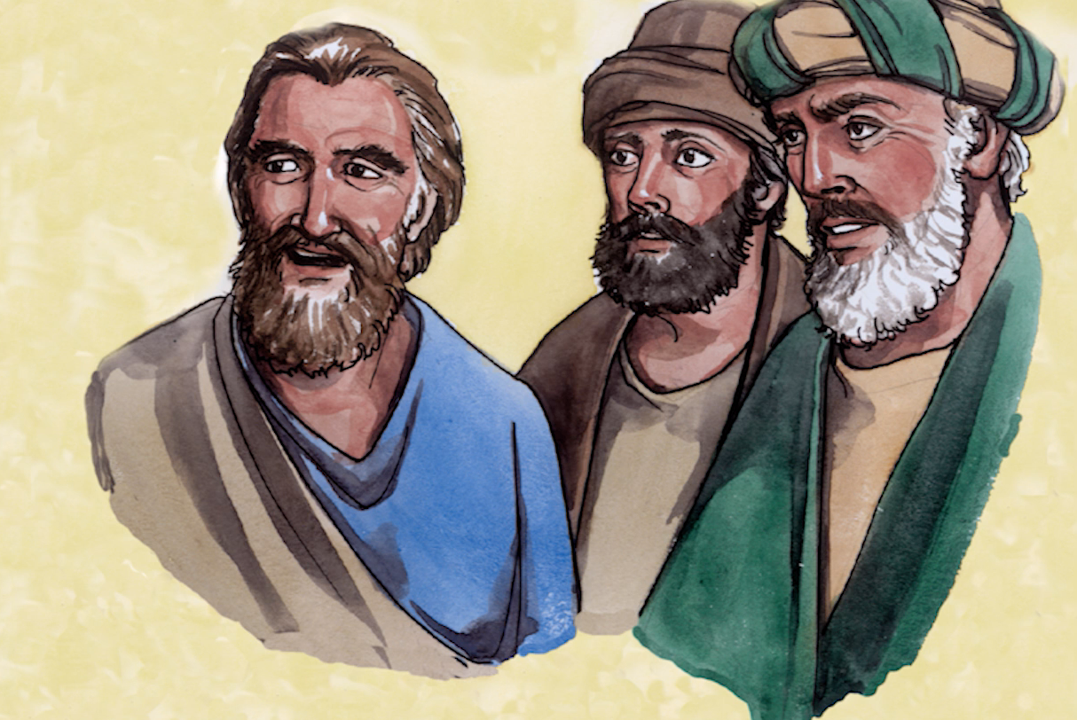
5
Pharisees Criticize Jesus
Matthew 12:23-24
All the people were astonished and said, “Could this be the Son of David?” But when the Pharisees heard this, they said, “It is only by Beelzebul, the prince of demons, that this fellow drives out demons.”

Slide 7
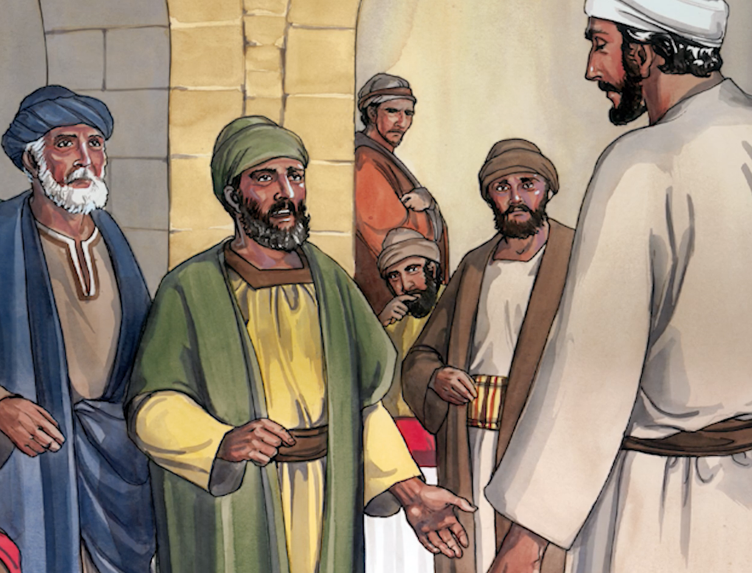
6
Jesus Responds to Pharisees
Matthew 12:25
Jesus knew their thoughts and said to them, “Every kingdom divided against itself will be ruined, and every city or household divided against itself will not stand.”

Slide 8
7
Woes to Pharisees and Teachers of the Law
Jesus Talks About Hypocrisy

Slide 9
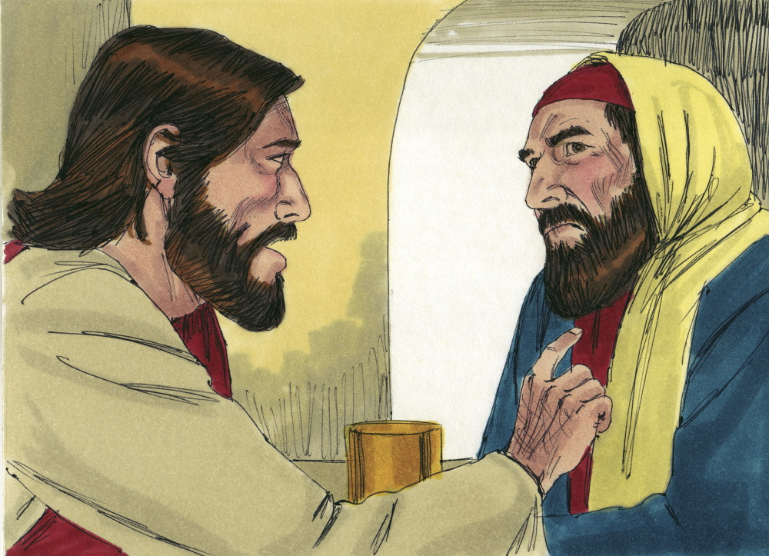
8
Jesus is Invited to the Home of a Pharisee
Luke 11:37-38
When Jesus had finished speaking, a Pharisee invited him to eat with him; so he went in and reclined at the table. But the Pharisee was surprised when he noticed that Jesus did not first wash before the meal.

Slide 10
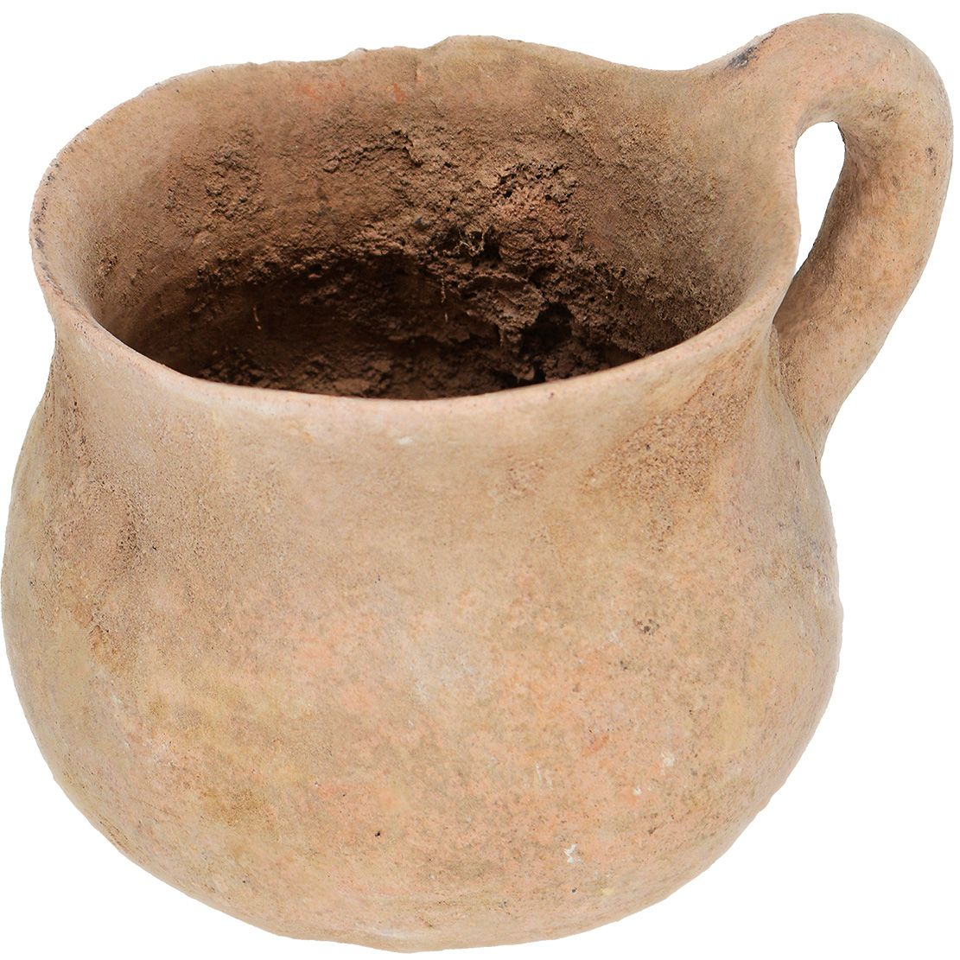
9
Clean the Inside of the Cup
Luke 11:39-40
Then the Lord said to him, “Now then, you Pharisees clean the outside of the cup and dish, but inside you are full of greed and wickedness. You foolish people! Did not the one who made the outside make the inside also?”

Slide 11
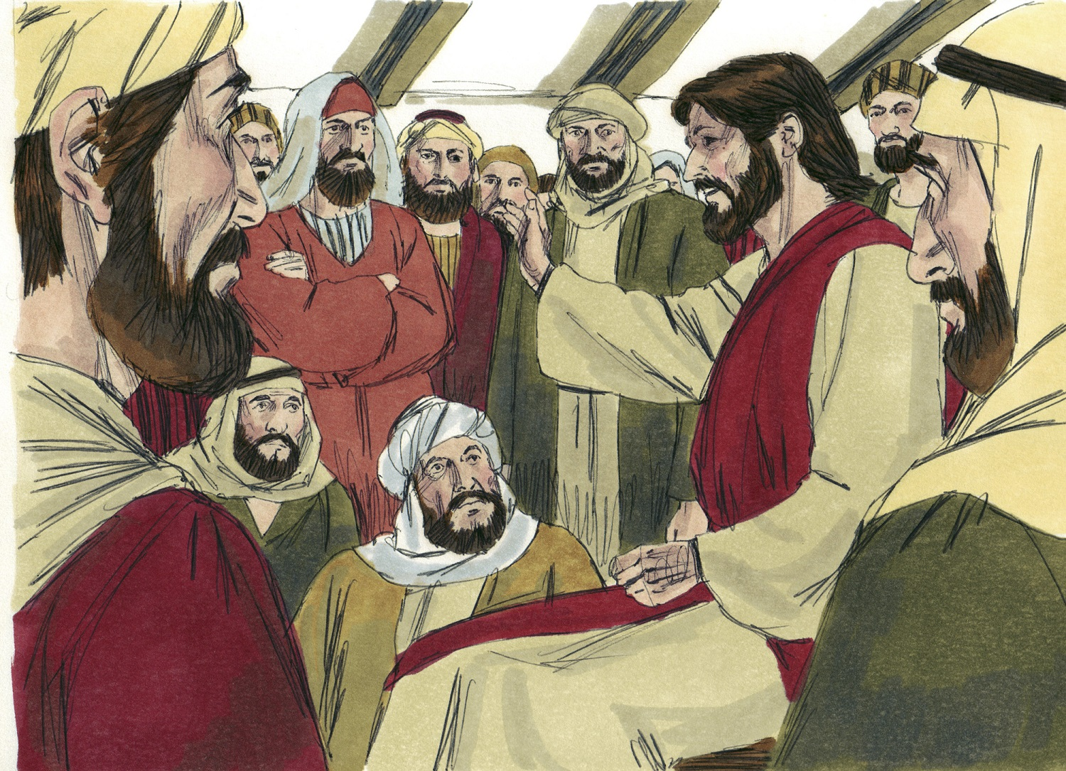
10
Justice and the Love of God
Luke 11:42
“Woe to you Pharisees, because you give God a tenth of your mint, rue and all other kinds of garden herbs, but you neglect justice and the love of God. You should have practiced the latter without leaving the former undone.”

Slide 12
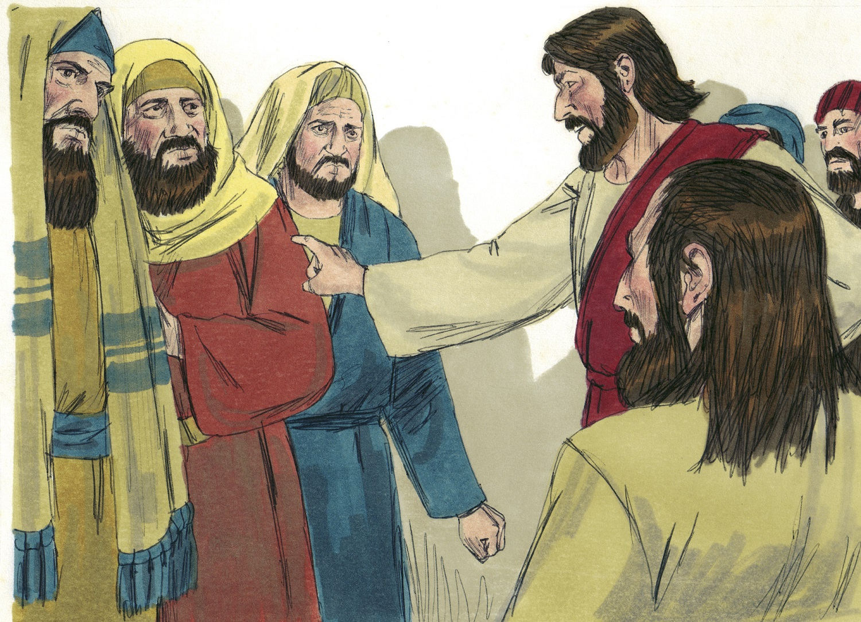
11
Woe to the Pharisees
Luke 11:43
“Woe to you Pharisees, because you love the most important seats in the synagogues and respectful greetings in the marketplaces.”

Slide 13
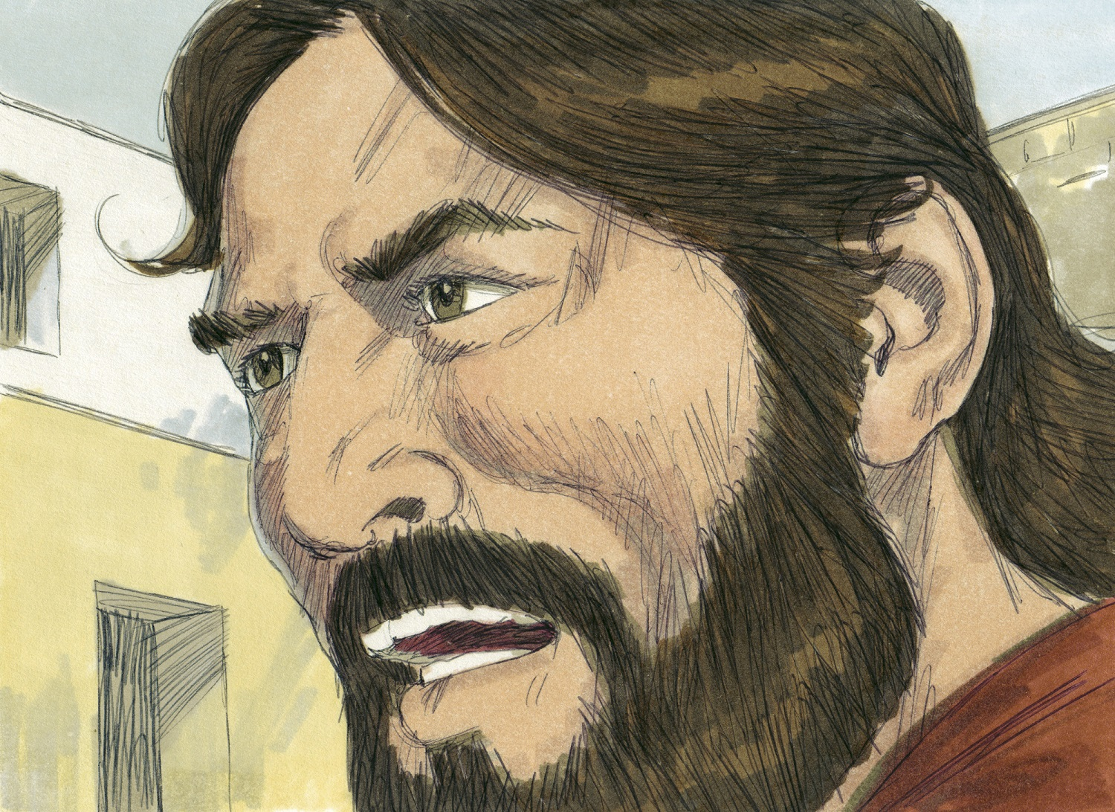
12
Woe to the Pharisees
Luke 11:44
“Woe to you, because you are like unmarked graves, which people walk over without knowing it.”

Slide 14
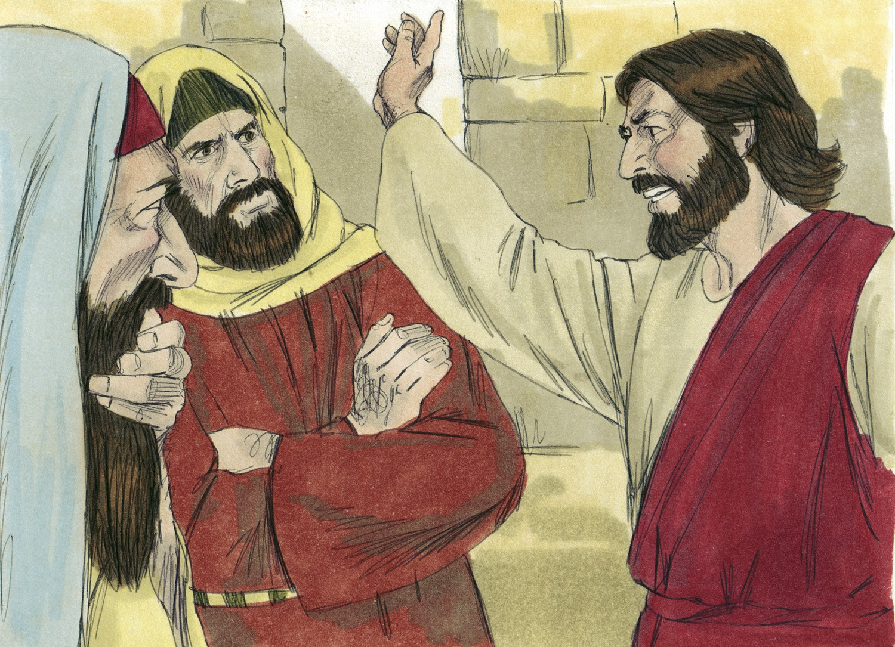
13
Woe to the Teachers of the Law
Luke 11:46
Jesus replied, “And you experts in the law, woe to you, because you load people down with burdens they can hardly carry, and you yourselves will not lift one finger to help them.”

Slide 15
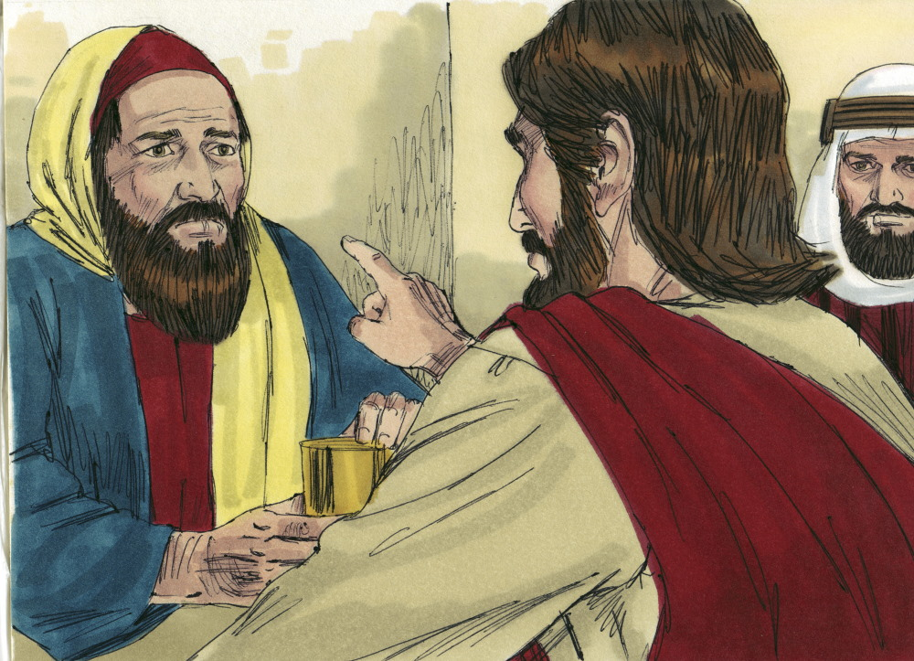
14
Woe to the Teachers of the Law
Luke 11:47
“Woe to you, because you build tombs for the prophets, and it was your ancestors who killed them.”

Slide 16
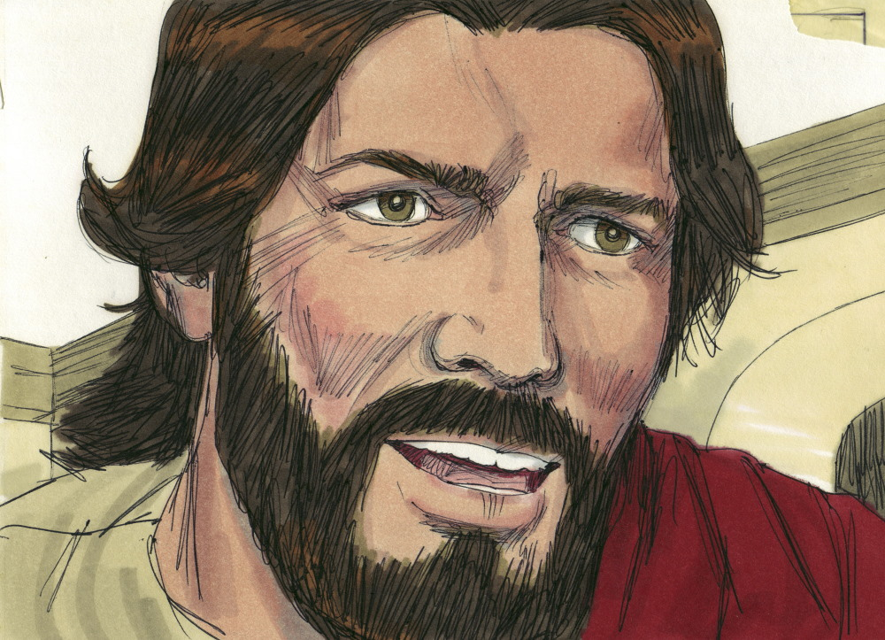
15
Woe to the Experts in the Law
Luke 11:52
“Woe to you experts in the law, because you have taken away the key to knowledge. You yourselves have not entered, and you have hindered those who were entering.”

Slide 17
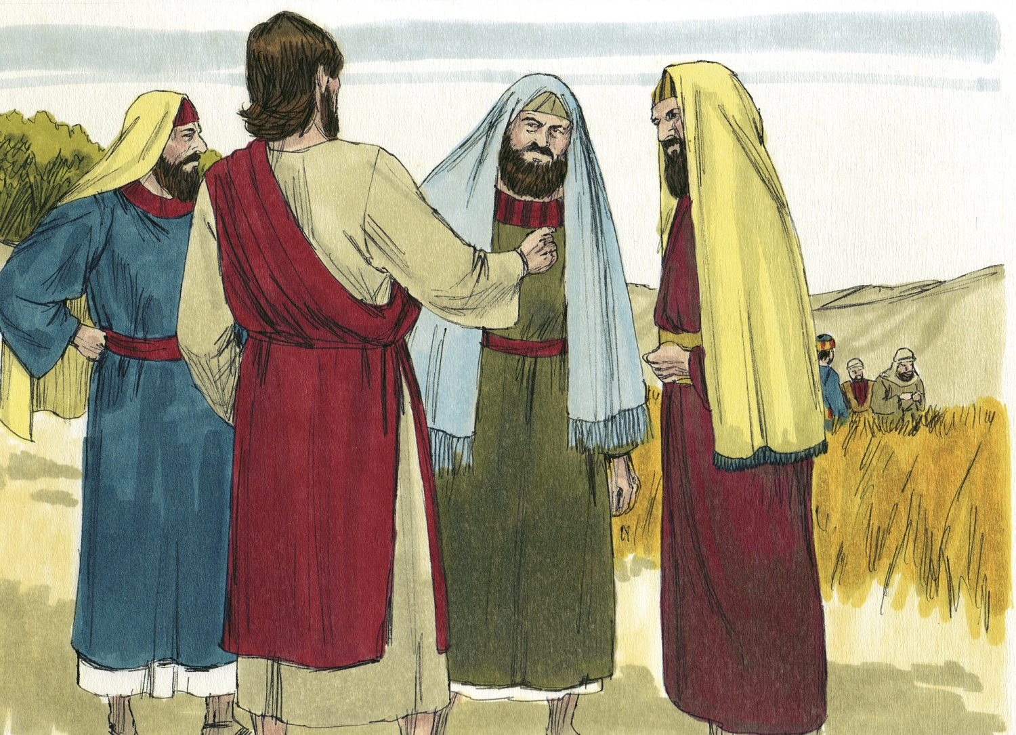
16
Jesus is Opposed
Luke 11:52-53
When Jesus went outside, the Pharisees and the teachers of the law began to oppose him fiercely and to besiege him with questions, waiting to catch him in something he might say.

