Slide 1
JESUS!
Lesson 23
John the Baptist Delegation
Anointing by Sinful Woman

Slide 2
Prayer Requests
1
Class Prayer
Praise
Thanksgiving
Concern
Grow up to be like Jesus

Slide 3
John the Baptist Delegation
2
John’s Disciples Talk with Jesus

Slide 4
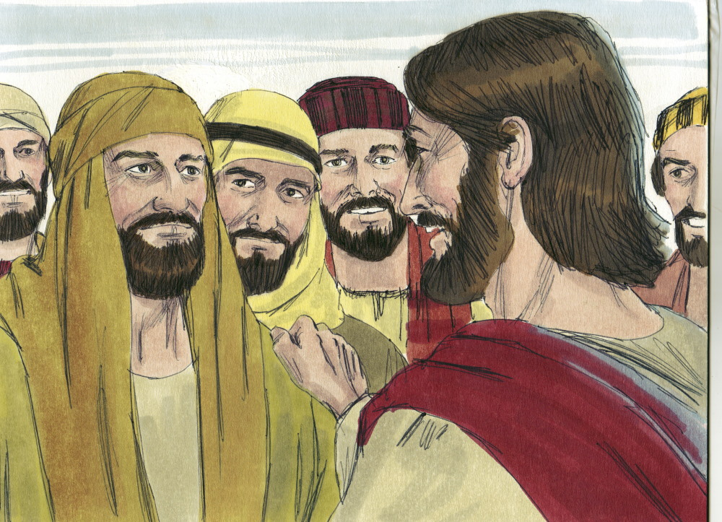
3
John’s Disciples Come to Jesus
Matthew 11:2
John sent his disciples to ask Jesus, “Are you the one who was to come, or should we expect someone else?”

Slide 5
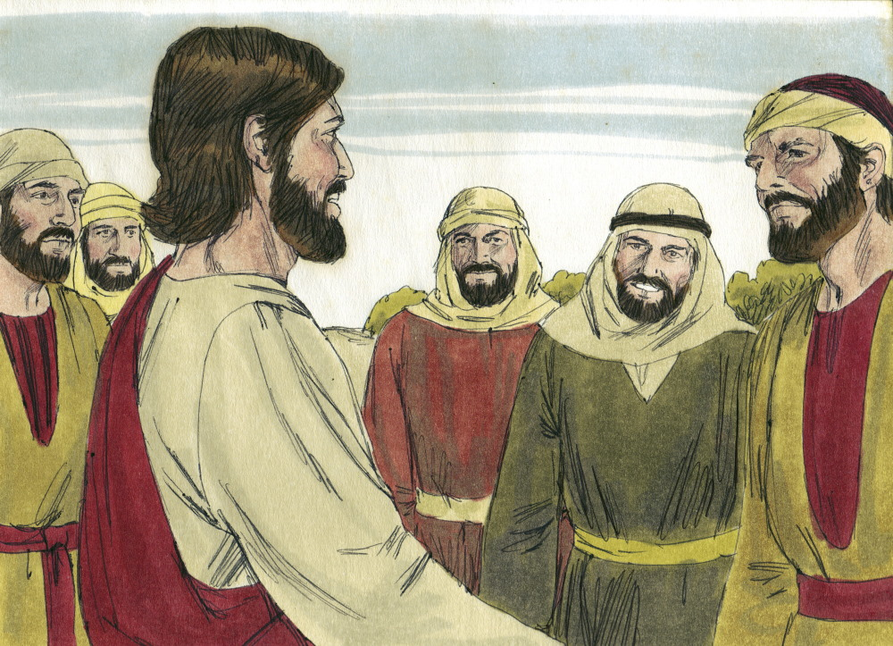
4
Is Jesus the Messiah?
Matthew 11:4
Jesus replied, “Go back and report to John what you hear and see.”

Slide 6
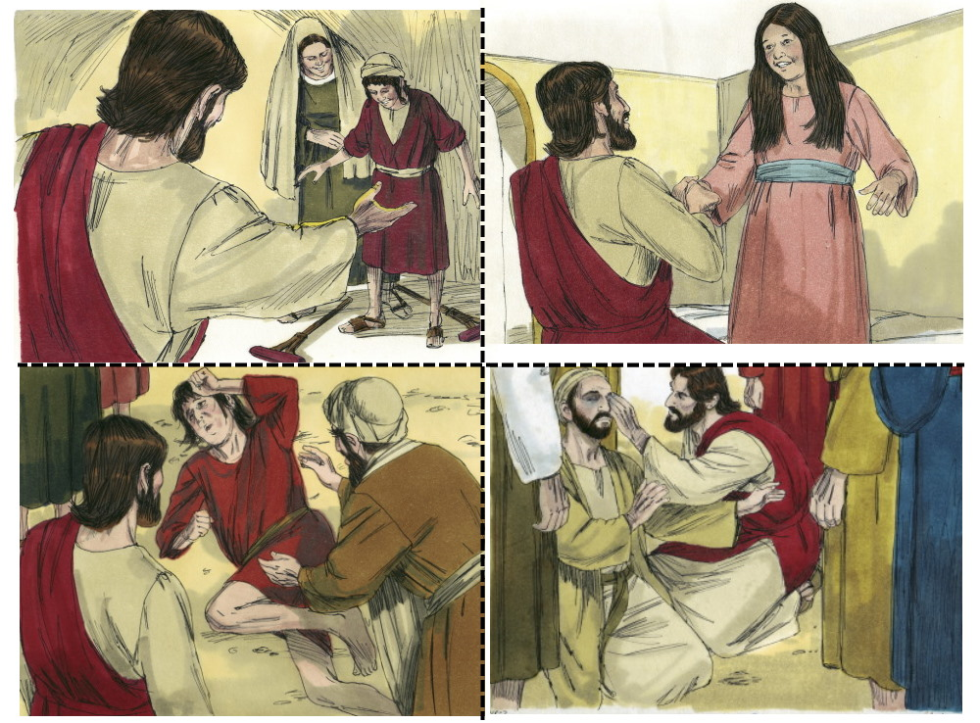
5
Jesus Answers John
Matthew 11:5
“The blind receive sight, the lame walk, those who have leprosy are cured, the deaf hear, the dead are raised, and the good news is preached to the poor.”

Slide 7
6
Jesus is Invited to Home of Pharisee
Anointing by a Sinful Woman

Slide 8
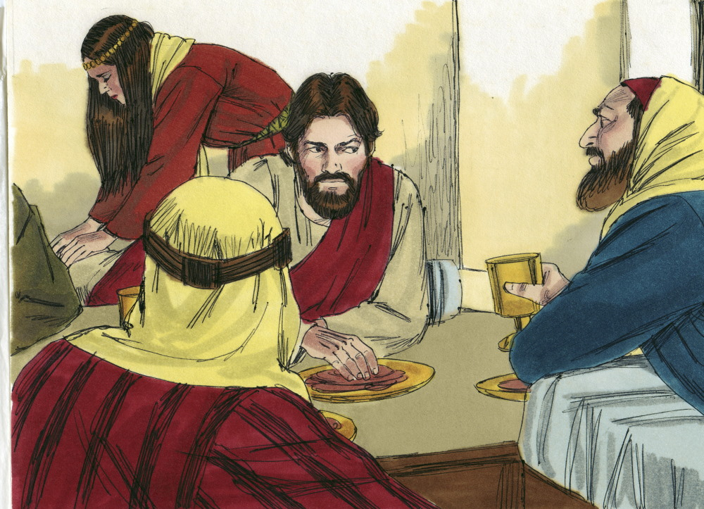
7
Jesus is Anointed
Luke 7:37-38
A woman who had lived a sinful life anointed Jesus’ feet with her tears and dried them with her hair. She then poured perfume on them.

Slide 9
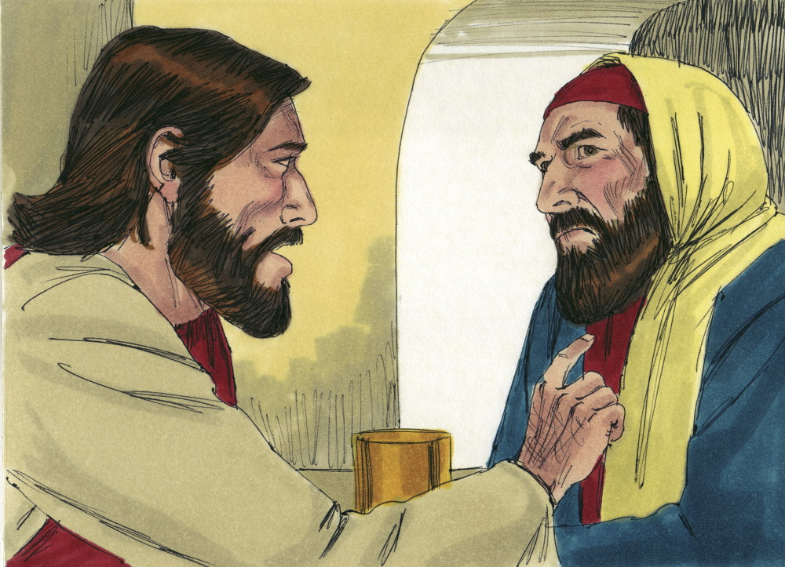
8
Jesus Tells Simon the Pharisee a Story
Luke 7:39-40
Simon the Pharisee said to himself, “If Jesus were a prophet he would know who was touching him.” Jesus tells Simon a story.

Slide 10
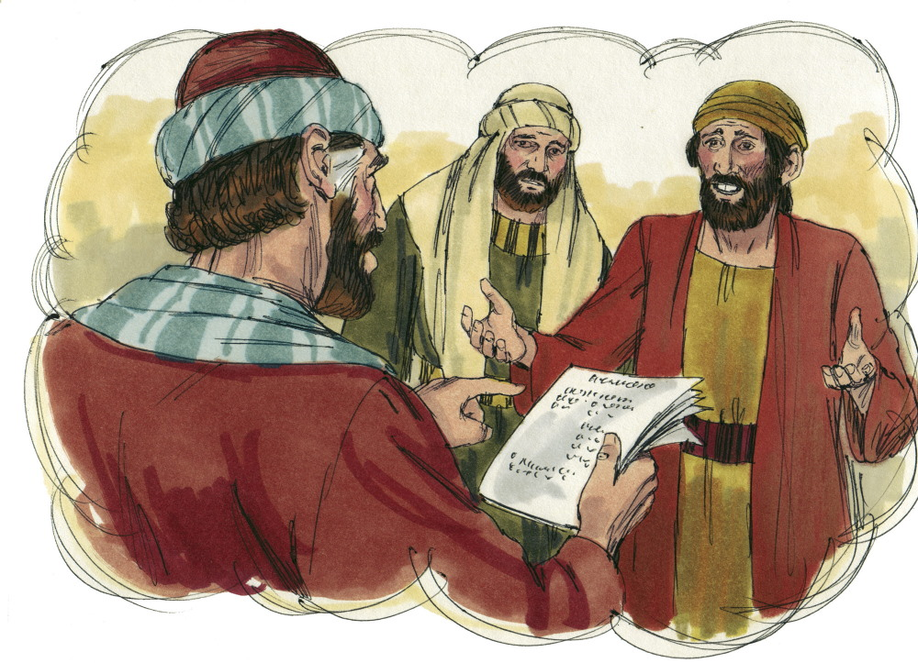
9
Story of a Moneylender
Luke 7:41-43
Two men had their debts forgiven. One owed 500 denarii and the other owed 50 denarii.

Slide 11
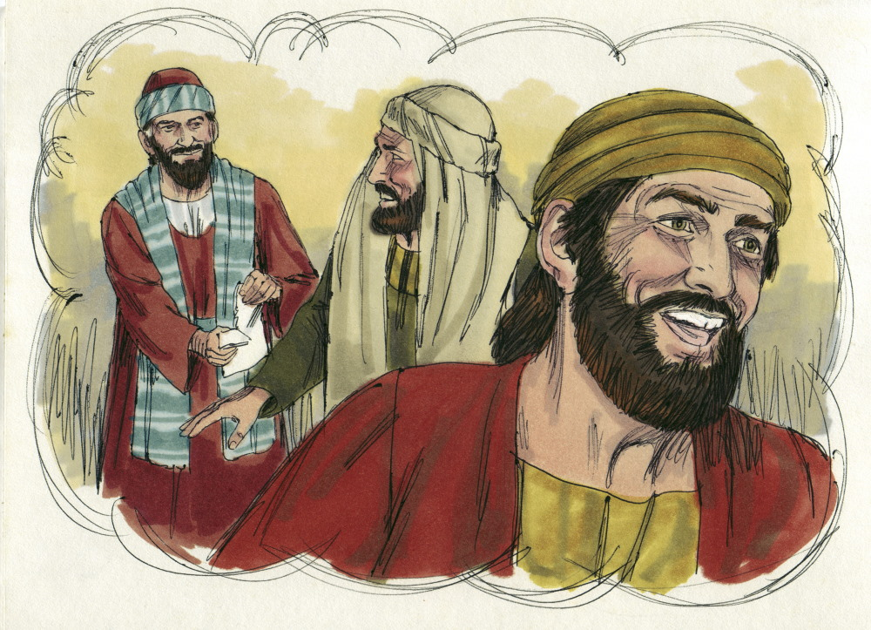
10
Jesus Asks Simon a Question
Luke 7:43
Jesus asked Simon, “Which one will love the moneylender more?” Simon answered, “The one who had the bigger debt canceled.”

Slide 12
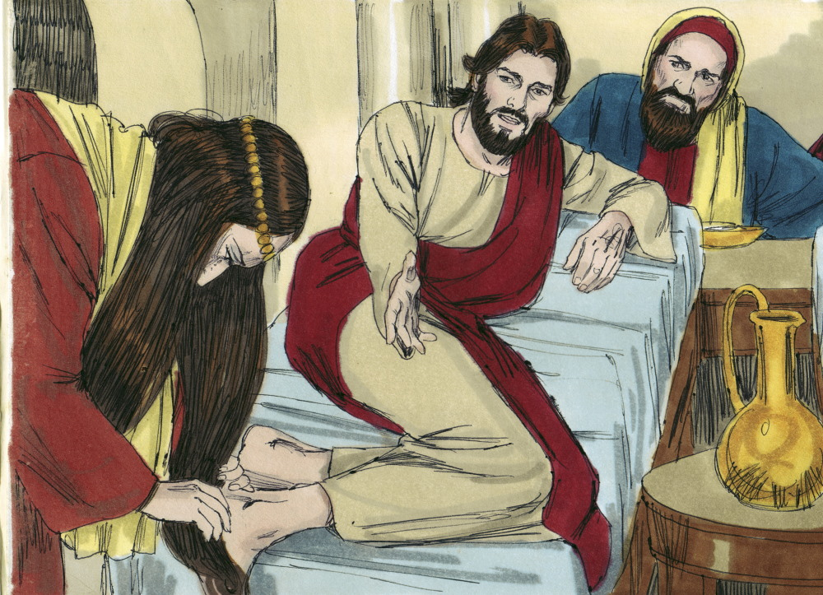
11
Jesus Turns to the Woman
Luke 7:44
Jesus said to Simon, “I came into your house. You did not give me any water for my feet, but she wiped my feet with her tears and hair.”

Slide 13
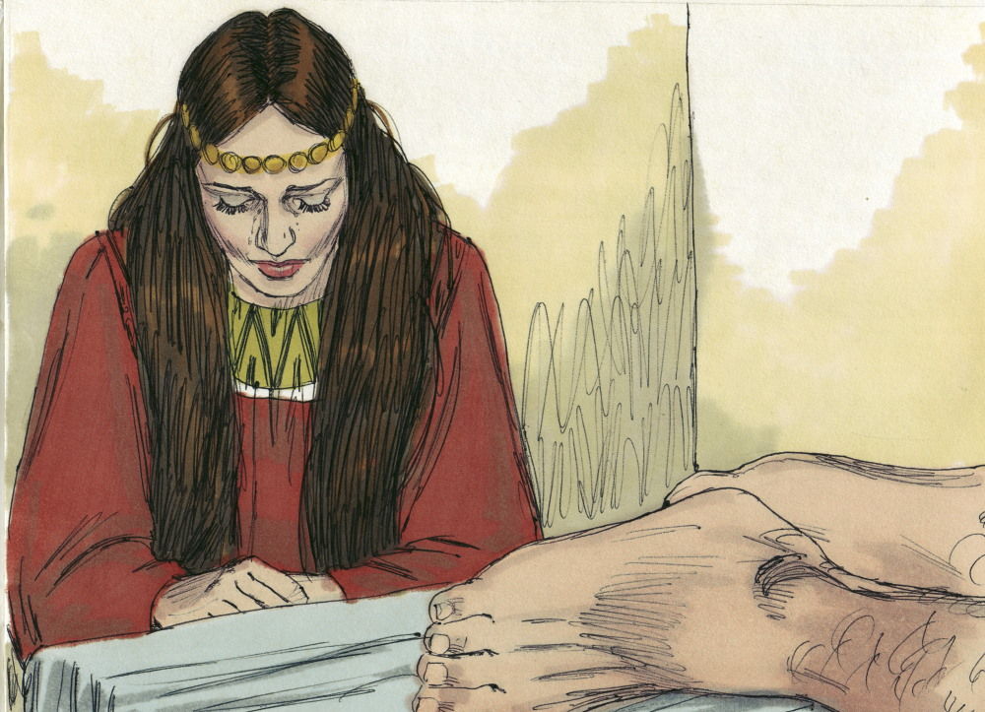
12
Jesus Praises the Woman
Luke 7:46
Jesus said, “You did not put oil on my head, but she poured perfume on my feet.”

Slide 14
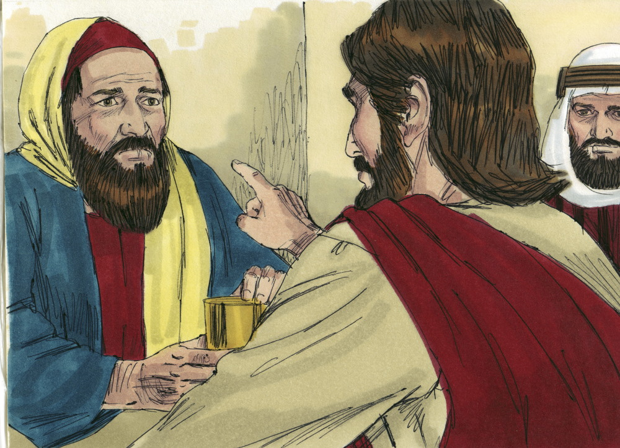
13
The Woman Loved Much
Luke 7:47
“Therefore, I tell you, her many sins have been forgiven – for she loved much.”

Slide 15
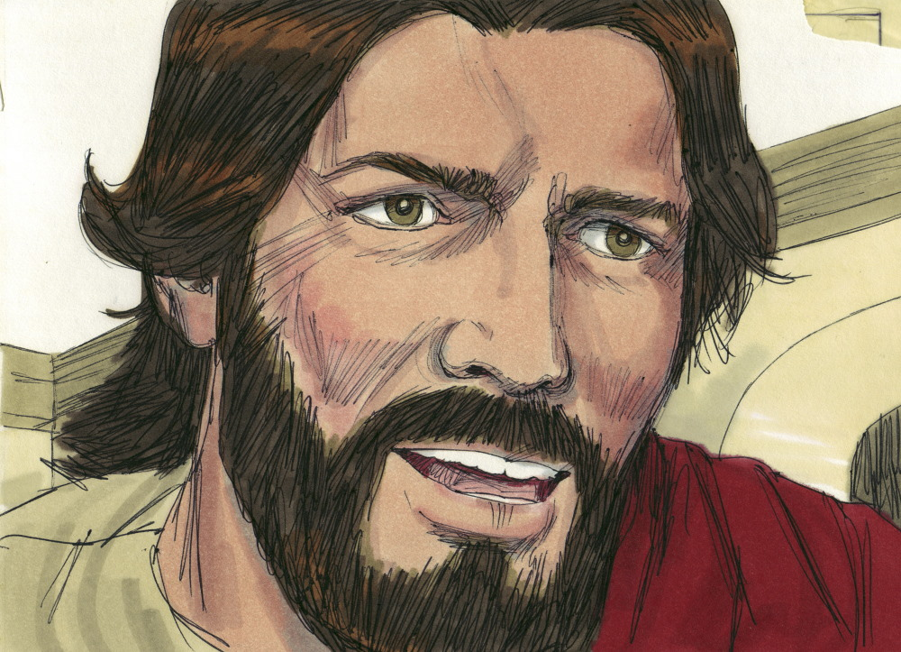
14
Forgiveness and Love
Luke 7:47
“He who has been forgiven little loves little.”

Slide 16
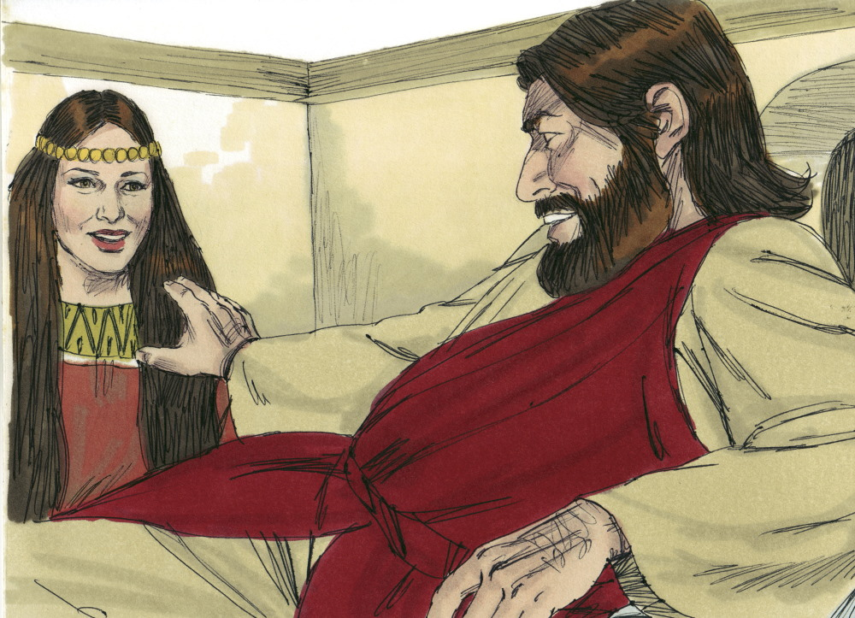
15
Jesus Forgives Sin
Luke 7:48-50
Jesus said to the woman, “Your sins have been forgiven. Your faith has saved you, go in peace.”

