Slide 1
JESUS!
Lesson 21
Sermon on the Mount (Part 3)
Worry
Wise and Foolish Builders

Slide 2
Prayer Requests
1
Class Prayer
Praise
Thanksgiving
Concern
Grow up to be like Jesus

Slide 3
Worry
2
Sermon on the Mount

Slide 4
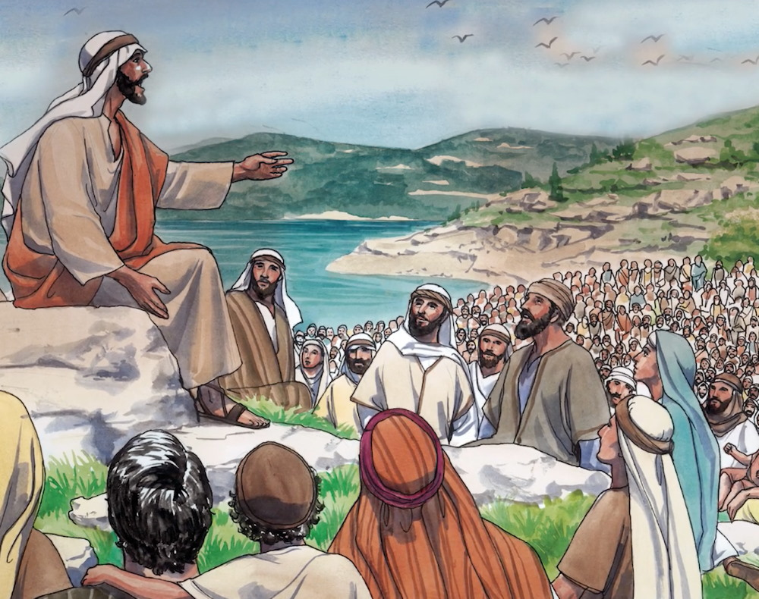
3
Do Not Worry
Matthew 6:25
“Therefore I tell you, do not worry about your life, what you will eat or drink, or about your body, what you will wear.”

Slide 5
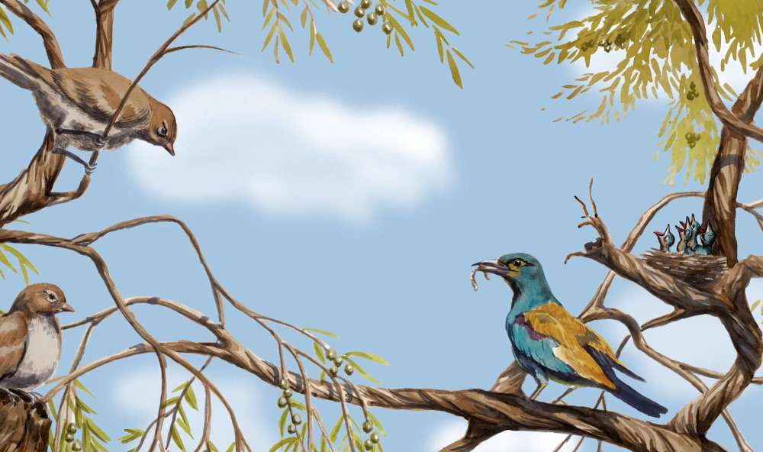
4
Look at the Birds
Matthew 6:26
“Look at the birds of the air; they do not sow or reap or store away in barns, and yet your heavenly Father feeds them.”

Slide 6
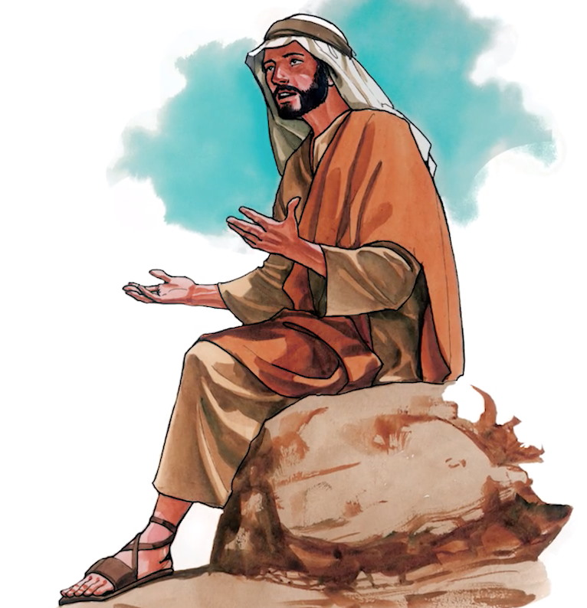
5
Length of Life
Matthew 6:27
“Who of you by worrying can add a single hour to his life?”

Slide 7
6
Lilies of the Field
Matthew 6:28
“And why do you worry about clothes? See how the lilies of the field grow. They do not labor or spin.”

Slide 8
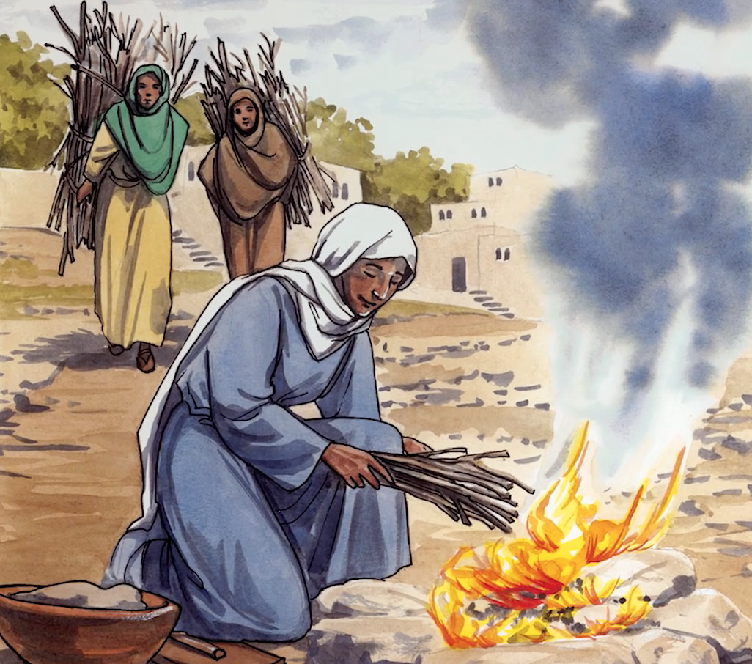
7
God’s Care
Matthew 6:30
“If that is how God clothes the grass of the field, which is here today and tomorrow is thrown into the fire, how much more will he clothes you?”

Slide 9
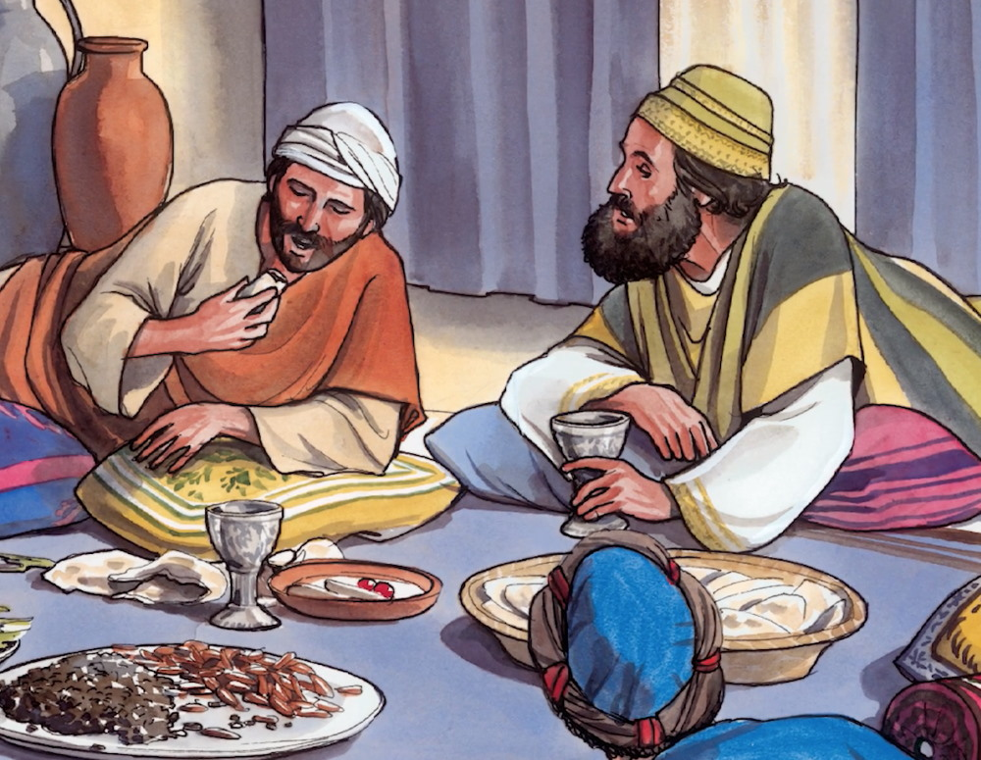
8
Eating and Drinking
Matthew 6:31
”So do not worry about what you will eat or drink. The pagans run after these things, and your heavenly Father knows that you need them.”

Slide 10
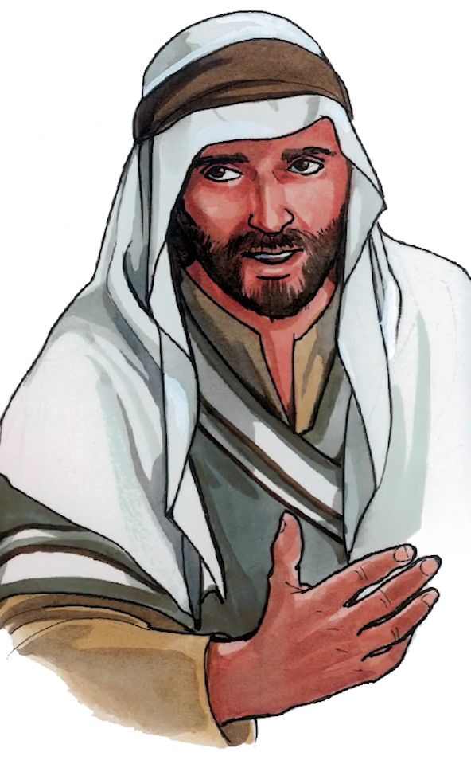
9
Seek First His Kingdom
Matthew 6:33
“But seek first his kingdom and his righteousness, and all these things will be given to you as well.”

Slide 11
10
Sermon on the Mount
Wise and Foolish Builders

Slide 12
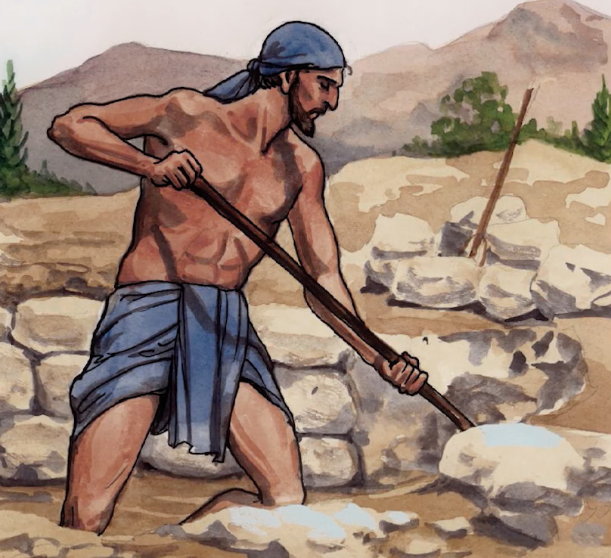
11
Wise Builder
Matthew 7:24
“Everyone who hears these words of mine and puts them into practice is like a wise man who built his house on the rock.”

Slide 13
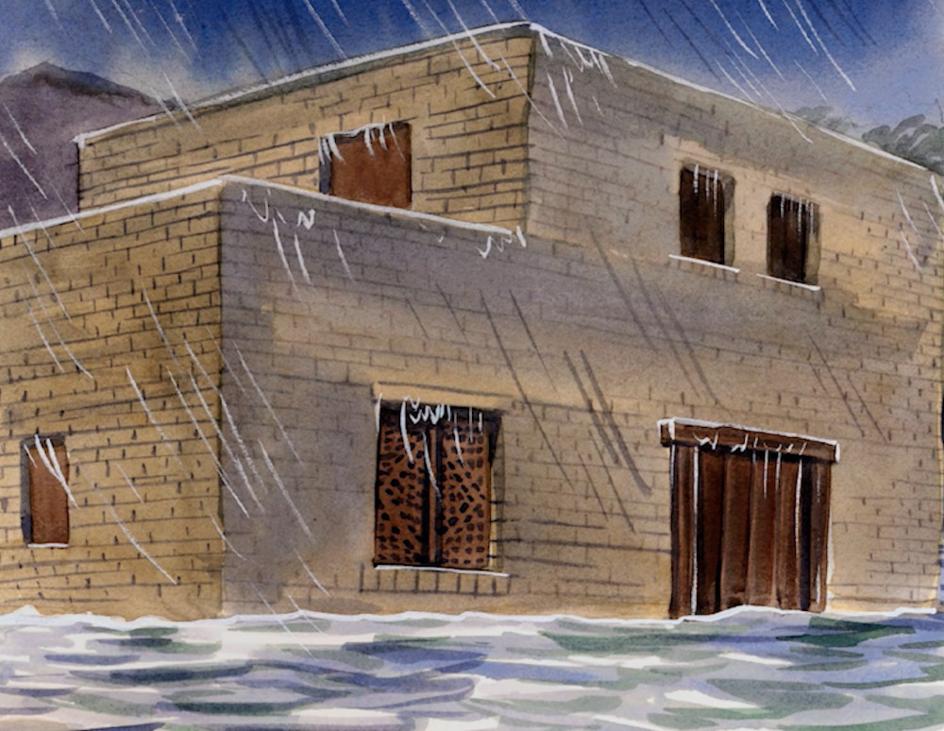
12
The Storms Came Down
Matthew 7:25
“The rain came down, the streams rose, and the wind blew and beat the house, yet it did not fall, because it’s foundation was on the rock.”

Slide 14
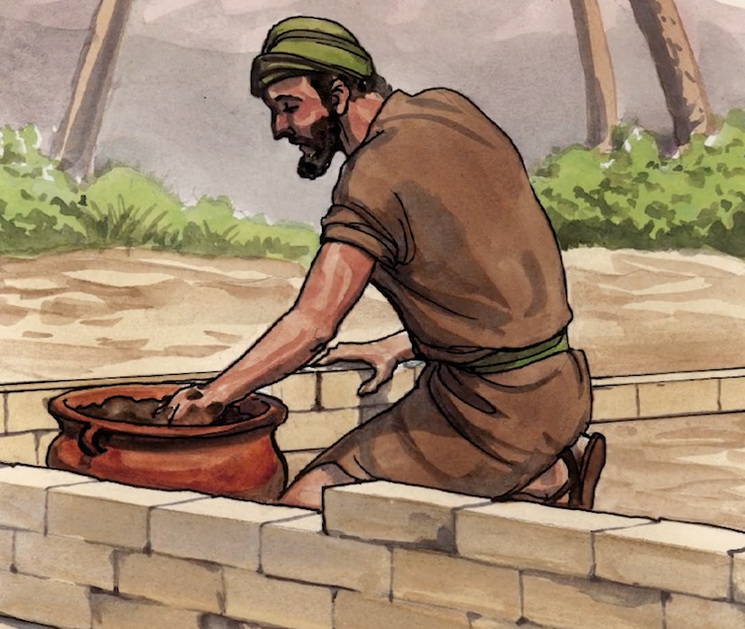
13
Foolish Builder
Matthew 7:26
“But everyone who hears these words of mine and does not put them into practice is like the foolish man who built his house on the sand.”

Slide 15
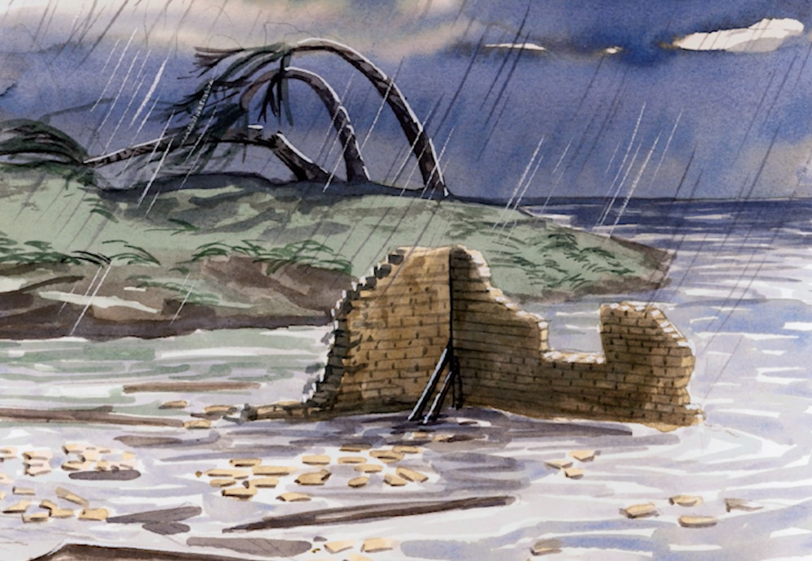
14
The Storms Came Down
Matthew 27
“The rain came down, the streams rose, and the winds blew and beat against that house, and it fell with a great crash.”

Slide 16
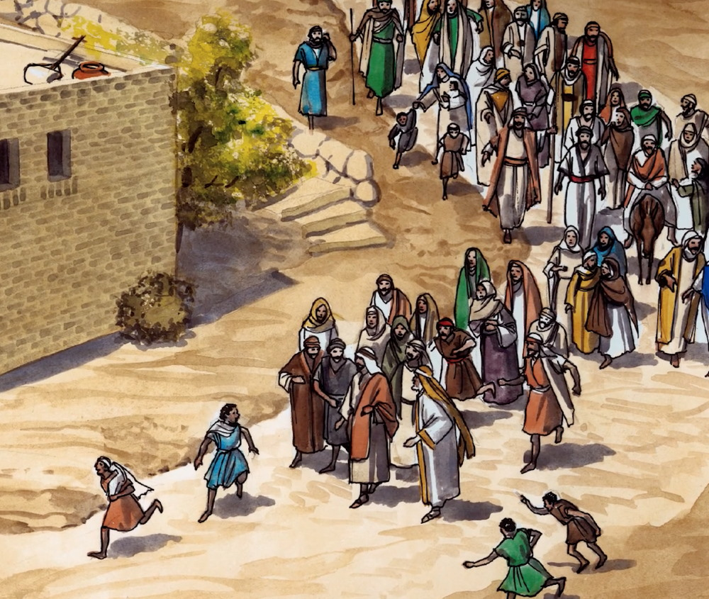
15
Crowds are Amazed
Matthew 7:28
“The crowds were amazed at his teaching, because he taught as one who had authority, and not as their teachers of the law.”

