Slide 1
JESUS!
Lesson 20 (Sermon on the Mount – Part 2)
Adultery and Divorce Lord’s Prayer Fasting Treasures in Heaven

Slide 2
Prayer Requests
1
Class Prayer
Praise
Thanksgiving
Concern
Grow up to be like Jesus

Slide 3
Adultery and Divorce
2
Sermon on the Mount

Slide 4
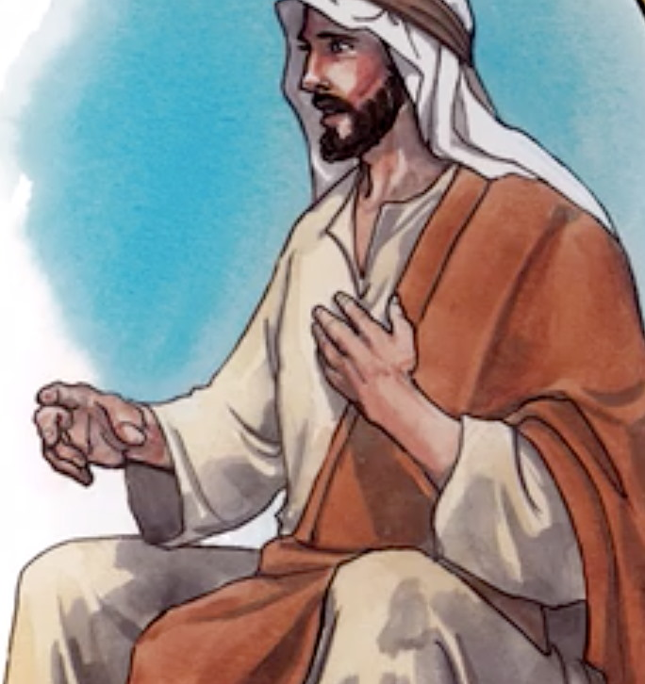
3
Adultery
Matthew 5:27
Jesus said, “You have heard it said, ‘Do not commit adultery.”

Slide 5
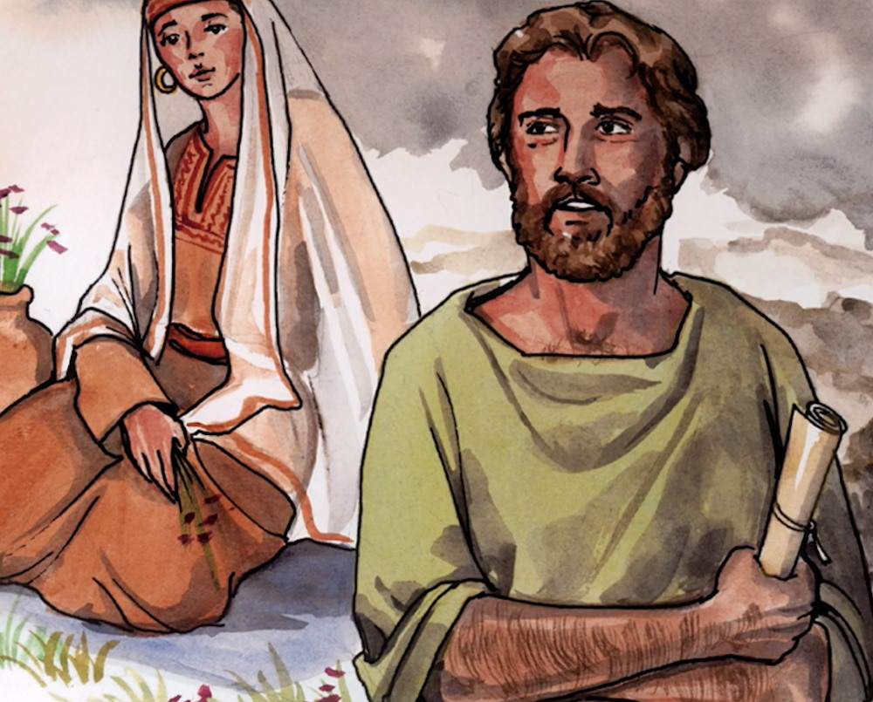
4
Adultery
Matthew 5:28
”But I tell you that anyone who looks at a woman lustfully has already committed adultery with her in his heart.”

Slide 6
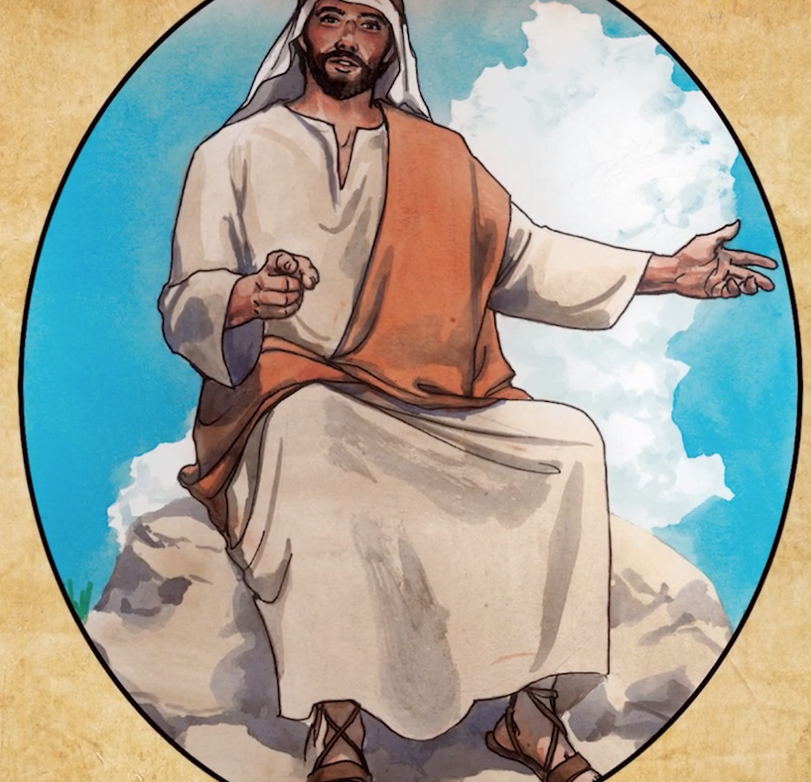
5
Sin
Matthew 5:29
“If your right eye causes you to sin, gouge it out and throw it away.”

Slide 7
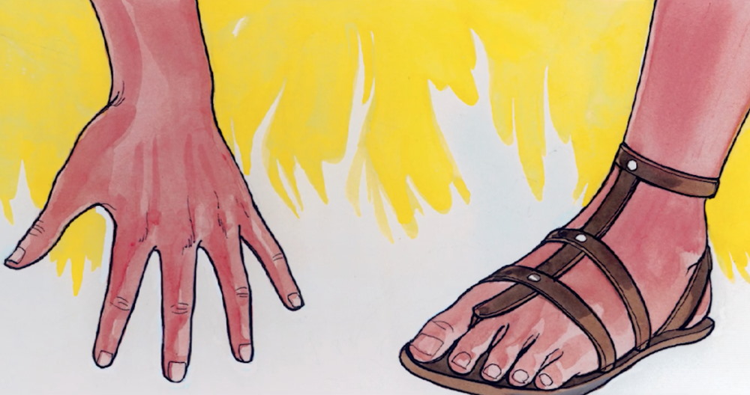
6
Sin
Matthew 5:30
“And if your right hand causes you to sin, cut it off and throw it away.”

Slide 8
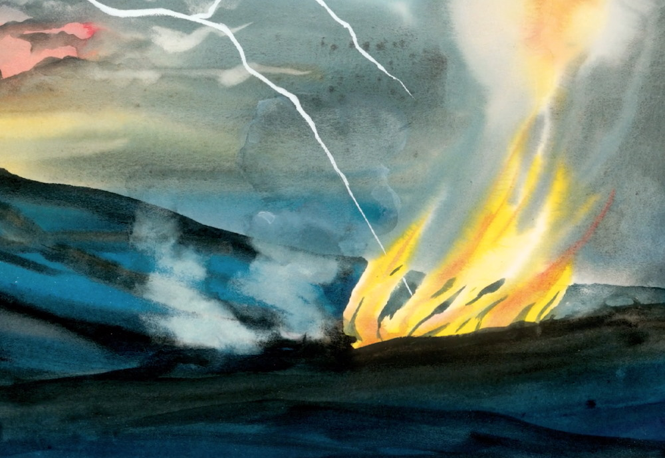
7
Sin
Matthew 5:30
“It is better for you to lose one part of your body than for your whole body to go into hell.”

Slide 9
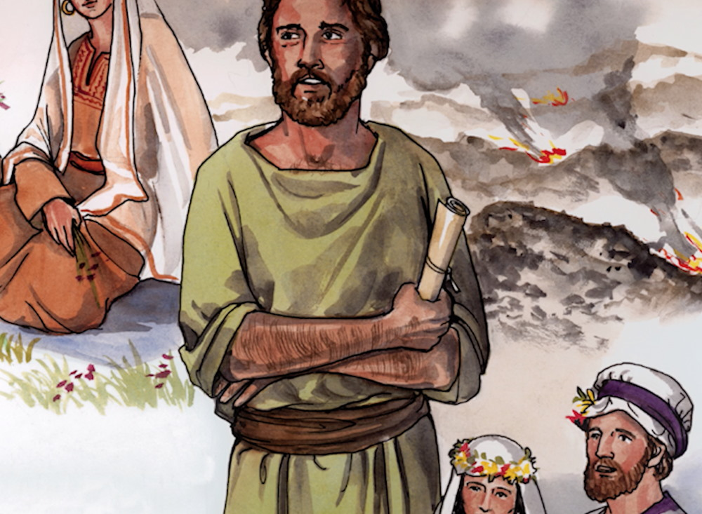
8
Divorce
Matthew 5:31
“It has been said, ’Anyone who divorces his wife must give her a certificate of divorce.’”

Slide 10
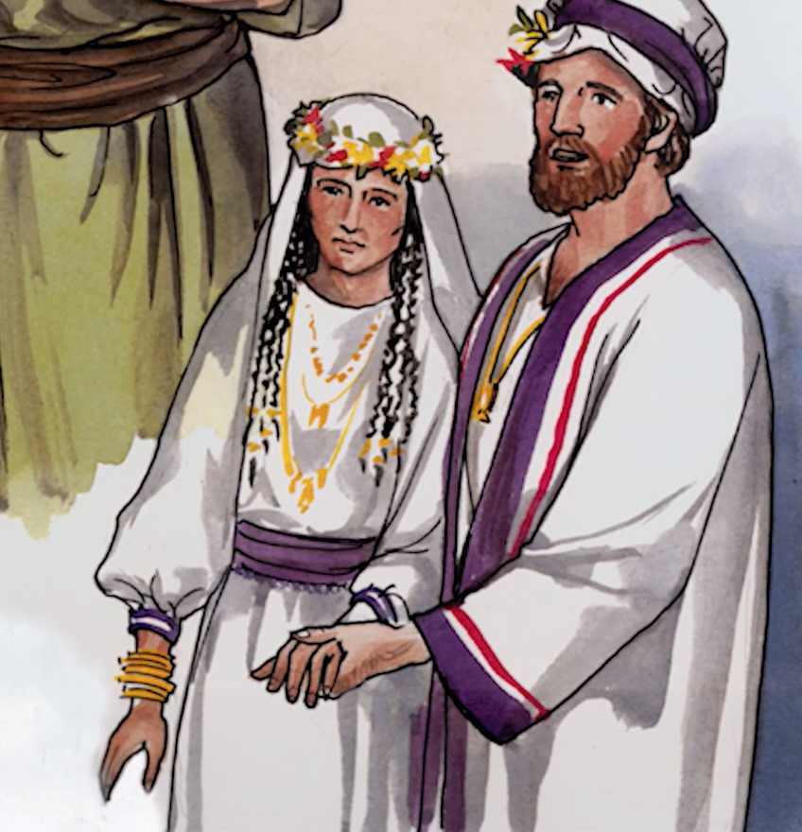
9
Divorce
Matthew 5:32
”But I tell you that anyone who divorces his wife, except for marital unfaithfulness, causes her to become an adulteress.”

Slide 11
10
Sermon on the Mount
The Lord’s Prayer

Slide 12
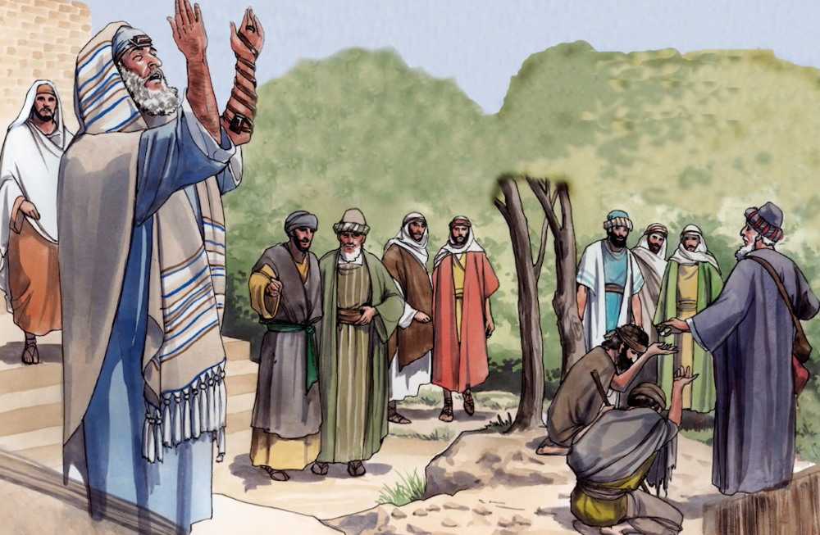
11
Prayer
Matthew 6:5
“And when you pray, do not be like the hypocrites, for they pray standing in the synagogues and street corners to be seen by men.”

Slide 13
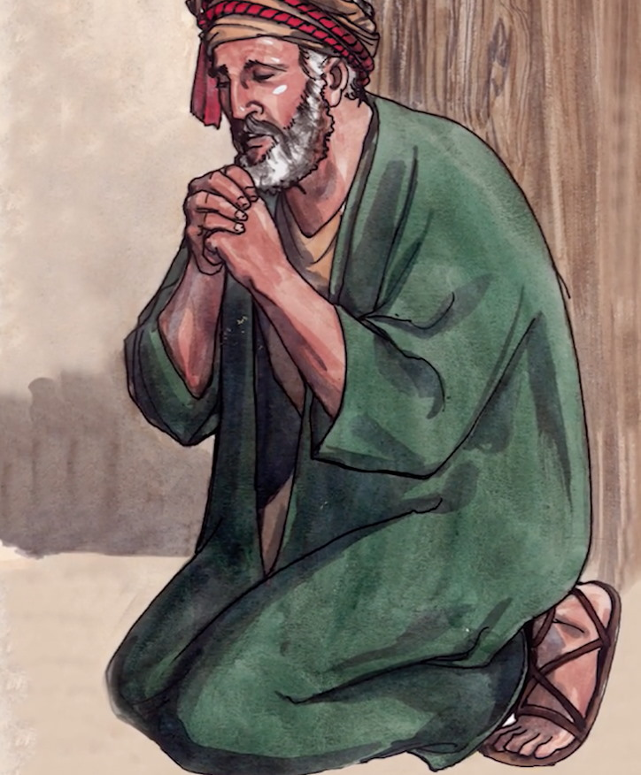
12
Prayer
Matthew 6:6
“But when you pray, go into your room, close the door and pray to your Father, who is unseen.”

Slide 14
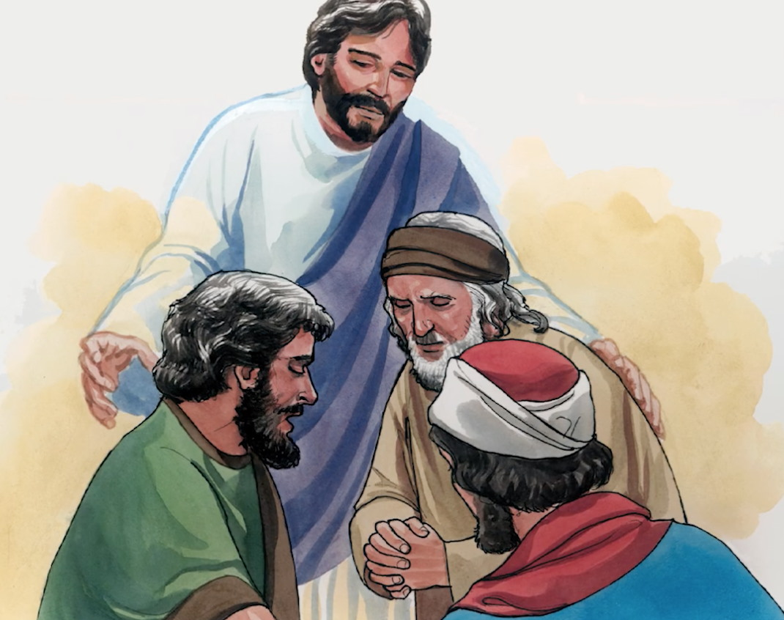
13
The Lord’s Prayer
Matthew 6:9-10
“Our Father in heaven, hallowed be your name, your kingdom come, your will be done on earth as it is in heaven.”

Slide 15
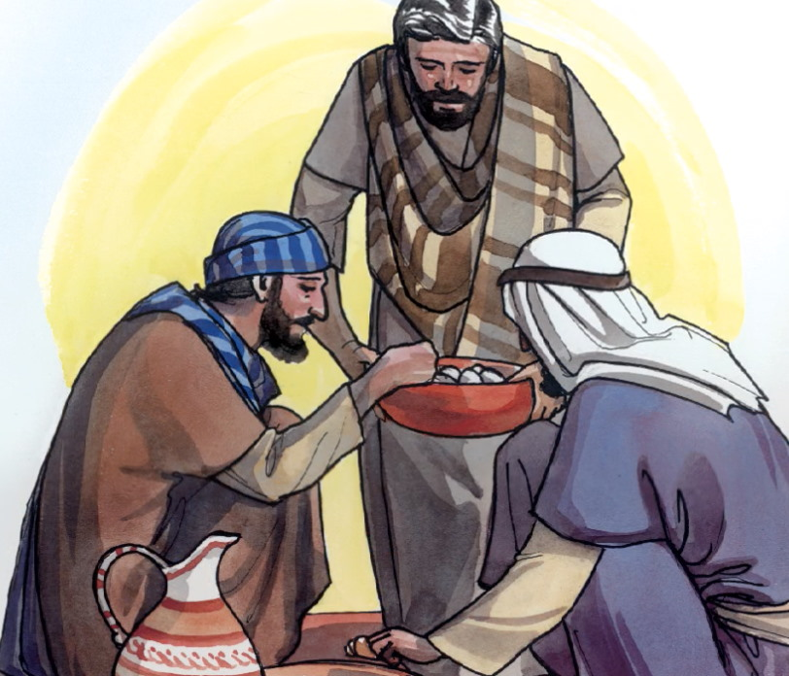
14
The Lord’s Prayer
Matthew 6:11
“Give us today our daily bread. Forgive our debts, as we also have forgiven our debtors.”

Slide 16
15
The Lord’s Prayer
Matthew 6:13
“And lead us not into temptation, but deliver us from the evil one.”

Slide 17
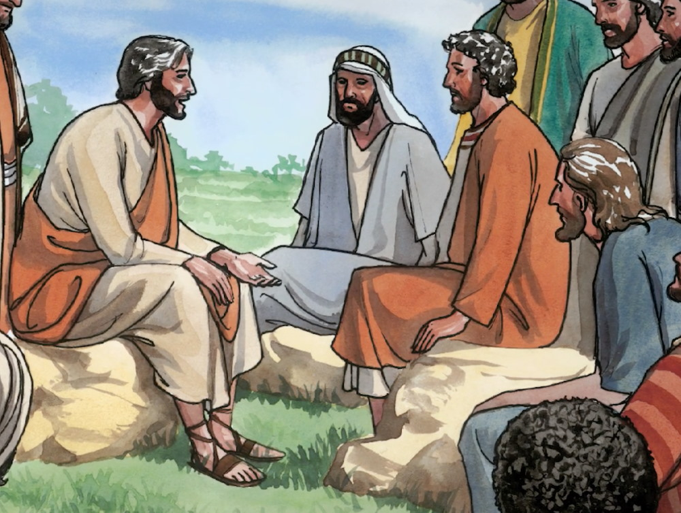
16
Forgiveness
Matthew 6:14
“For if you forgive men when they sin against you, your heavenly Father will also forgive you.”

Slide 18
17
Fasting
Treasures in Heaven
Sermon on the Mount

Slide 19
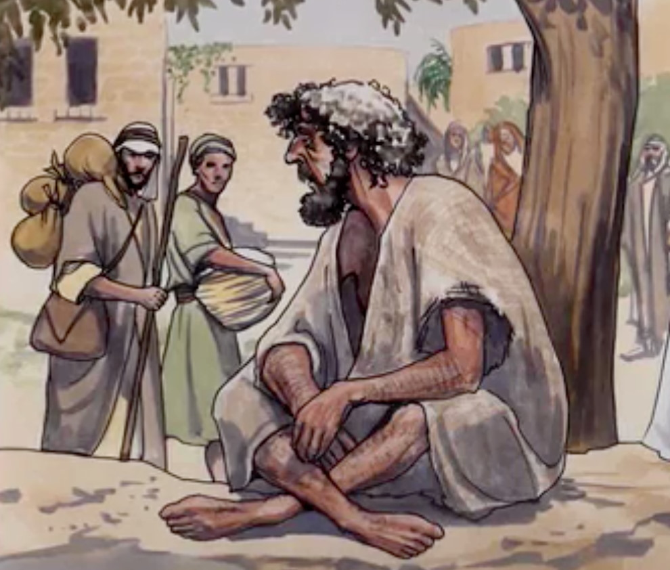
18
Fasting
Matthew 6:16
“When you fast, do not look somber as the hypocrites do, for they disfigure their faces to show men they are fasting.”

Slide 20
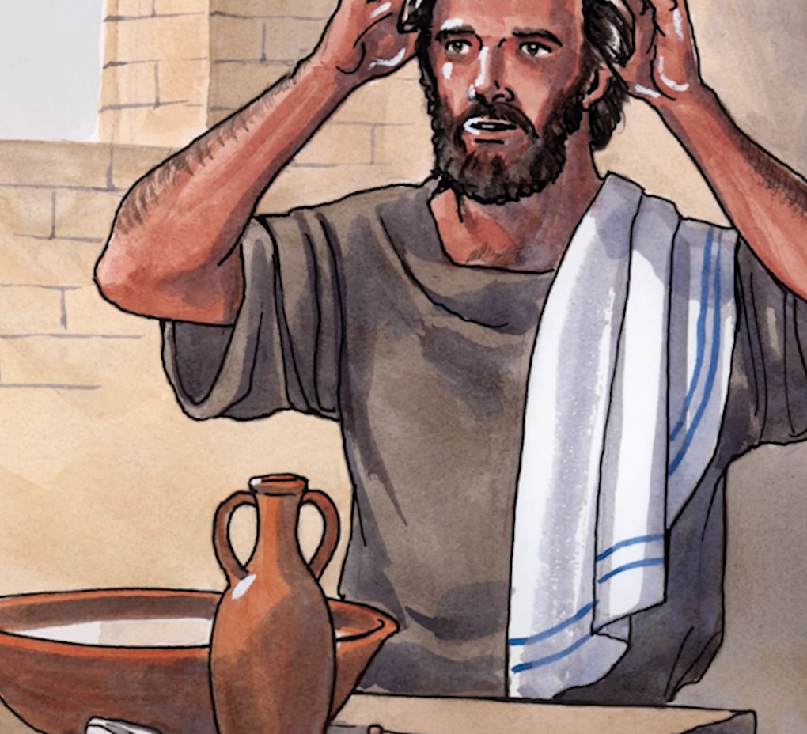
19
Fasting
Matthew 6:17
“But when you fast, put oil on your head and wash your face, so that it will not be obvious to men that you are fasting.”

Slide 21
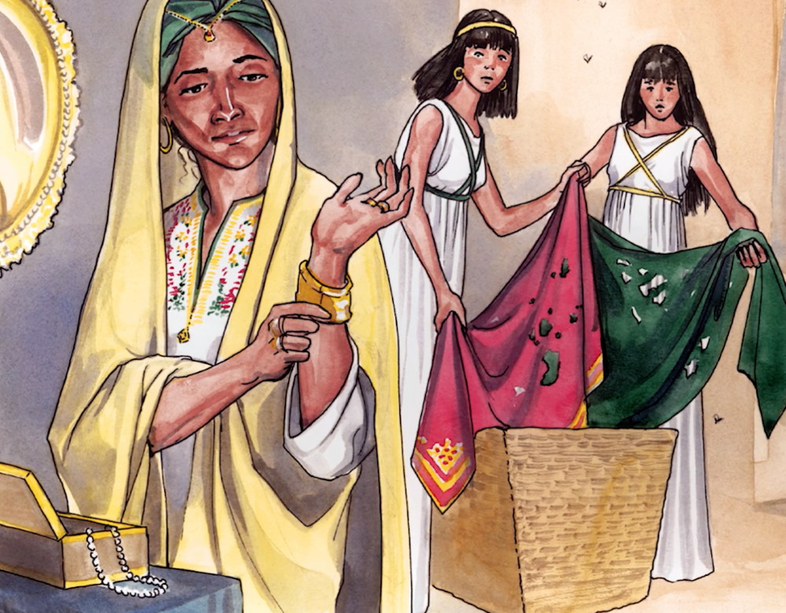
20
Treasure in Heaven
Matthew 6:19
“Do not store up for yourselves treasures on earth, where moth and rust destroy.”

Slide 22
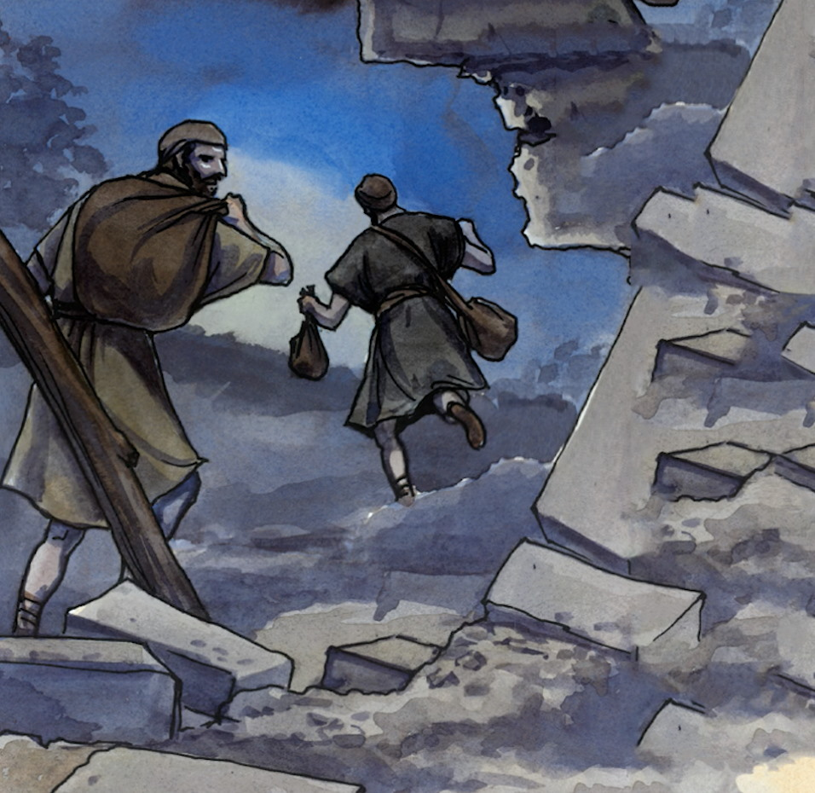
21
Treasures in Heaven
Matthew 6:19
“And where thieves break in and steal.”

Slide 23
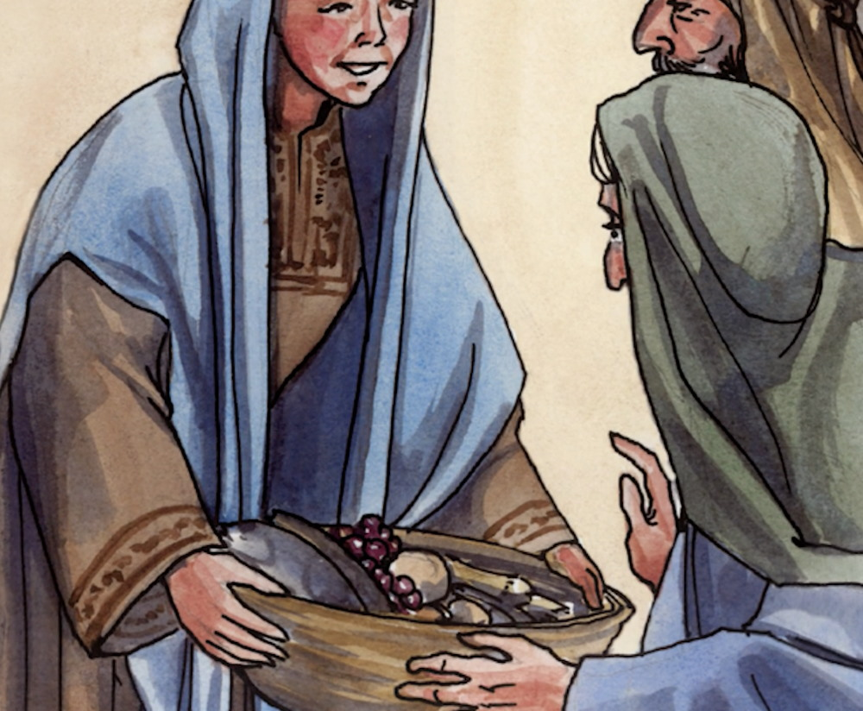
22
Treasures in Heaven
Matthew 6:20
“But store up for yourselves treasures in heaven, where moth and rust do not destroy, and where thieves do not steal.”

Slide 24
23
Treasures in Heaven
Matthew 6:22
“The eye is the lamp of the body. If your eyes are good, your whole body will be full of light.”

