Slide 1
JESUS!
Lesson 18
Sabbath Controversy
Twelve Apostles Called

Slide 2
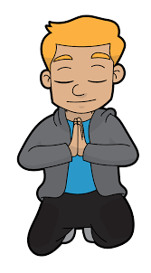
Prayer Requests
1
Class Prayer
Praise
Thanksgiving
Concern
Grow up to be like Jesus

Slide 3
Sabbath Controversy
2
The Sabbath

Slide 4
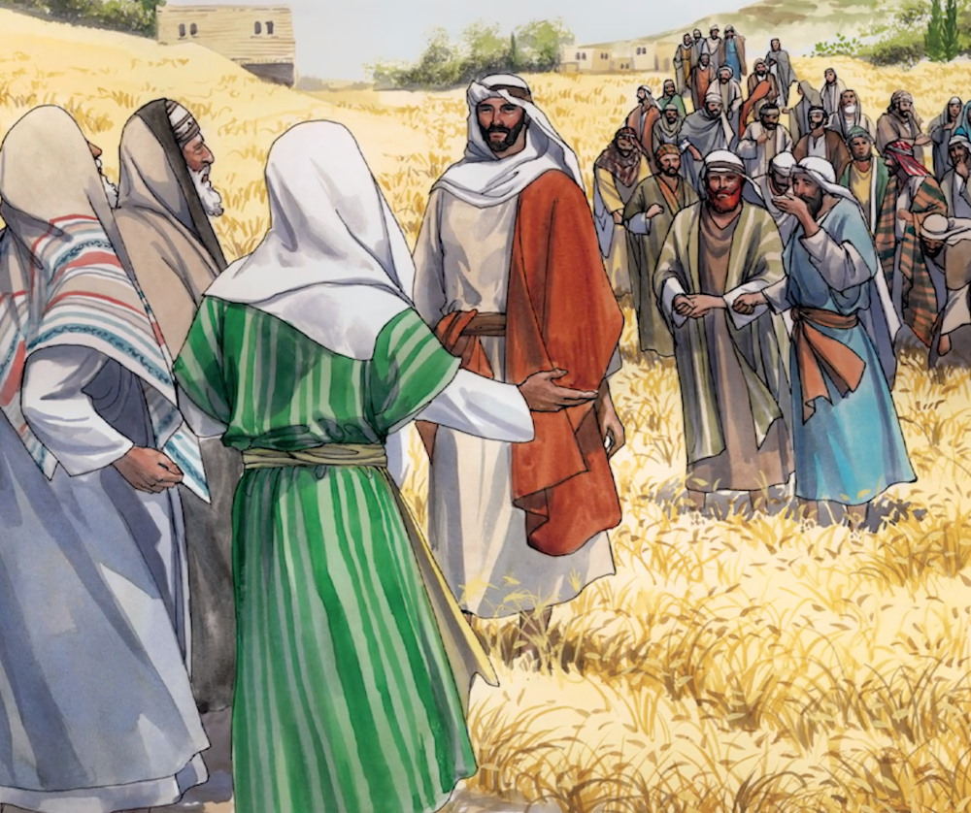
3
Jesus is Questioned
Luke 6:1-2
Jesus is questioned by the Pharisees on why his disciples are picking and eating grain on the Sabbath.

Slide 5
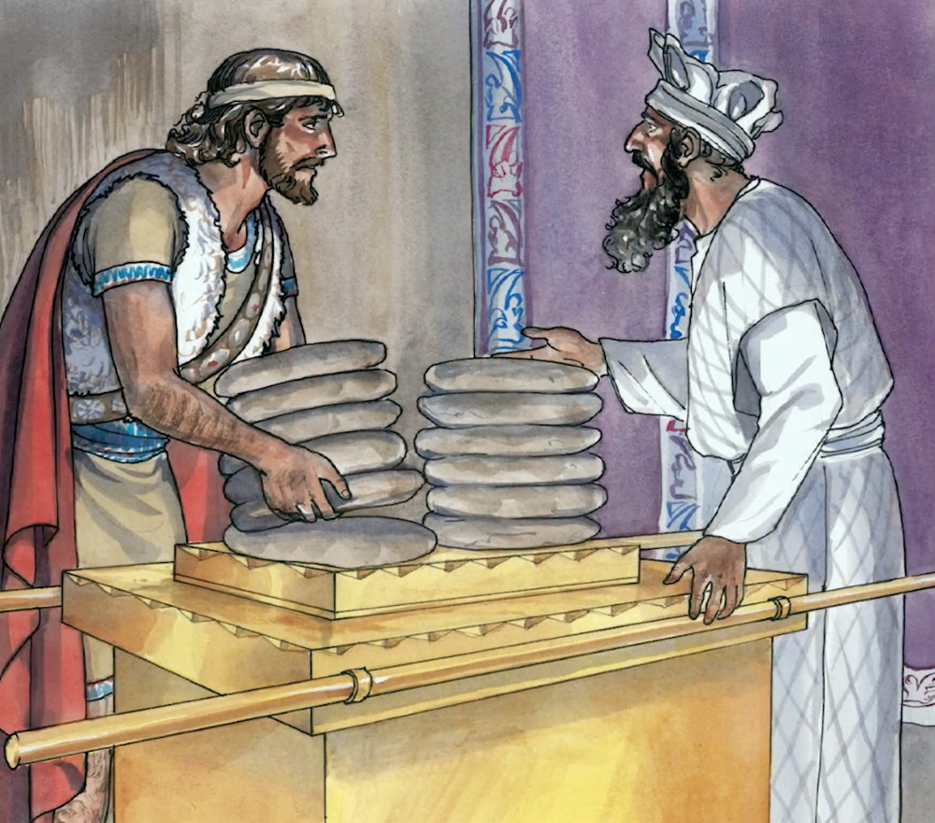
4
Jesus Answers Them
Luke 6:3-4
Jesus refers to David eating consecrated bread and giving some to his companions.

Slide 6
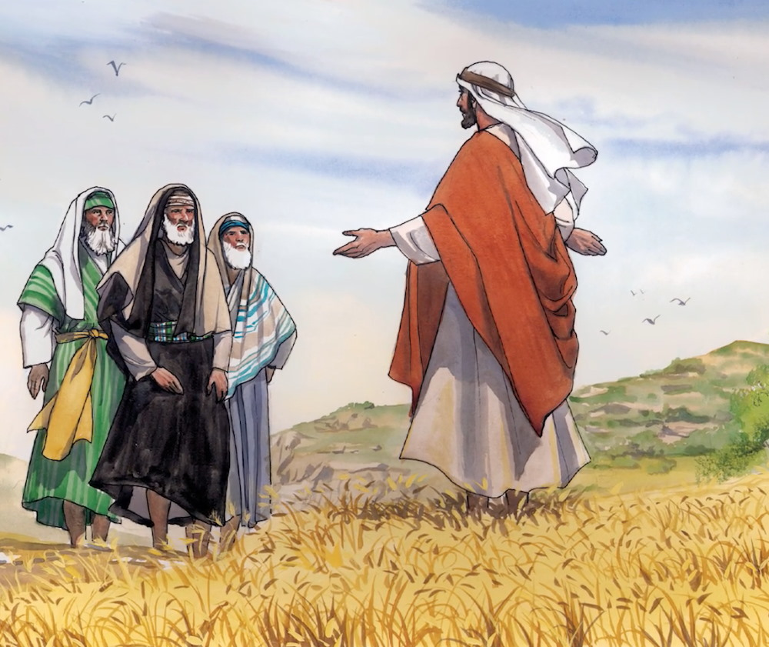
5
Jesus is Lord of the Sabbath
Luke 6:5
Then Jesus said to them, “The Son of Man is Lord of the Sabbath.”

Slide 7
6
Jesus Heals on the Sabbath
Jesus Performs Miracle

Slide 8
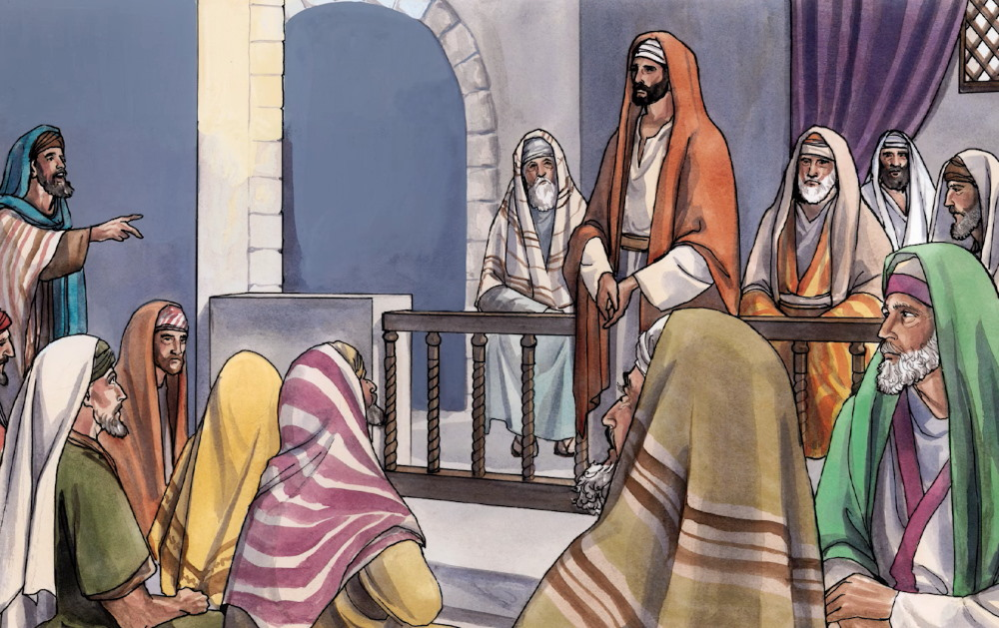
7
Jesus Teaches in the Synagogue
Matthew 12:9
On another Sabbath Jesus was teaching in the synagogue and there was a man with a shriveled right hand.

Slide 9
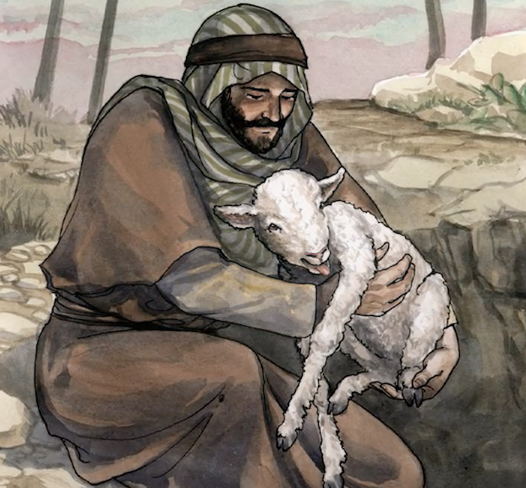
8
Jesus Asks the Pharisees a Question
Matthew 12:11-12
Jesus said to them, “If any of you has a sheep and it falls into a pit on the Sabbath, will you not lift it out?”

Slide 10
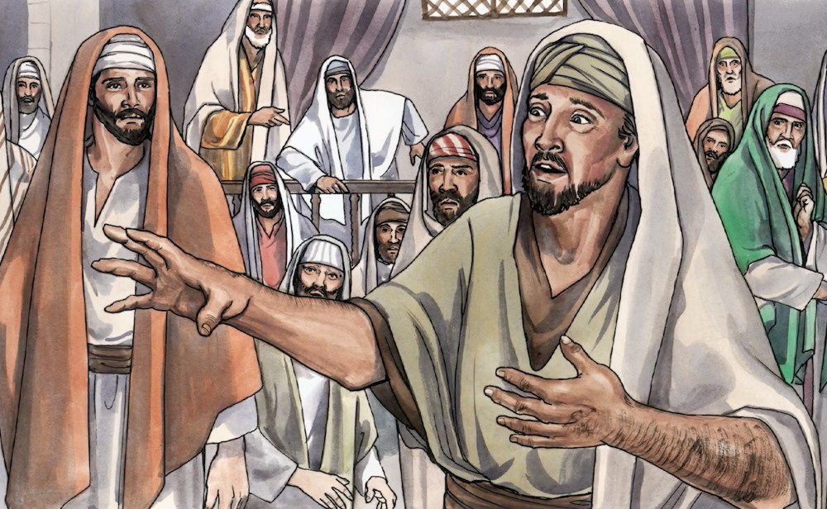
9
Jesus Heals the Man
Matthew 12:13
Jesus said to the man, “Stretch out your hand.” He did so, and his hand was completely healed.

Slide 11
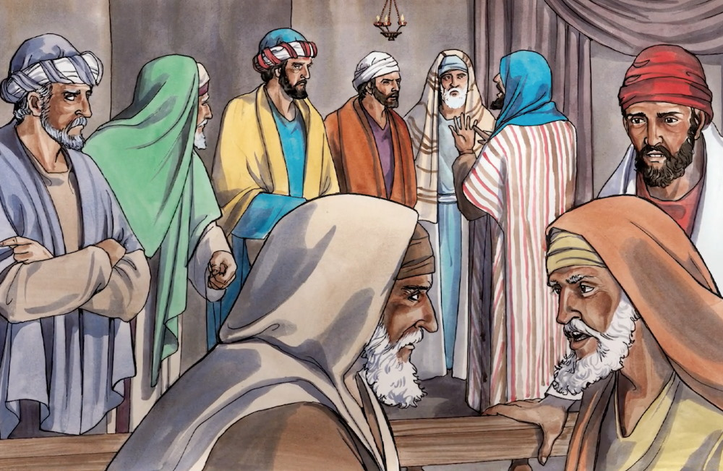
10
Pharisees are Furious
Matthew 12:14
The Pharisees were furious and began to plot ways how they might kill Jesus.

Slide 12
11
Jesus Calls the Twelve Apostles
Twelve Apostles Called

Slide 13
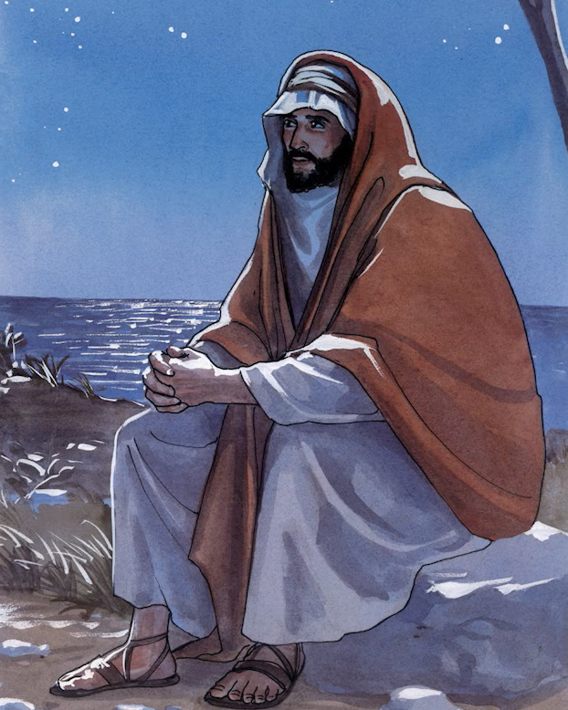
12
Jesus Prays
Luke 6:12
Jesus went out to a mountainside to pray, and spent the night praying to God.

Slide 14
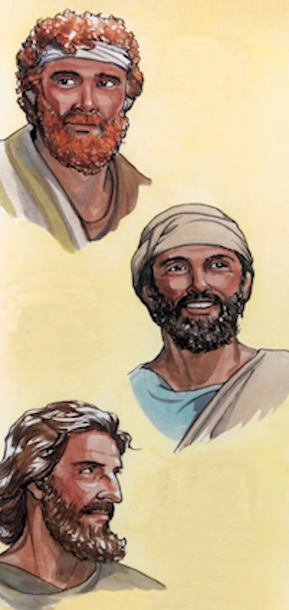
13
Simon (whom he named Peter)
Andrew (Peter’s brother)
James
Jesus Chooses the Twelve
Luke 6:13
When morning came he called his disciples to him and chose twelve, whom he designated apostles.

Slide 15
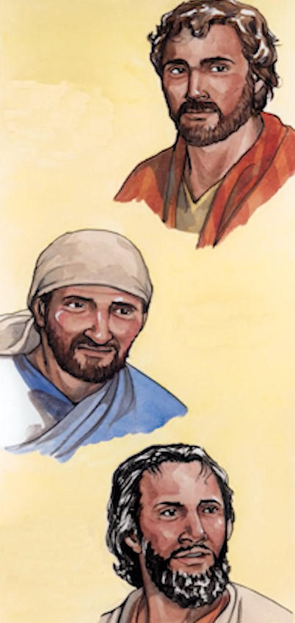
14
John (the brother of James)
Philip
Bartholomew
Jesus Chooses the Twelve
Luke 6:13
When morning came he called his disciples to him and chose twelve, whom he designated apostles.

Slide 16
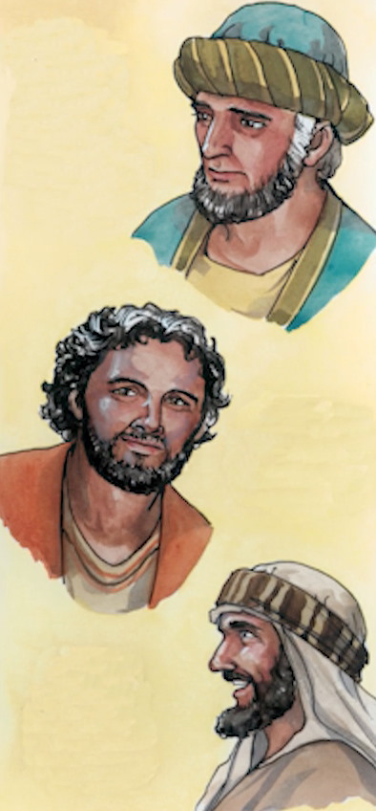
15
Matthew
Thomas
James (son of Alphaeus)
Jesus Chooses the Twelve
Luke 6:13
When morning came he called his disciples to him and chose twelve, whom he designated apostles.

Slide 17
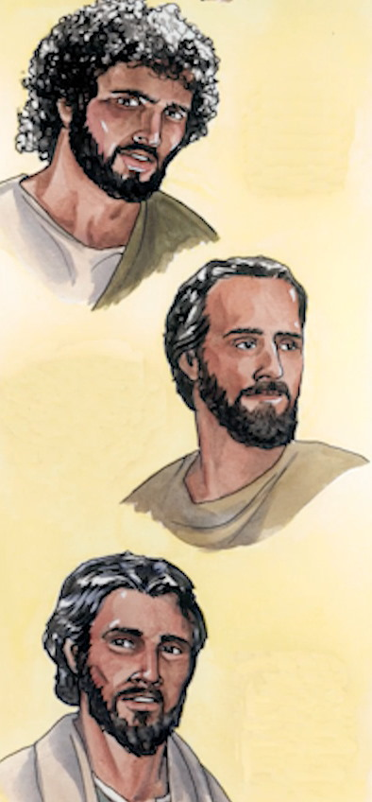
16
Simon (who was called the Zealot)
Judas (son of James)
Judas Iscariot (who became a traitor)
Jesus Chooses the Twelve
Luke 6:13
When morning came he called his disciples to him and chose twelve, whom he designated apostles.

