Slide 1
JESUS!
Lesson 17
Healing at the Pool of Bethesda

Slide 2
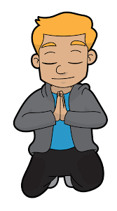
Prayer Requests
1
Class Prayer
Praise
Thanksgiving
Concern
Grow up to be like Jesus

Slide 3
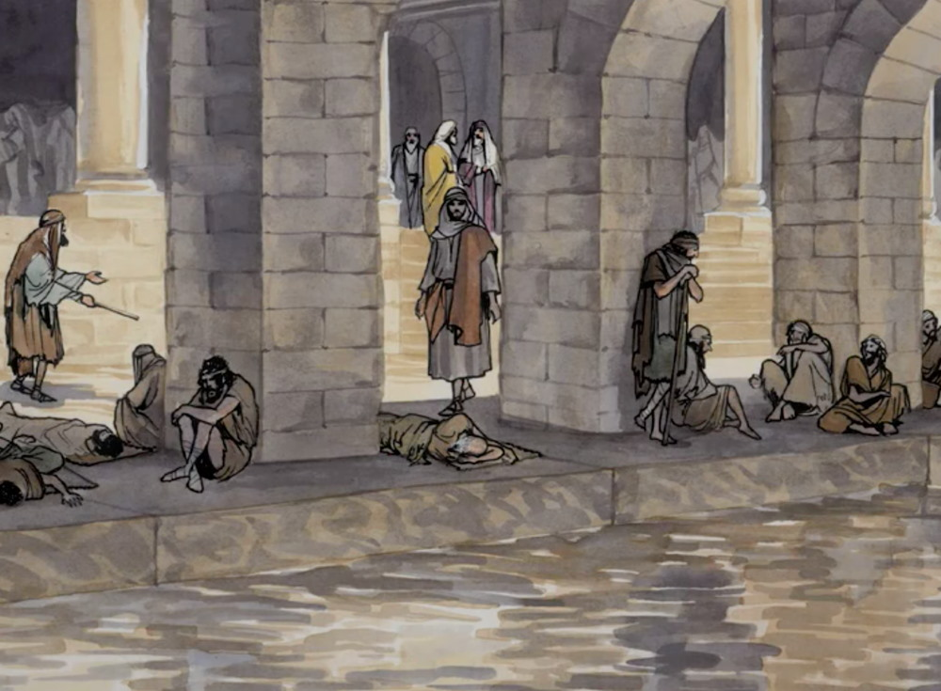
2
Jesus Visits Jerusalem
John 5:1-3
While in Jerusalem Jesus goes to the pool of Bethesda and sees a great number of disabled people.

Slide 4
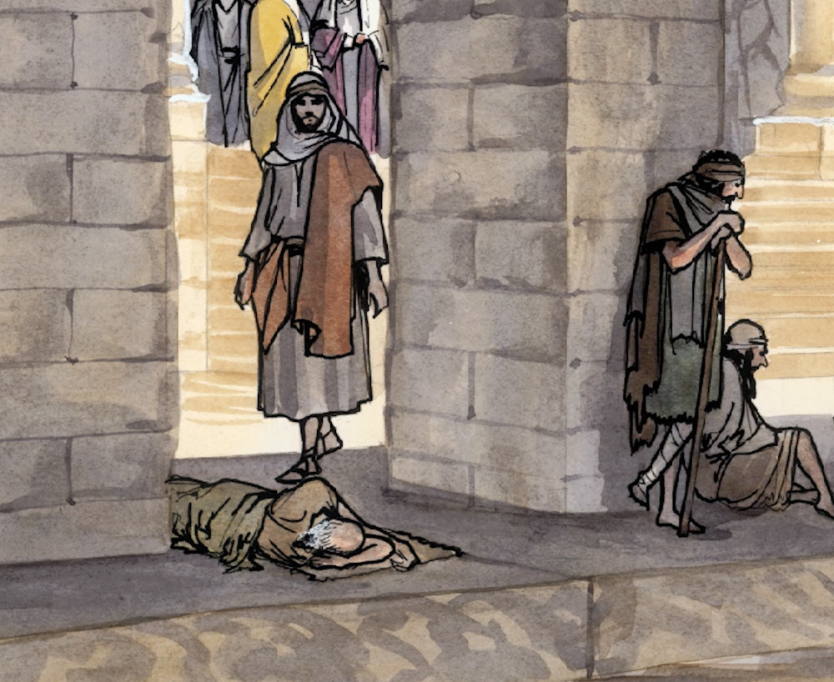
3
Jesus Sees an Invalid
John 5:5-6
Jesus sees a man who had been an invalid for 38 years lying near the pool.

Slide 5
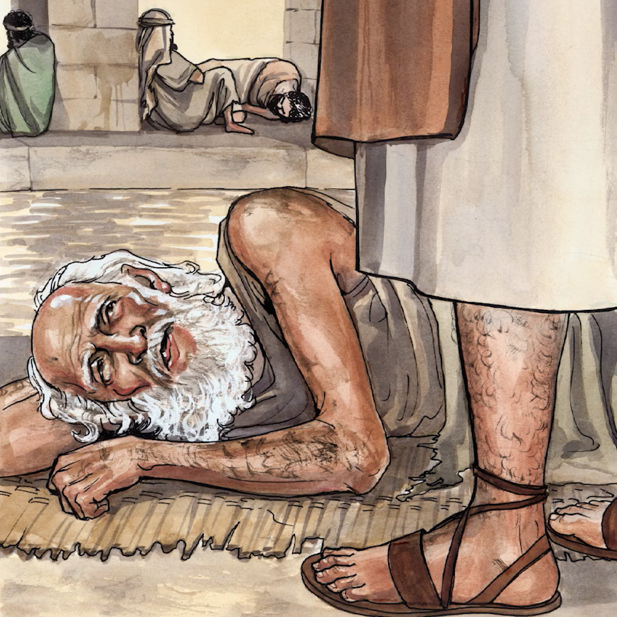
4
Jesus Asks a Question
John 5:6-7
Jesus asks the man if he wants to get well but the invalid says he has no one to help into the pool when the waters are stirred.

Slide 6
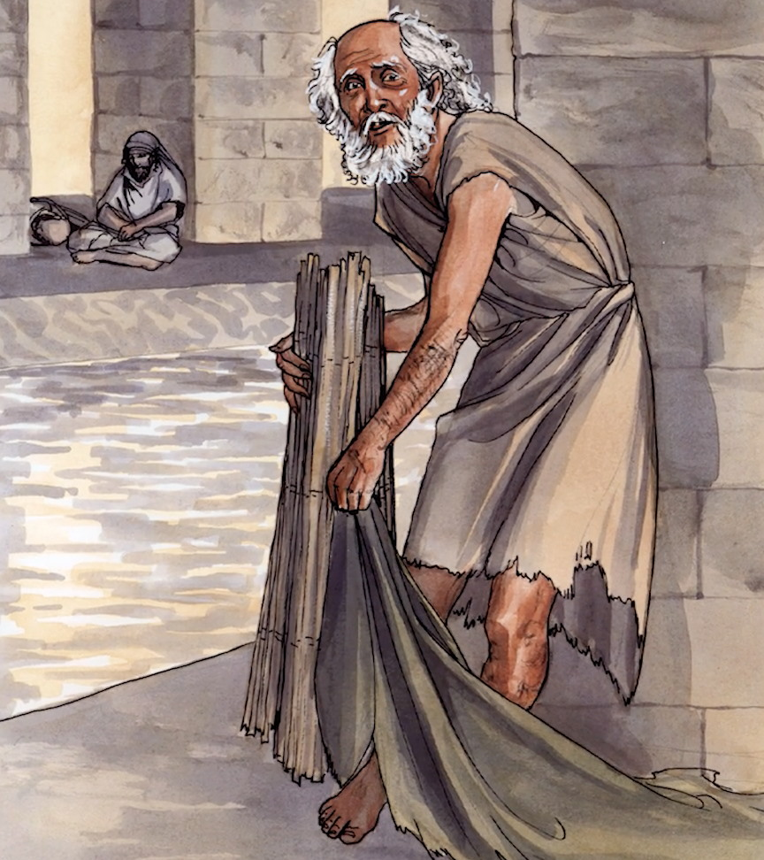
5
Jesus Heals the Man
John 4:8-9
Jesus tells the man, “Get up! Pick up your mat and walk.”

Slide 7
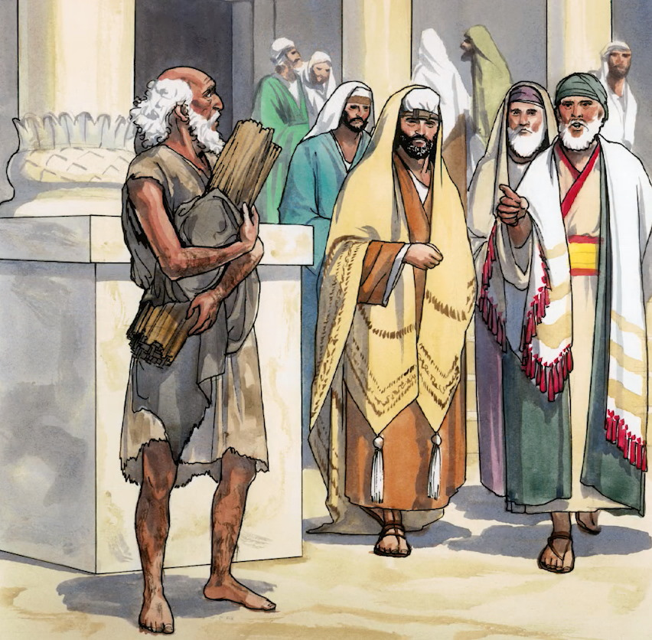
6
Healing Takes Place on the Sabbath
John 4:9-10
The man is told that it was unlawful to carry his mat on the Sabbath.

Slide 8
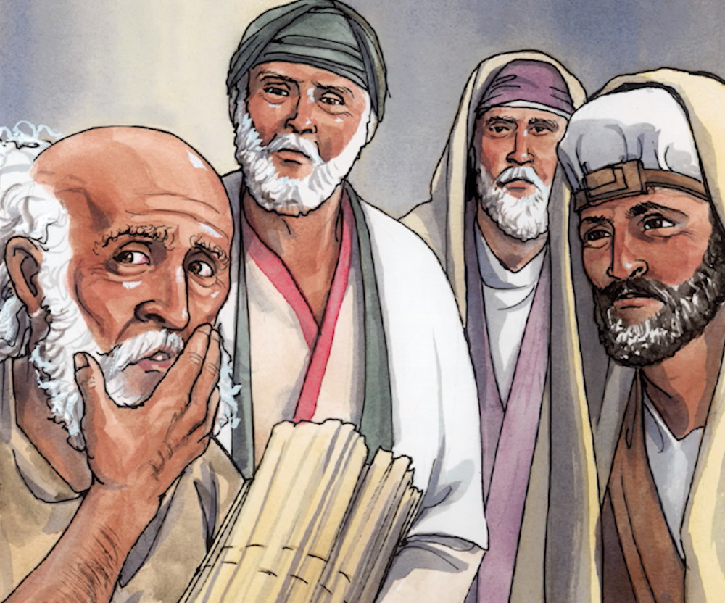
7
Healed Man is Questioned
John 4:12-13
The man who was healed was asked who had healed him, but he didn’t know.

Slide 9
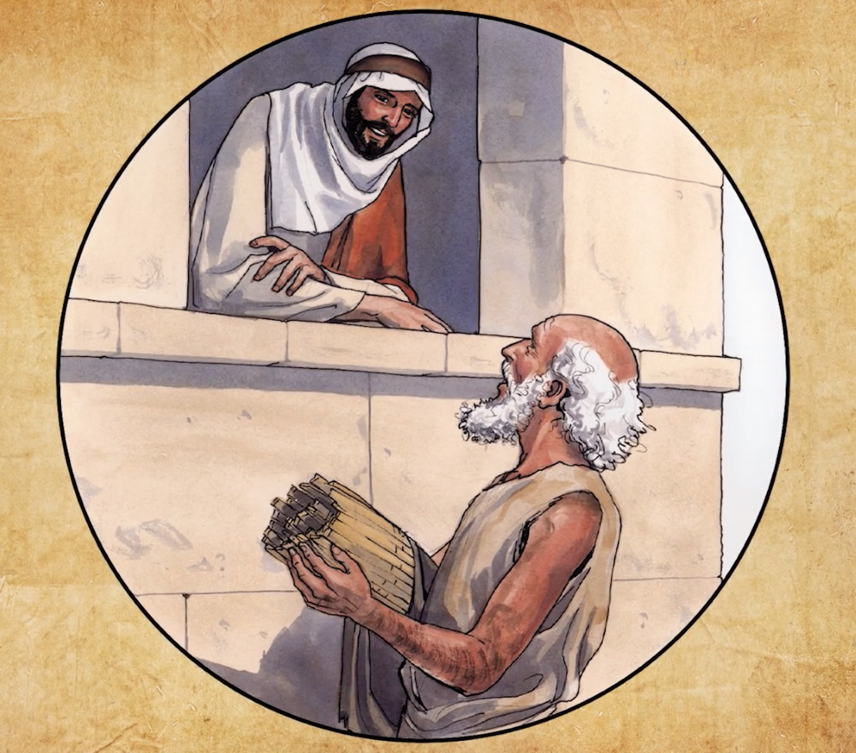
8
Jesus Sees the Man Again
John 4:14
Jesus sees the man and says, “See, you are well again. Stop sinning or something worse may happen to you.”

Slide 10
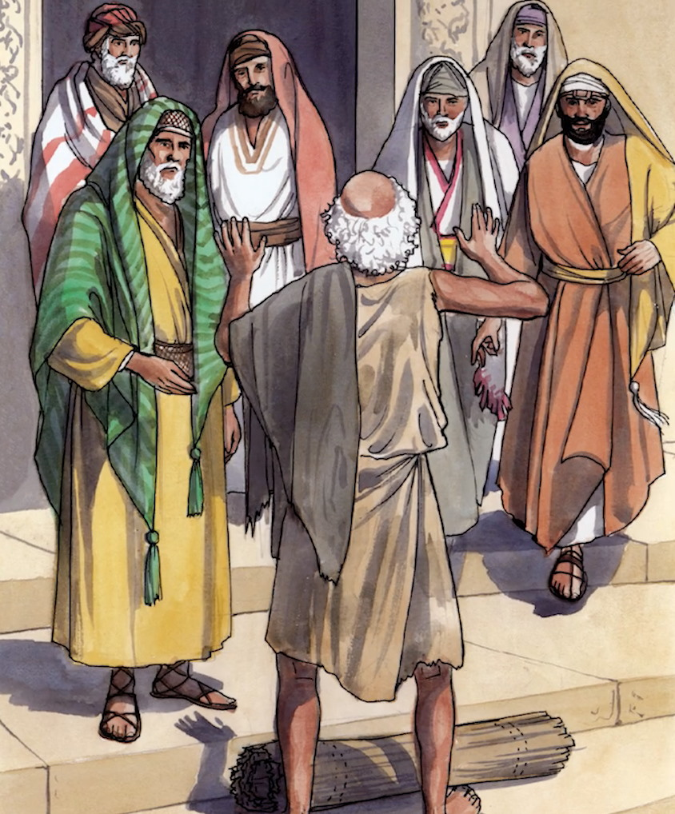
9
The Healed Man Testifies About Jesus
John 4:15
The man who was healed tells the Jews it was Jesus who had made him well.

