Slide 1
JESUS!
Lesson 16
A Paralytic is Lowered Through the Roof
Calling of Matthew
Feasting and Fasting

Slide 2
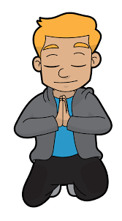
Prayer Requests
1
Class Prayer
Praise
Thanksgiving
Concern
Grow up to be like Jesus

Slide 3
Jesus Heals a Paralytic
2
Paralytic Man

Slide 4
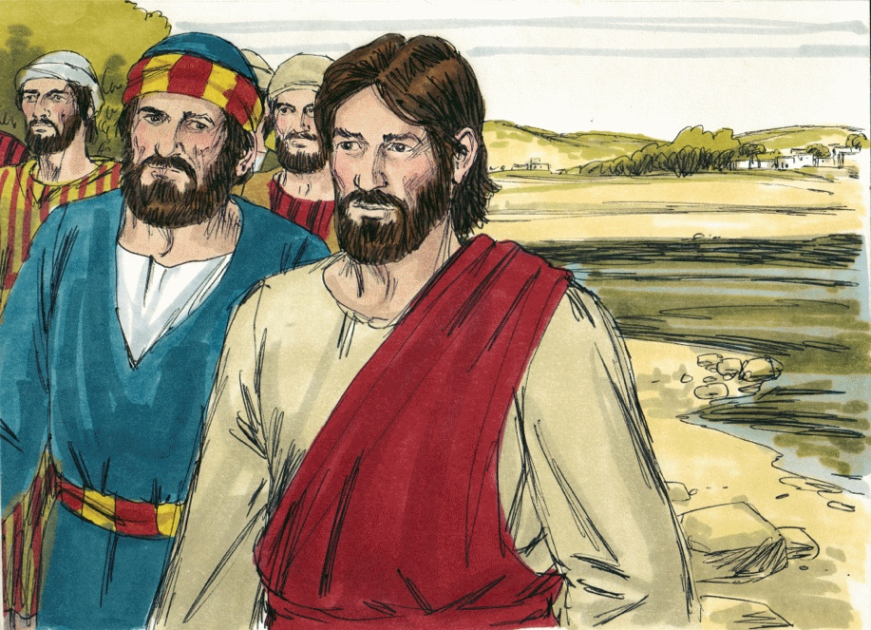
3
Jesus Visits Capernaum
Mark 2:1
Jesus enters Capernaum and the people hear he has come home.

Slide 5
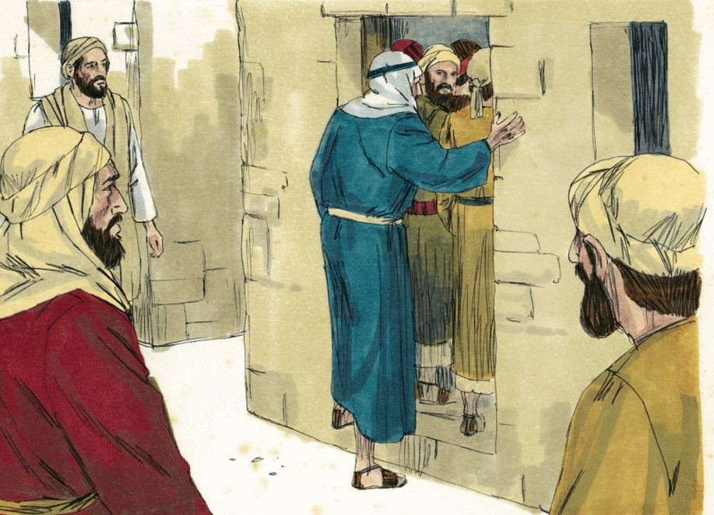
4
Large Crowds Gather
Mark 2:2
So many people gathered that there was no room, not even outside the door.

Slide 6
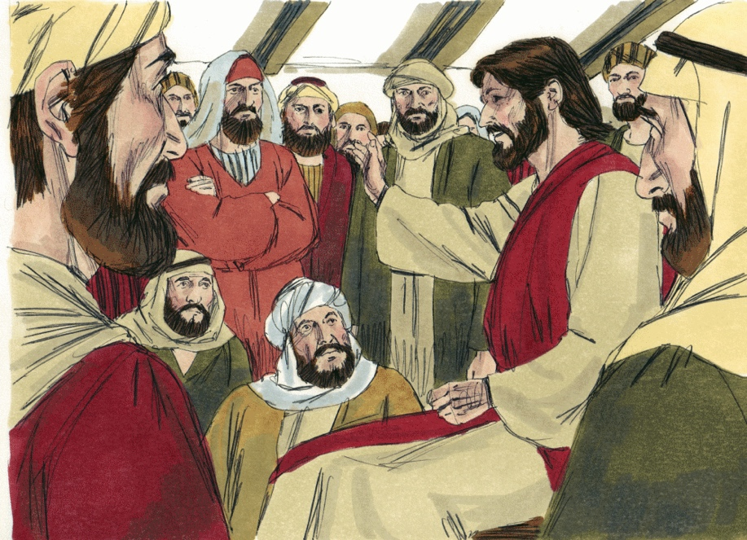
5
Jesus Preaches
Mark 2:2
Jesus preaches the word to those who had gathered.

Slide 7
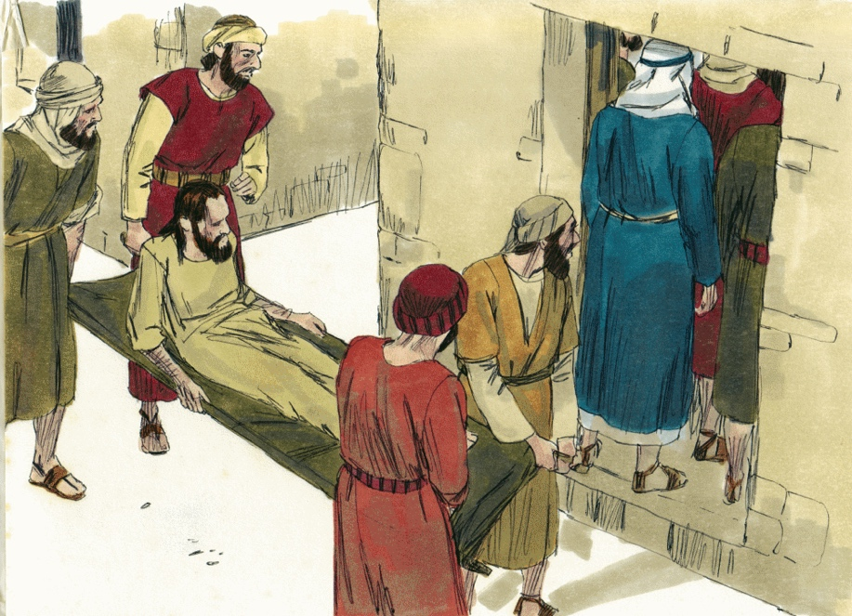
6
A Paralytic Man Arrives
Mark 2:3
Four men carrying a paralytic see that they could not get to Jesus.

Slide 8
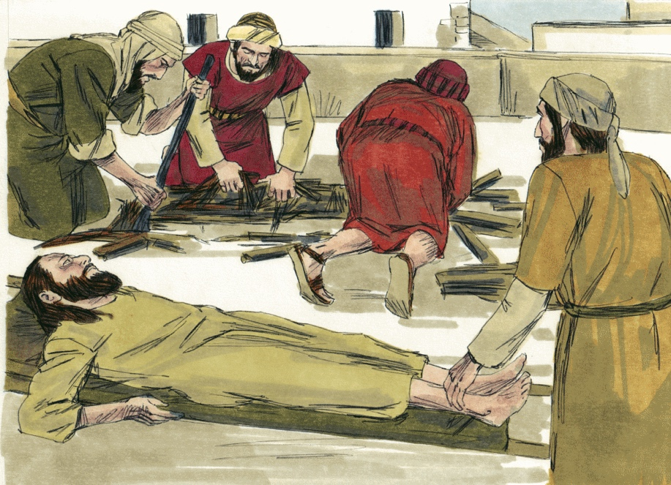
7
Opening in the Roof
Mark 2:4
Since they could not get to Jesus, they create an opening in the roof above Jesus.

Slide 9
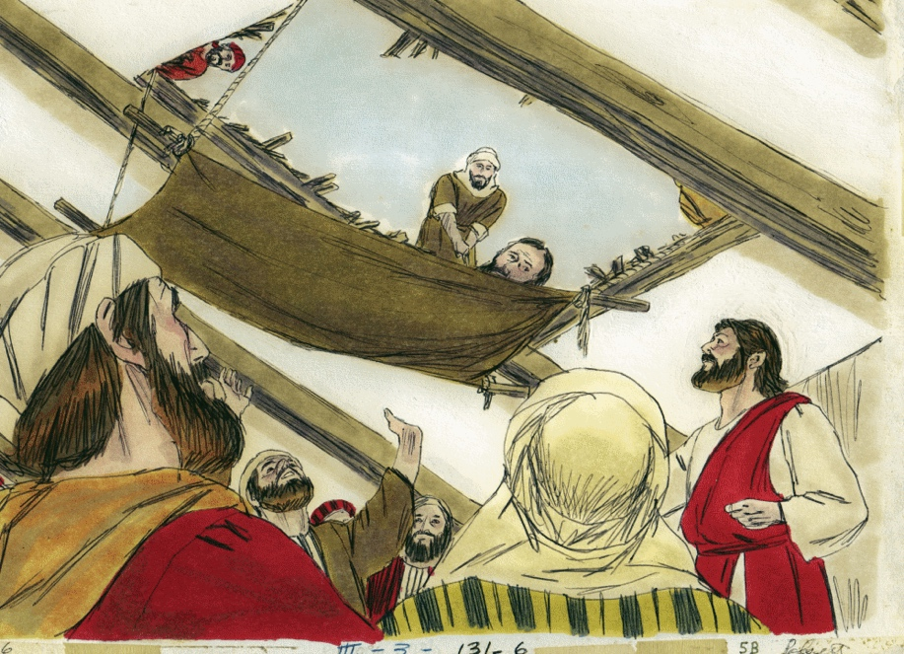
8
Paralytic Man Lowered
Mark 2:4
The paralytic man is lowered on his mat through the roof to Jesus.

Slide 10
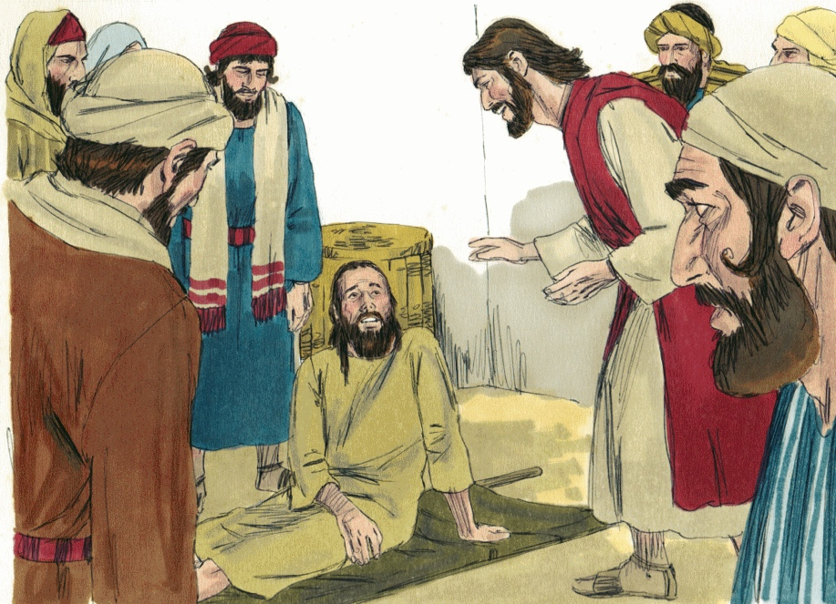
9
Jesus Forgives Sins
Mark 2:5
When Jesus saw their faith, he said to the paralytic, “Son, your sins are forgiven.”

Slide 11
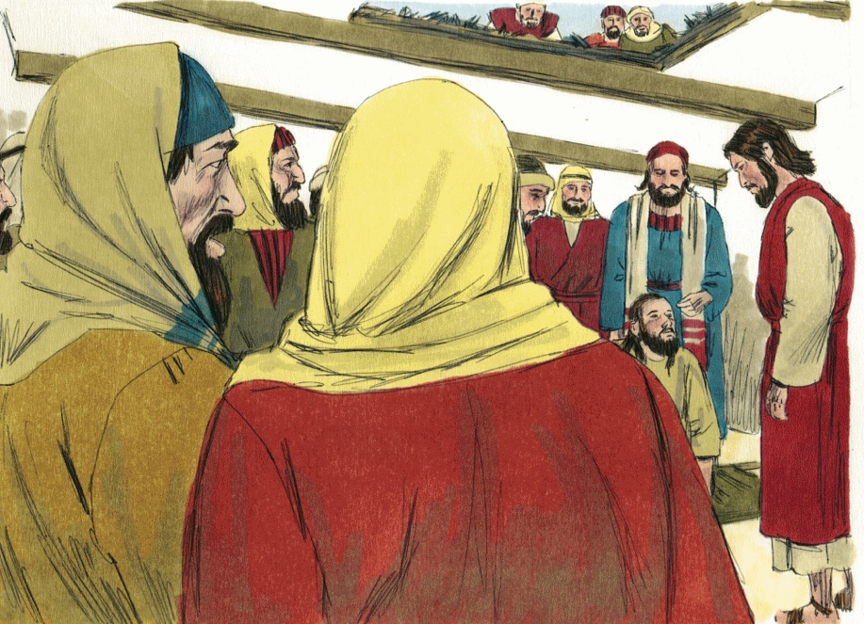
10
Teachers of the Law
Mark 2:6
Teachers of the law think to themselves, “He’s blaspheming! Only God can forgive sins!”

Slide 12
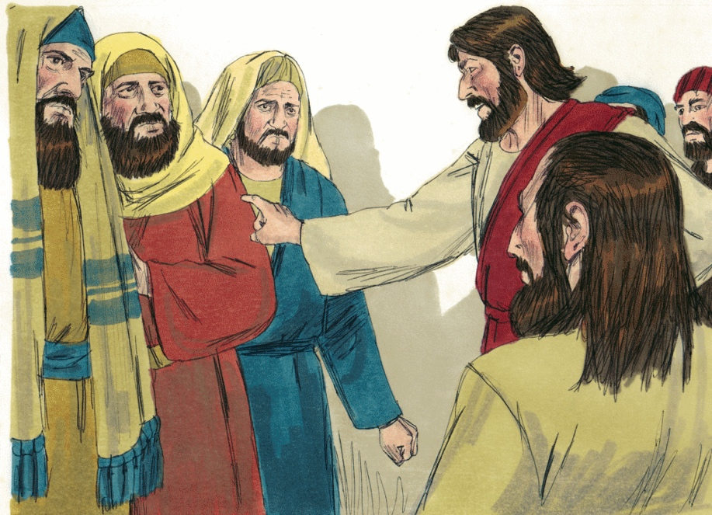
11
Jesus Questions the Teachers
Mark 2:8
Jesus knows their thoughts and says, “Why are you thinking these things?”

Slide 13
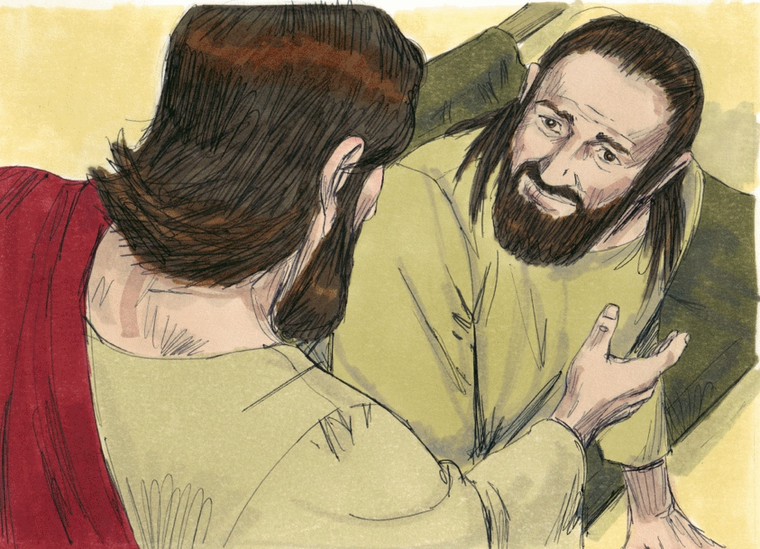
12
Jesus Heals the Paralytic
Mark 2:11
Jesus says to the paralytic, “Get up, take your mat and go home.”

Slide 14
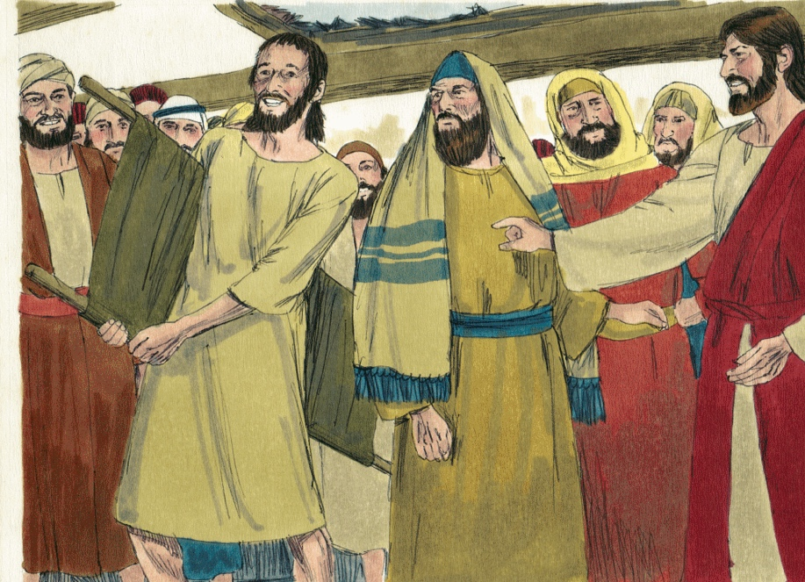
13
Paralytic Man is Healed
Mark 2:12
The man got up, took his mat and walked out in full view of them all.

Slide 15
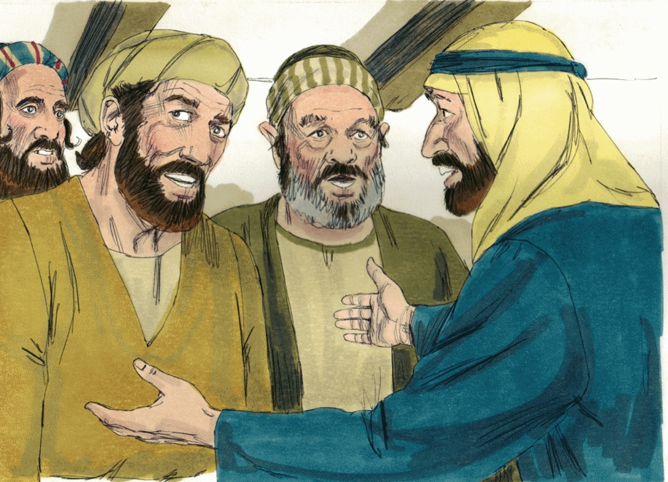
14
People are Amazed
Mark 2:12
This amazed everyone and they praised God.

Slide 16
Jesus Calls Matthew
15
Jesus Calls Matthew

Slide 17
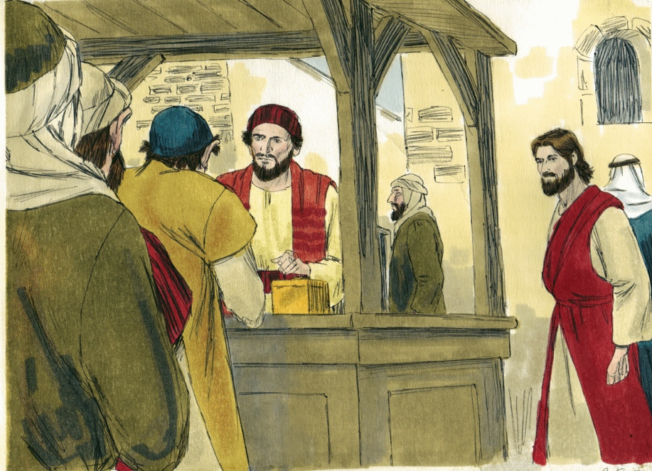
16
Jesus Sees Matthew
Mark 2:14
Jesus sees Matthew (Levi) at his tax collector’s booth.

Slide 18
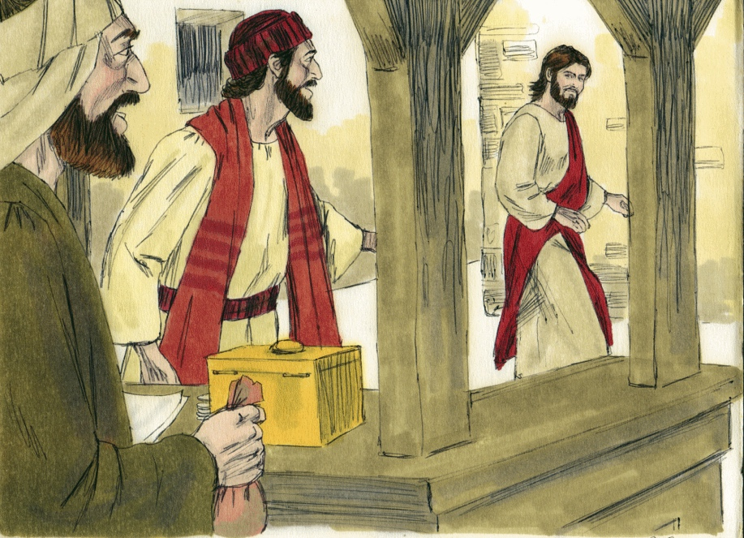
17
Jesus Talks to Matthew
Mark 2:14
Jesus tells Levi to follow him.

Slide 19
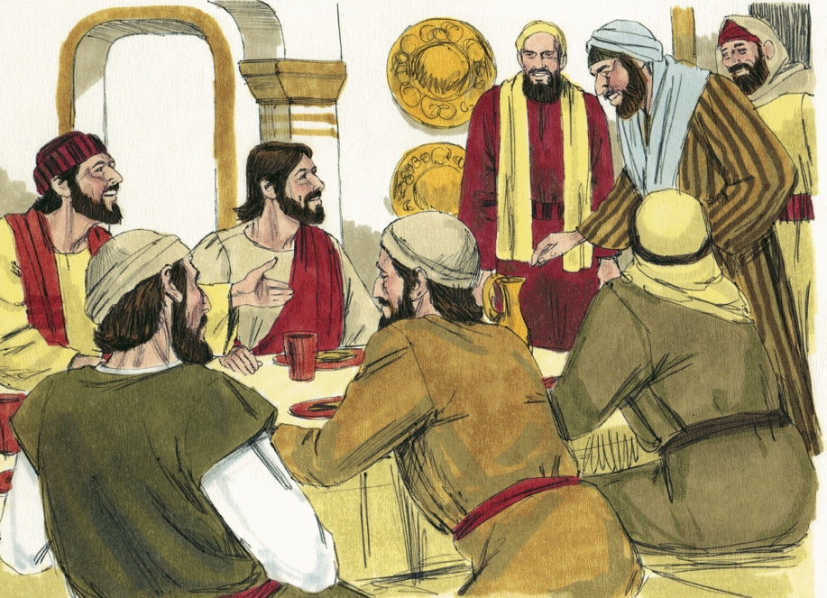
18
Jesus Goes to Matthew’s House
Mark 2:15
While Jesus was having dinner at Levi’s house, many tax collectors and “sinners” were eating with him.

Slide 20
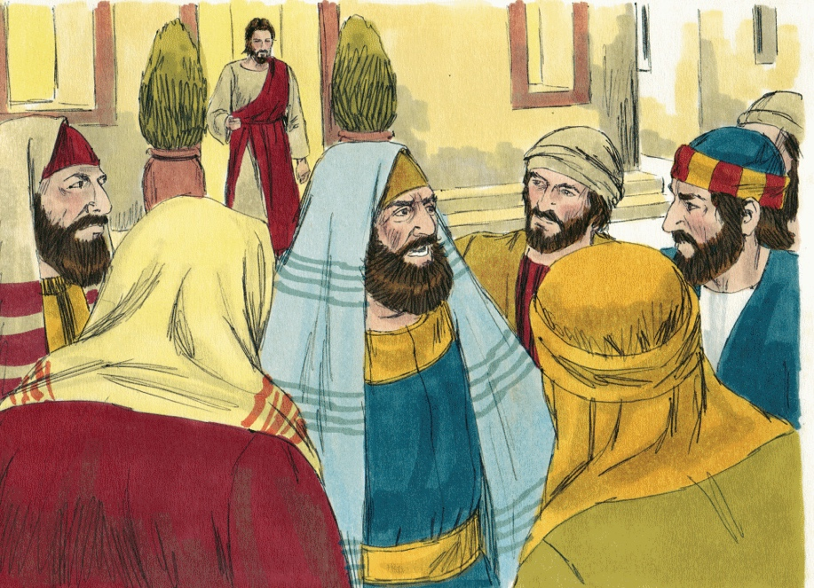
19
Pharisees Question the Disciples
Mark 2:16
The Pharisees ask the disciples, “Why does he eat with tax collectors and sinners?”

Slide 21
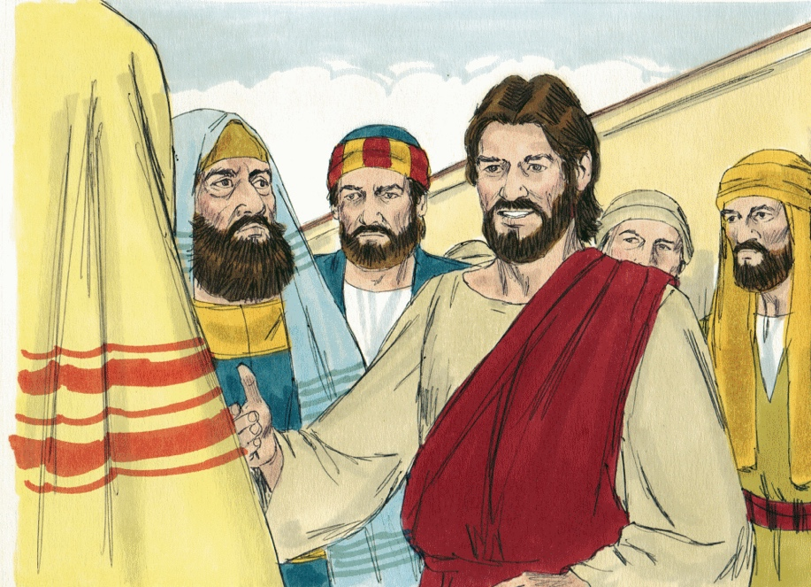
20
Jesus Answers the Pharisees
Mark 2:17
Jesus said to them, “It is not the healthy who need a doctor, but the sick."

Slide 22
Jesus is Questioned About Fasting
21
Fasting

Slide 23
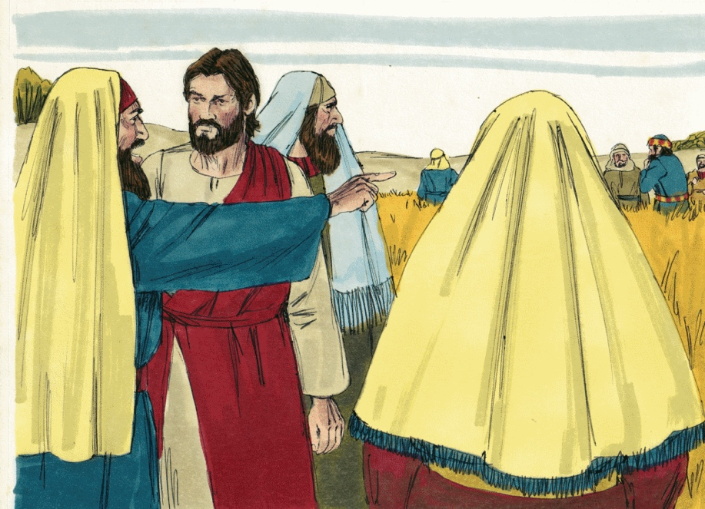
22
Jesus is Questioned About Fasting
Mark 2:18
Jesus is asked, “How is it that John’s and the Pharisee’s disciples are fasting, but yours are not?”

Slide 24
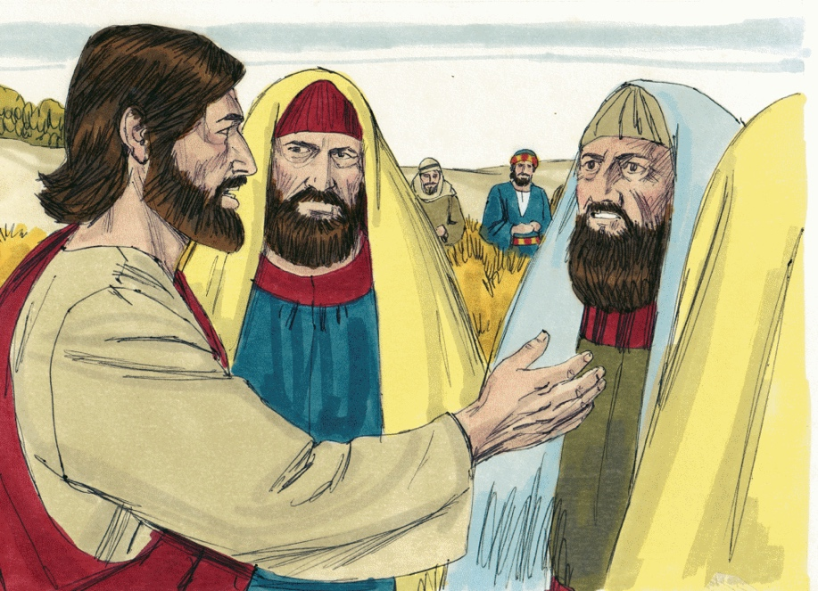
23
Jesus Answers
Mark 2:19
Jesus replied, “How can the guests of the bridegroom fast while he is with them?”

