Slide 1
JESUS!
Lesson 14
Jesus’ Rejection at Nazareth

Slide 2
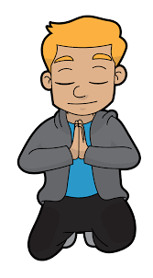
Prayer Requests
1
Class Prayer
Praise
Thanksgiving
Concern
Grow up to be like Jesus

Slide 3
Jesus’ Rejection at Nazareth
2
Jesus is Rejected

Slide 4
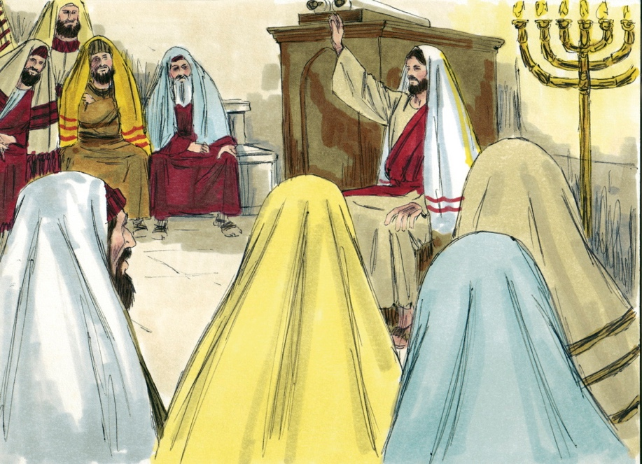
3
Jesus Visits Nazareth
Luke 4:16
Jesus attends synagogue in Nazareth

Slide 5
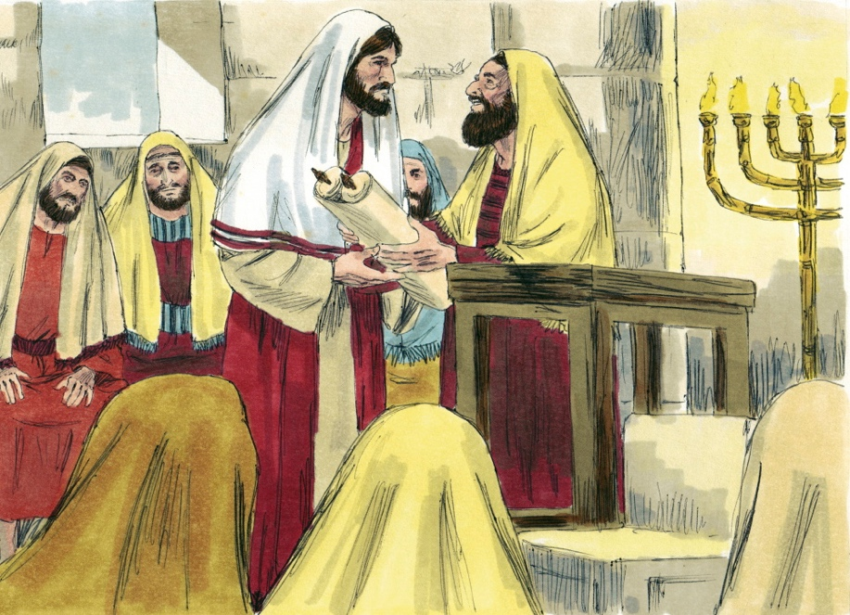
4
Jesus Stands Up to Read
Luke 4:17
Jesus is handed a scroll from the prophet Isaiah

Slide 6
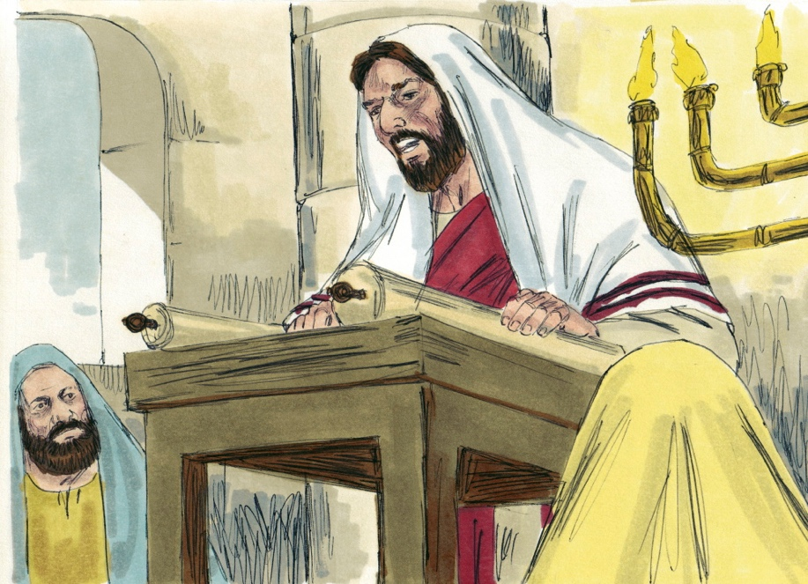
5
Jesus Reads From Scroll
Luke 4:18-19
Jesus reads passage from Isaiah (Isaiah 61:1-2)

Slide 7
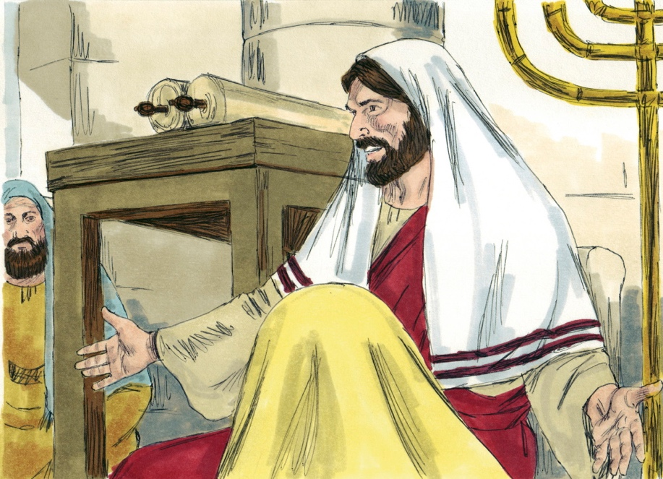
7
Jesus Sits Back Down
Luke 4:20
Jesus says the scripture was fulfilled in their hearing

Slide 8
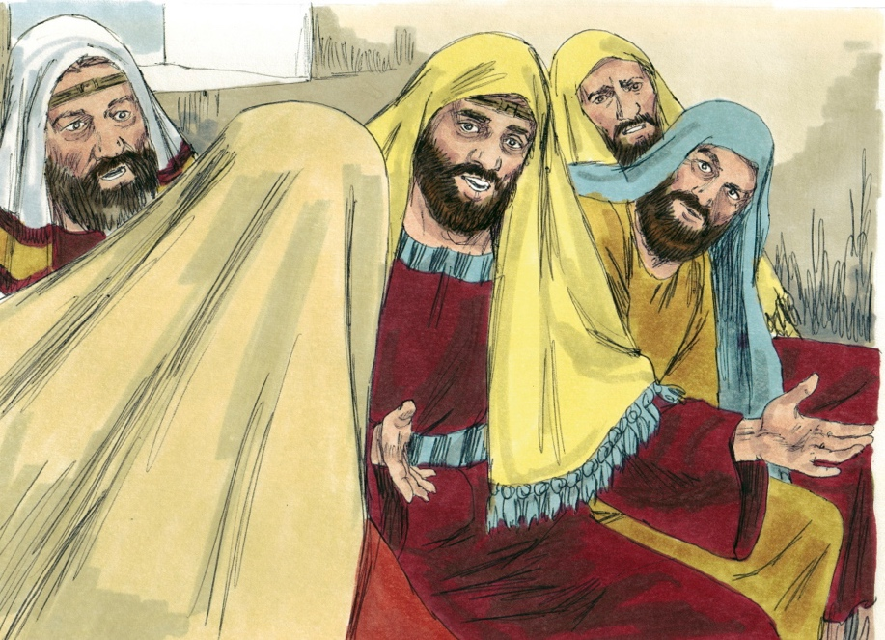
8
People are Amazed
Luke 4:22
All spoke well of Jesus and were amazed and asked, “Isn’t this Joseph’s son?”

Slide 9
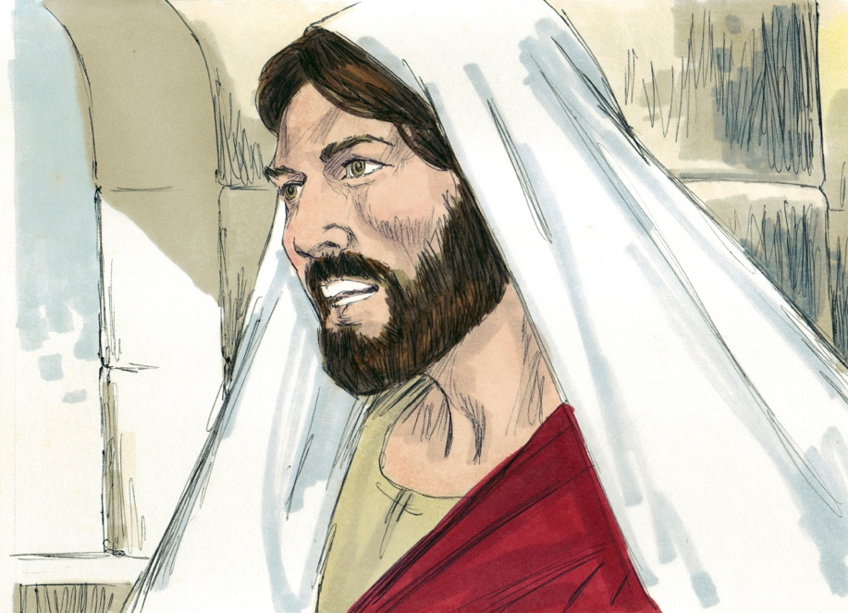
9
Jesus is not Accepted
Luke 4:24
Jesus said to the gathering, “I tell you the truth, no prophet is accepted in his hometown.”

Slide 10
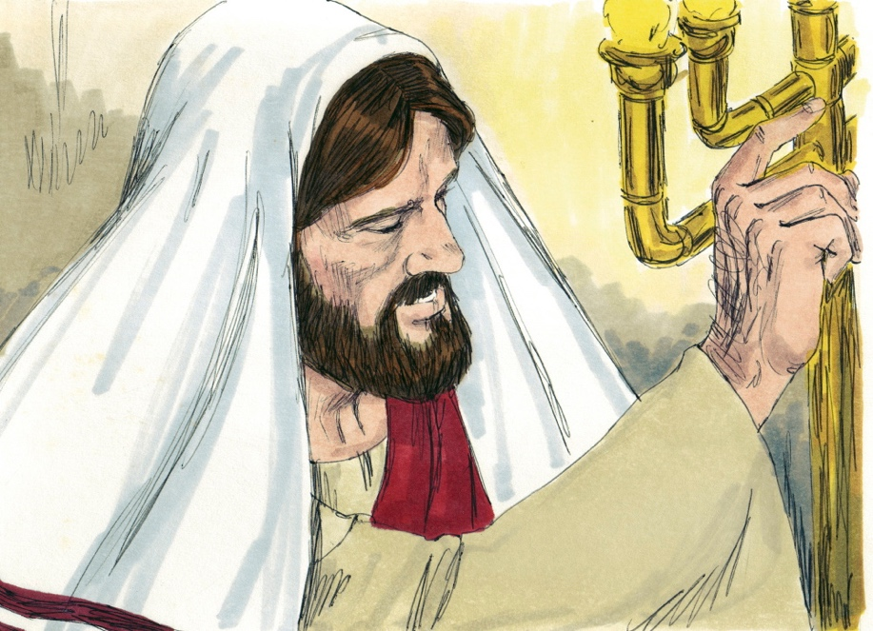
10
Jesus’ Message is for all People
Luke 4:25-27
Jesus tells the stories of the widow in Zarephath and Naaman the Syrian.

Slide 11
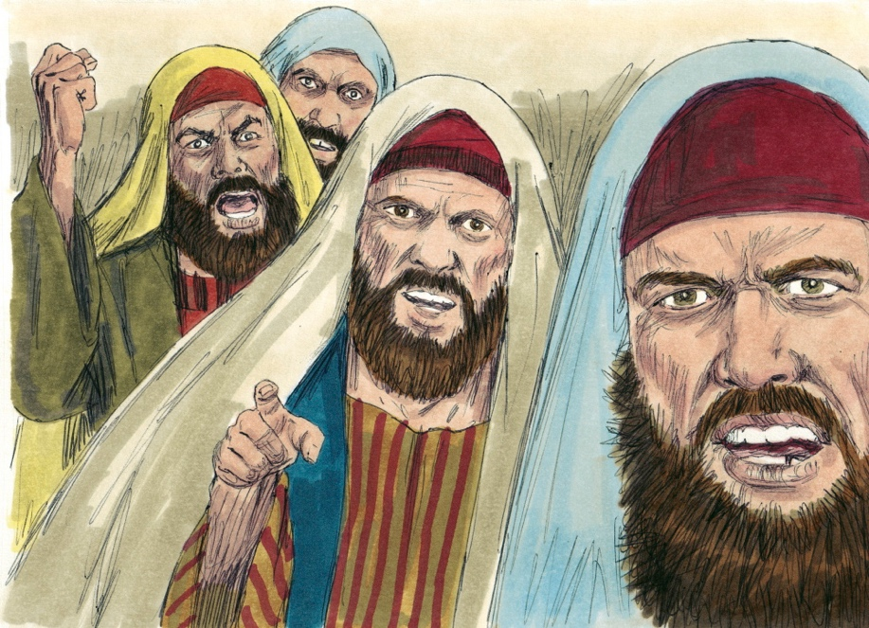
11
Jesus is Rejected
Luke 4:28
The people in the synagogue are furious.

Slide 12
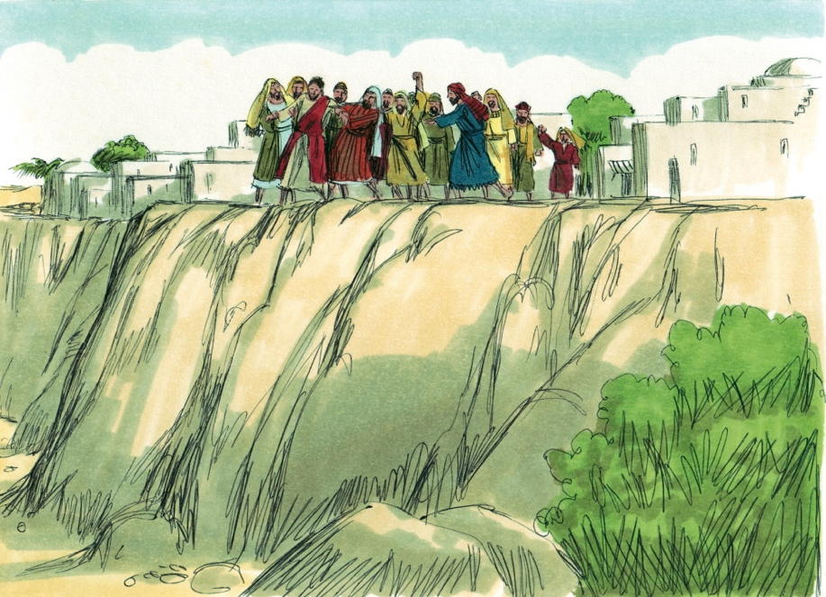
12
Jesus is Taken to Cliff
Luke 4:29
The people want to throw Jesus off a cliff.

Slide 13
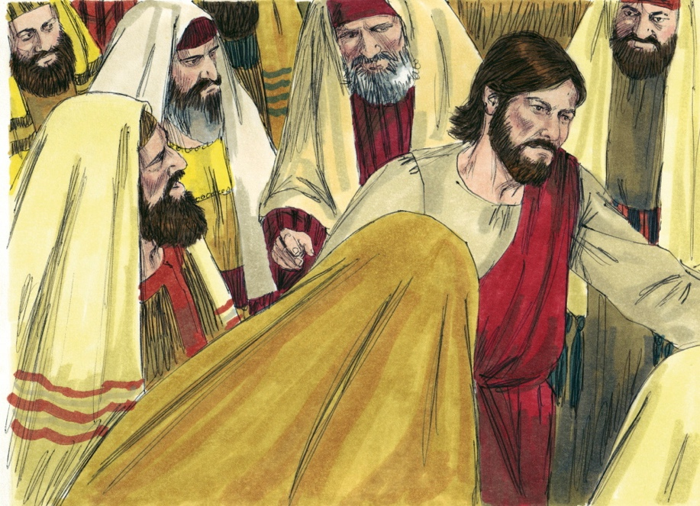
13
Jesus Walks Through Crowd
Luke 4:30
Jesus walks through crowd and goes on his way.

