Slide 1
JESUS!
Lesson 12
The Woman at the Well

Slide 2
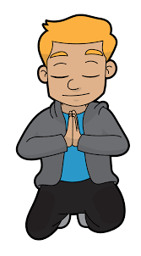
Prayer Requests
1
Class Prayer
Praise
Thanksgiving
Concern
Grow up to be like Jesus

Slide 3
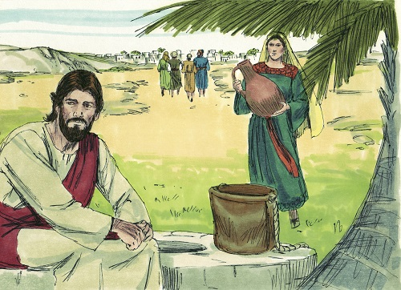
2
Jesus Visits Samaria
John 4:4-6
Jesus visits a town in Samaria

Slide 4
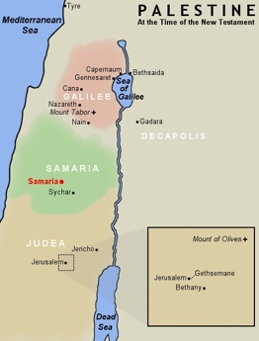
Samaria was located between Galilee and Judea
3
Overview of Jesus’ Travels
As recorded in the Gospel of John, Jesus made 4 trips to Jerusalem during his ministry.

Slide 5
Who were the Samaritans?
4
Samaritans
Samaritans were left after the Assyrians conquered the Northern.
The Samaritans believed in the God of Israel, but they worshipped at Mount Gerizim (instead of Jerusalem) with their own adapted worship practices.
Most Jews regarded the Samaritans as ignorant, superstitious, and outside of God’s favour and mercy.
Read Luke 9:51-56 (Samaritan Opposition)

Slide 6
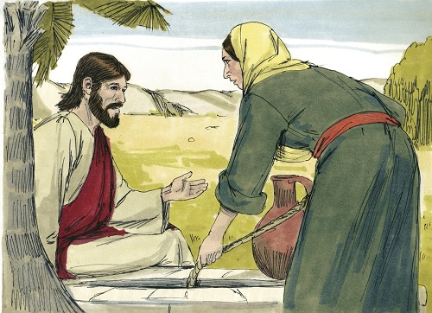
5
Jesus Talks with a Samaritan Woman
John 4:7-9
Jesus makes a request

Slide 7
Why it was unusual for Jesus to talk with the Samaritan Woman
6
Jesus Talks with a Samaritan Woman
In first century, a woman’s place was thought to be in the home.
Women were responsible for raising the children, and maintaining the home.
Men were not to greet women in public.
At the Temple in Jerusalem, women were restricted to an outer court. In synagogues they were separated from the men.

Slide 8
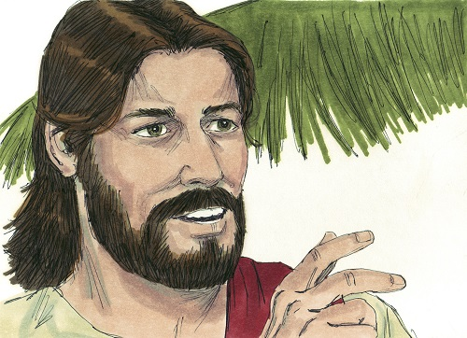
7
Jesus Talks of Living Water
John 4:10
Living water

Slide 9
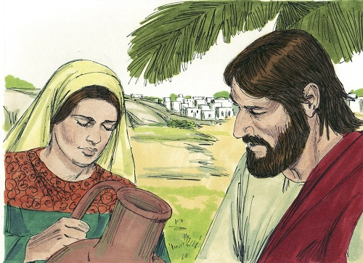
8
Jesus Makes Request
John 4:17-18
Jesus asks the woman to bring her husband.

Slide 10
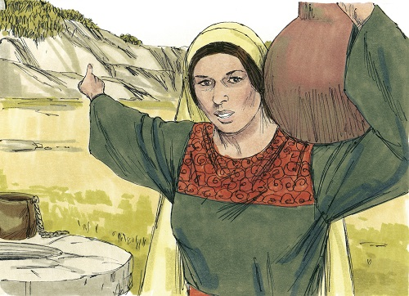
9
Where to Worship
John 4:19-20
The woman talks about where to worship.

Slide 11
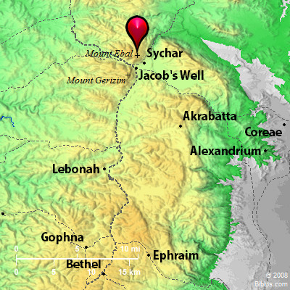
10
Map of Samaria
Locations of Sychar and Mount Gerizim

Slide 12
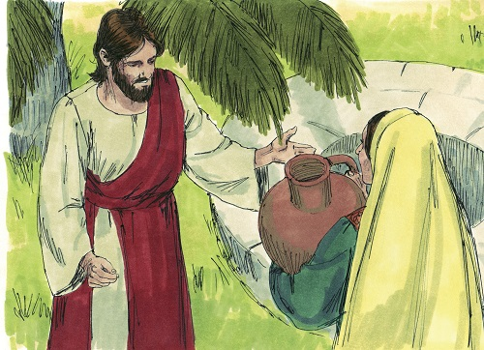
11
True Way to Worship
John 4:21-24
Worshipping in spirit and truth.

Slide 13
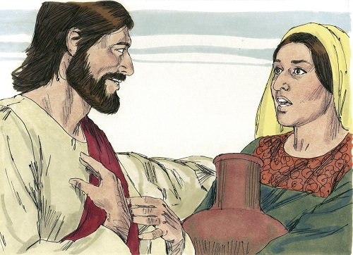
12
Jesus Reveals Himself
John 4:25-26
Jesus is the Christ.

Slide 14
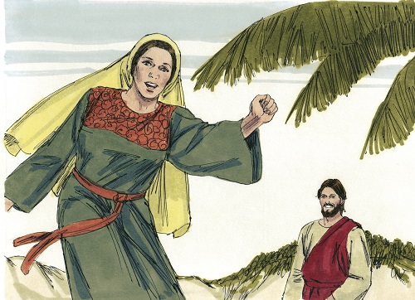
13
The News Spreads
John 4:27-29
Life through the Son

Slide 15
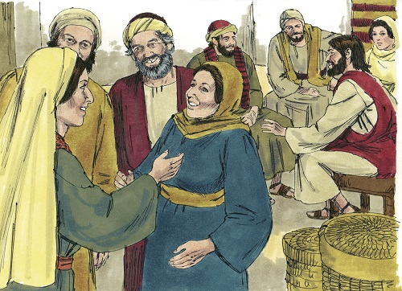
14
Samaritans Believe
John 4:39-41
Many Samaritans believe.

